Slide 1
PROMIS Meeting 21/9/2105
Practice Presentation
James Keen

Slide 2
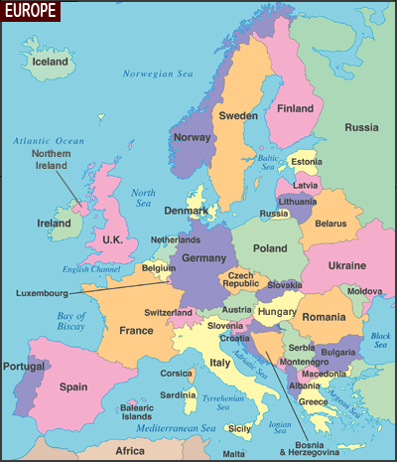
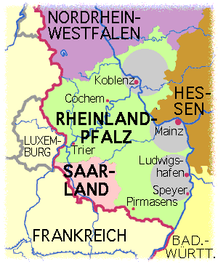
German ancestry
Family of Bakers
≈1500 - ≈1850

Slide 3
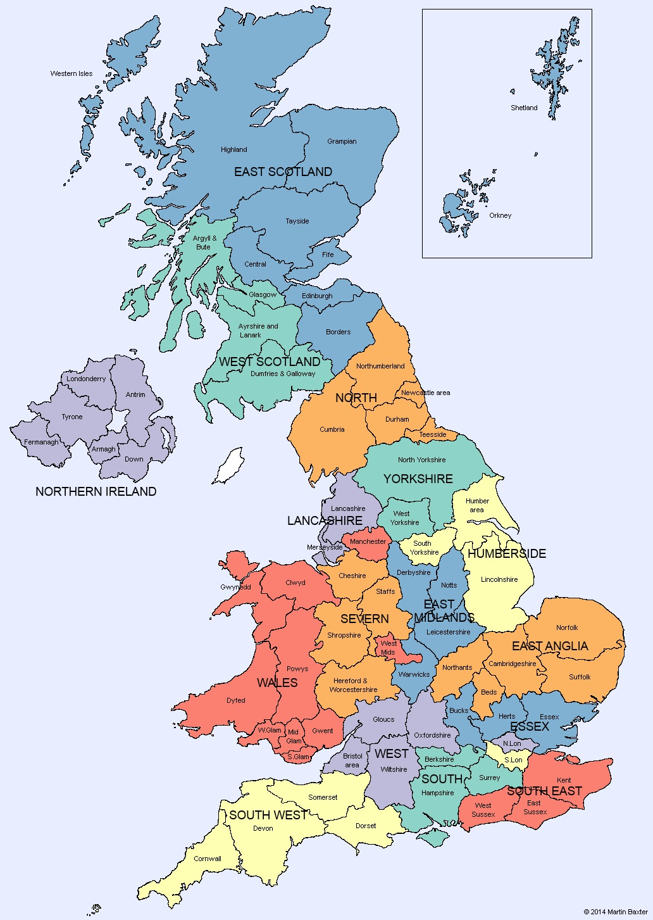
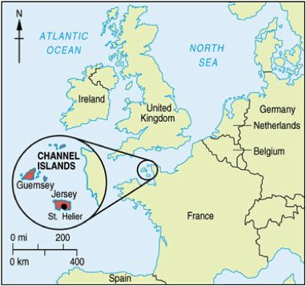
Farmers in central south England
Farmers in West Country
Wool merchants in South West
Cousins in Jersey
Grandparents lived in Wales
Physics student at Lancaster Uni

Slide 4
