Slide 2
Why care?
Heart Disease causes 50% of deaths in Europe
Genetic Element but often preventable
- Lack of exercise/diet are main causes

Slide 3
What is it?
Also known as Cardiovascular Disease
Affects Heart as well as Circulation System
Includes Blood Clots, Stroke, Heart Attack

Slide 4
Cause 1: Clogged Artery
- Caused by diet, obesity, alcohol

Slide 5
Cause 2: Heart Muscle
May be weak
(genetics, stress, age)
Irregular heart beat
- More genetic but exercise helps

Slide 6
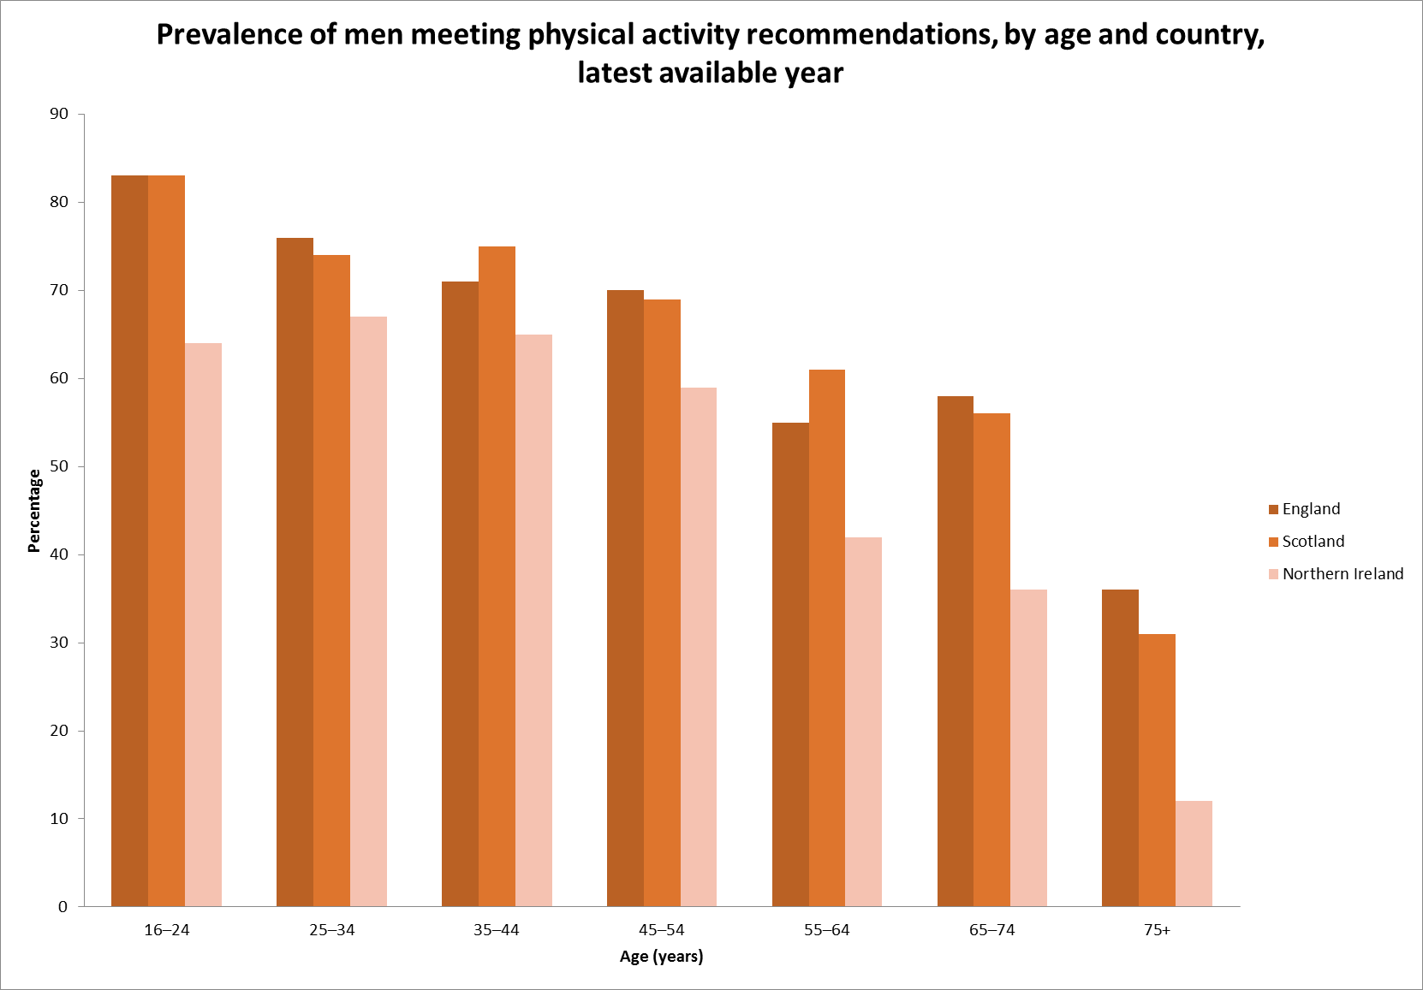
Prevent it!
Regular Exercise
Good Diet
Recommendations
easy to meet

