Slide 1
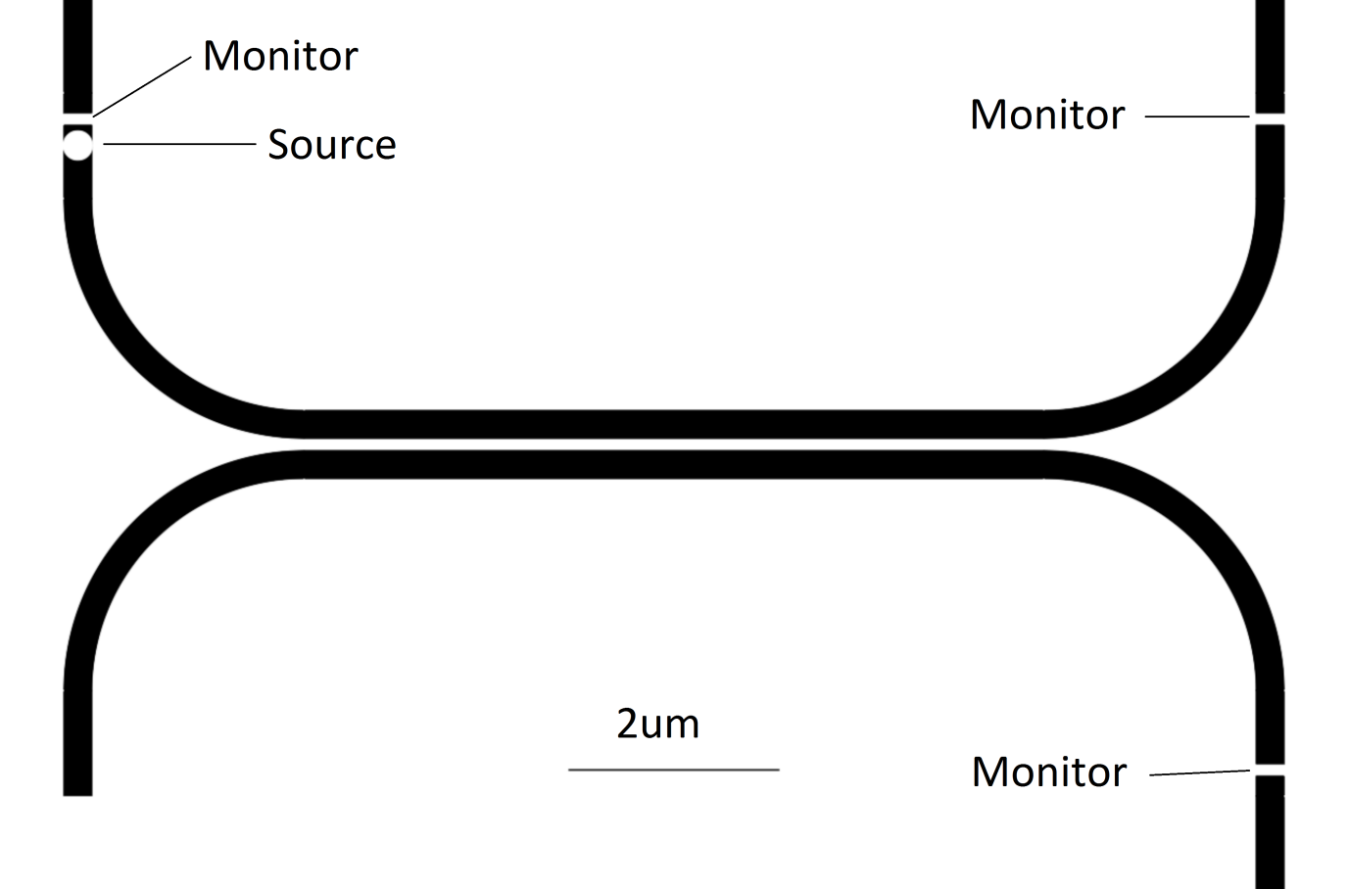
GaAs Directional Couplers
Evanescent Coupling
Dependence:
·Wavelength
· Coupling Region Length
· Distance between Coupling Waveguides
Coupling region separation = 100nm
Waveguide h*w = 140nm * 280nm
Jon Petticrew

Slide 2
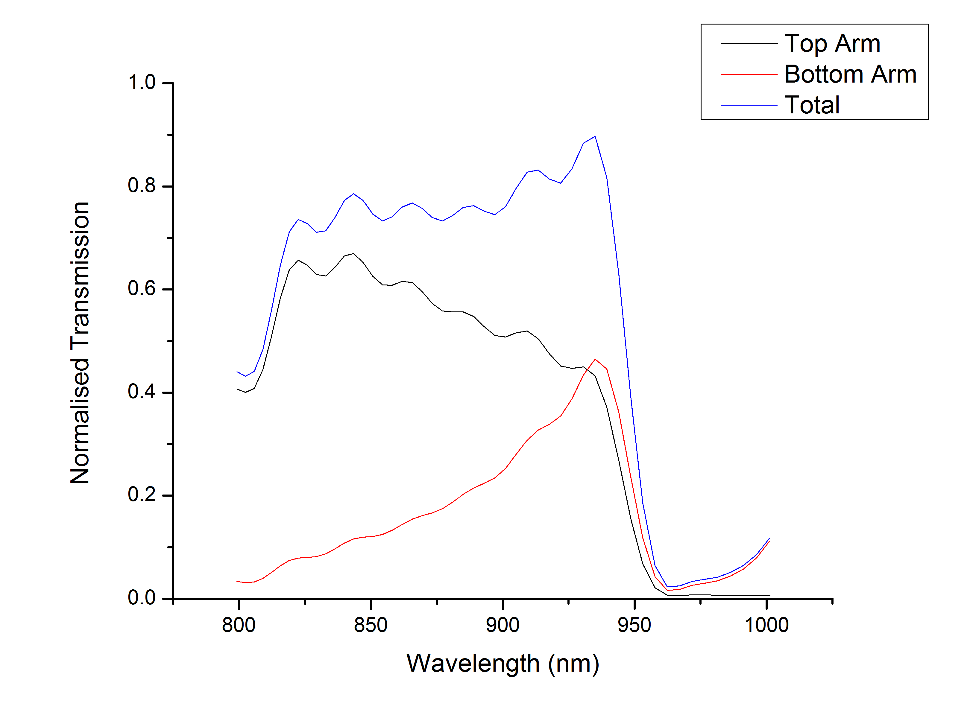
· Simulated results
· 50:50 splitting at 932±2nm
· Coupling Region length 9.7um

