Slide 1
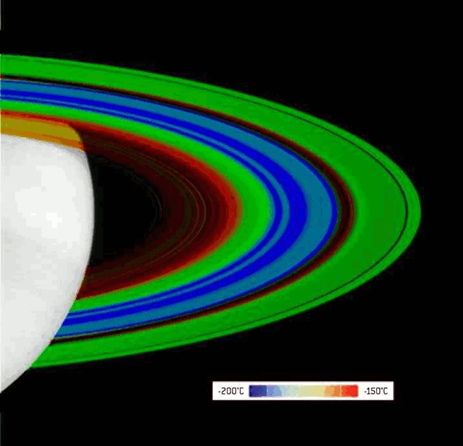
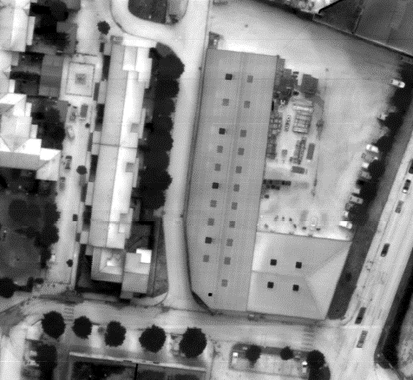
A wide introduction to
IR imaging detectors
Olivier Gravrand
CEA-LETI Grenoble
olivier.gravrand@cea.fr
CIRS Cassini detector (LW LETI)
TP2 detector (MW LETI)
Notes:
Apollinaire: « il est grand temps de rallumer les étoiles »

Slide 2
Outline
General introduction about IR detection
FOM for IR detection/imaging
Tailoring the photocurrent
Understanding the dark currents
Impact ionization for APDs
Focus1: Ultra high performances for very low fluxes
Focus2: High operating temperature
Conclusion

Slide 3
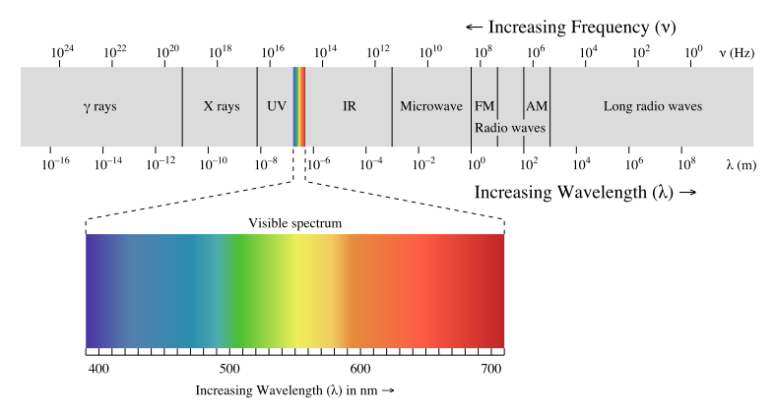
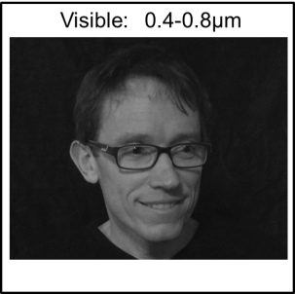
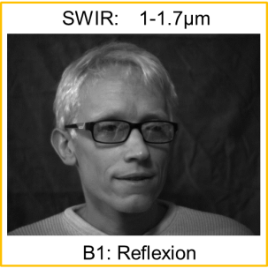
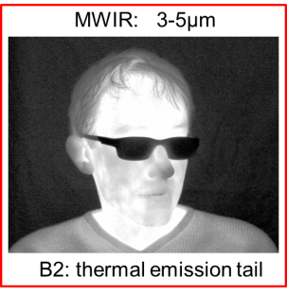
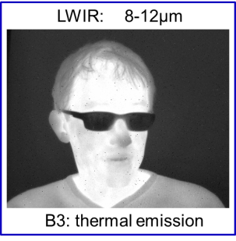
The EM spectrum from the IR point of view
100%
UV
Visible
NIR
SWIR
MWIR
LWIR
VLWIR
T_{atmosphere}
kT@300K=26meV
Lambda
(µm)
0
0.1
1
10
100
1000
E (eV)
10
1
0.1
0.01
0.001
2000K
600K
BB Luminance
300K
T_{BB} (K)
1e4
1e3
100
10
f (THz)
1000
100
10
1
IR → small energies(< eV)
Interest
  Corresp to molecular vibrations
  BB passive detection…
  Atmospheric windows…
  …
Notes:
kT@300K=26meV
kT@77K~9meV

Slide 4
Principle of IR detection: general concepts
Quantum detector
=
« cooled » detector
Thermal detector
=
Uncooled detector
IR
Absorption
IR
Thermometer
Conversion ϕ → e⁻
Thermal insulation
Read out circuit
Read out circuit
SIGNAL
SIGNAL
Signal=Current ⬄ photon flux
Signal=ΔT ⬄ optical power

Slide 5
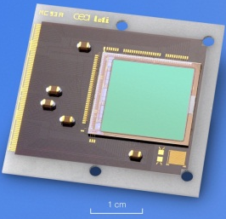
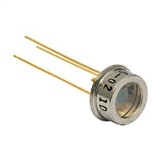
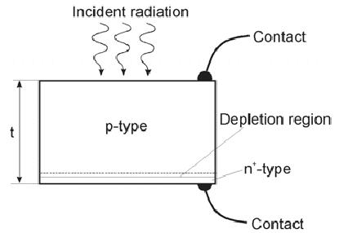
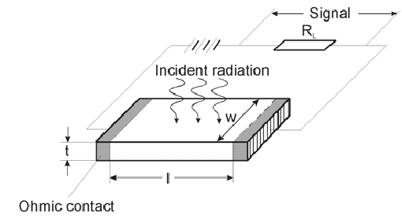


≠ Quantum detectors
PC = Photoconductor
Conductivity meas^{nt} under $φ$
  Low cost
  Large bias
  Strong current
  Noise
  mainly 1D (1st Gen)
PV = Photovoltaic
Direct meas^{nt} of the $φ$ current
  low current = low noise
  Fast response
  2D arrays possible
  Complex process (costy)

Slide 6
≠ Absorption Mechanisms
→ ≠ Spectral Shapes
Intrinsic material
Extrinsic material
E
Conduction band
E
Conduction band
E_{g}
E_{o}
Absorption
Valence band
Absorption
Valence band
λ_{c}
λ
λ_{c}
λ
E_{ϕ}
E_{g}
E_{ϕ}
E_{o}
E
E_{o}
Absorption
λ_{o}
λ
E_{ϕ}
E_{o}
Quantum well

Slide 7
The Super-lattice (SL) material
Sullivan 2005,
SPIE5783 p151
2 ways to understand this synthetic material
Modulation of the cristal potential in one axis
to fold the Brillouin zone, creating minibands
Coupling of a large number of Qwells by getting them closer in ordre to form the minibands
/!\ No selection rules for the optical absorption (≠ QWIP)
Yu, « fondamental of semiconductors », Springer
Aifer 2005, SPIE5783 112

Slide 8
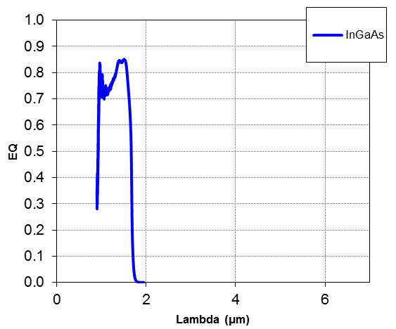
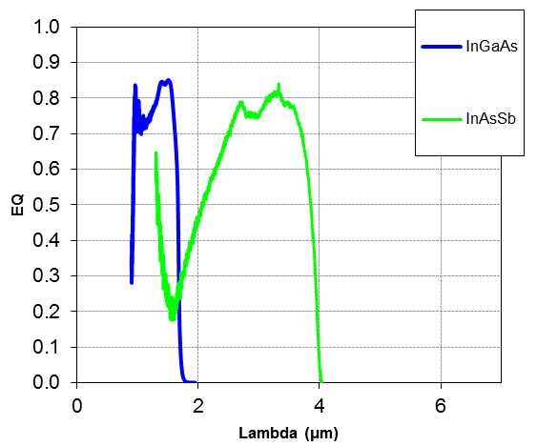
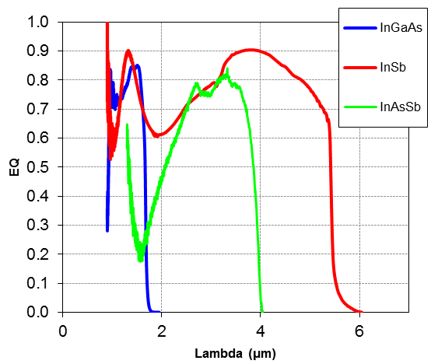
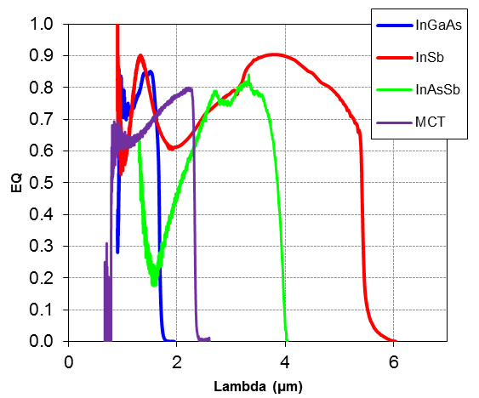
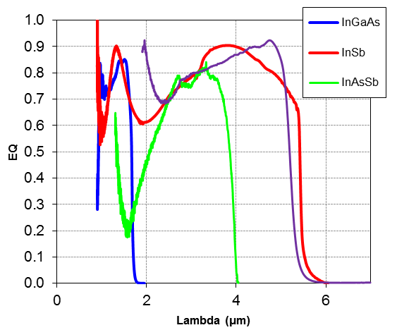
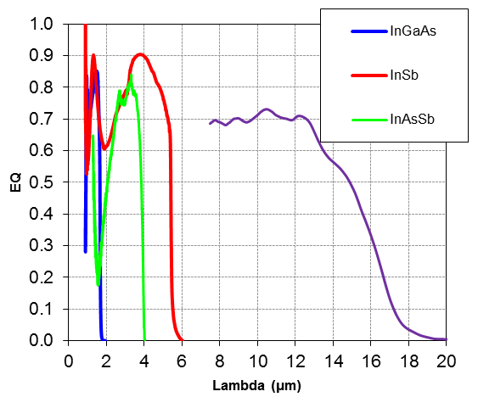
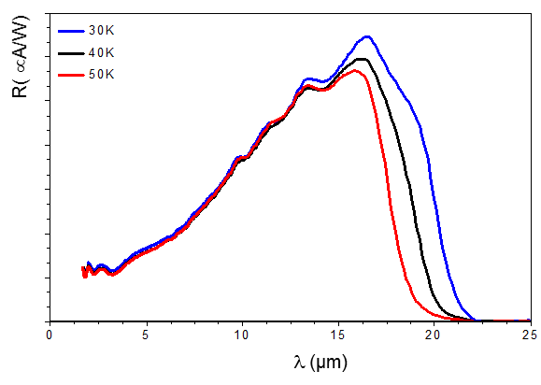
Bulk SC materials for IR detection
HgCdTe LWIR
>VLWIR
HgCdTe SWIR
HgCdTe MWIR
0.4
3.0
2.7
ZnTe
2.4
Visible
AlAs
2.1
1.8
1.5
AlSb
CdTe
0.8
Bande interdite (eV)
GaAs
InP
1.2
1
Longueur d’onde de coupure (µm)
0.9
Si
1.5
SWIR
Ge
GaSb
0.6
2
3
0.3
InAs
InSb
5
MWIR
8
0.0
12
LWIR
HgTe
-0.3
O. Gravrand, JEM 36(8), p981, 2007
5.4
5.6
5.8
6.0
6.2
6.4
6.6
Paramètre de maille (Å)
Notes:
On peut examiner ces différentes bandes spectrales en regard des matériaux semiconducteurs absorbants bulk
Commentaire SL2 InAs-GaSb: matériaux synthétiques avec alternances de couches grand gap pour générer des minibandes autour d’un petit gap…
…
Pendant mon travail au leti, j’ai eu la chance de pouvoir travailler sur la quasi-totalité des filières IR existantes
InGaAs, InSb, InAsSb, HgCdTe, SLS…

Slide 9


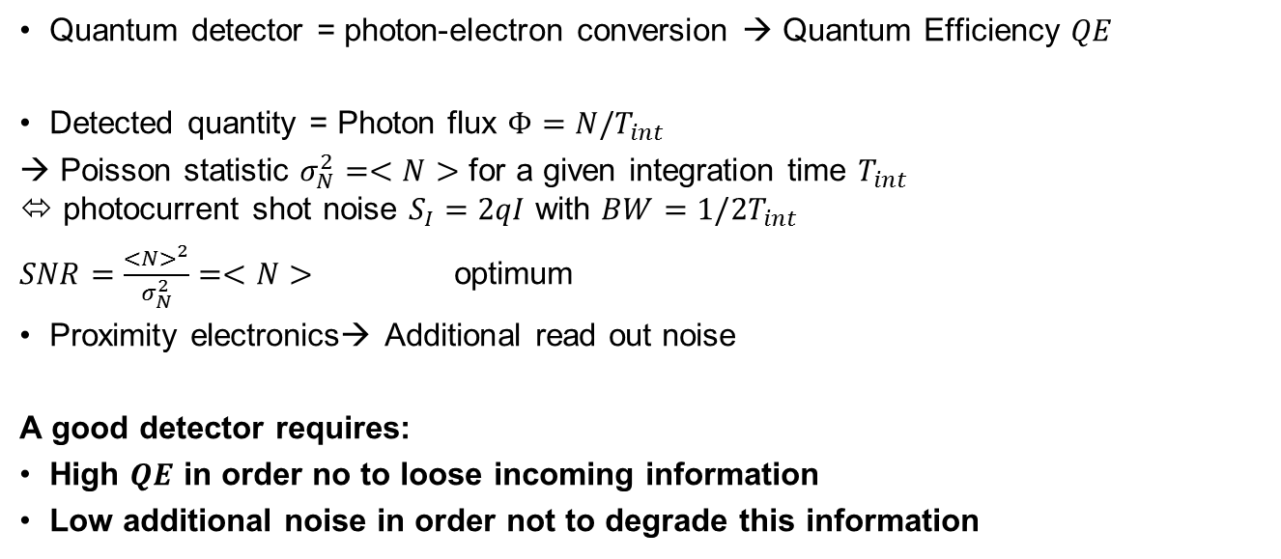
Détection by integration
Optics
Field of view
Ω
Proximity
electronics
Scene
Detector
$$Φ$$
Output
signal
t
Quantum detector = photon-electron conversion → Quantum Efficiency $QE$
Detected quantity = Photon flux $Φ=N/T_{int}$
→ Poisson statistic $σ_{N}^{2}=<N>$ for a given integration time $T_{int}$
⬄ photocurrent shot noise $S_{I}=2qI$ with $BW=1/2T_{int}$
$SNR=\frac{<N>^{2}}{σ_{N}^{2}}=<N>$ optimum
Proximity electronics→ Additional read out noise
A good detector requires:
High $QE$ in order no to loose incoming information
Low additional noise in order not to degrade this information
I
I
t
t

Slide 10
Photocurrents in pn junctions
Collected photocurrent limited by minority carriers
  N side: holes h+
  P side: electrons e-
  Space charge region (SCR)
Diffusion
V_{bi}
BC
E_{F}
W_{zce}
P: N_{A}
BV
Planar structure
N: N_{D}
SCR
Mesa structure
IR
IR

Slide 11
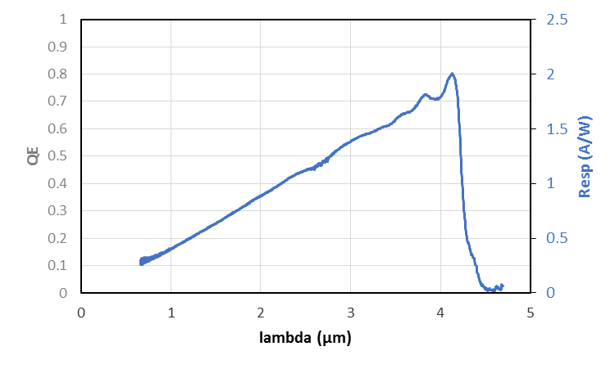
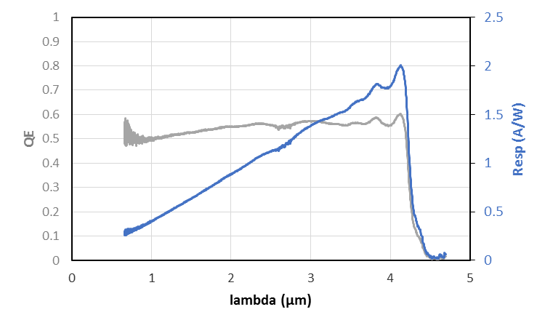
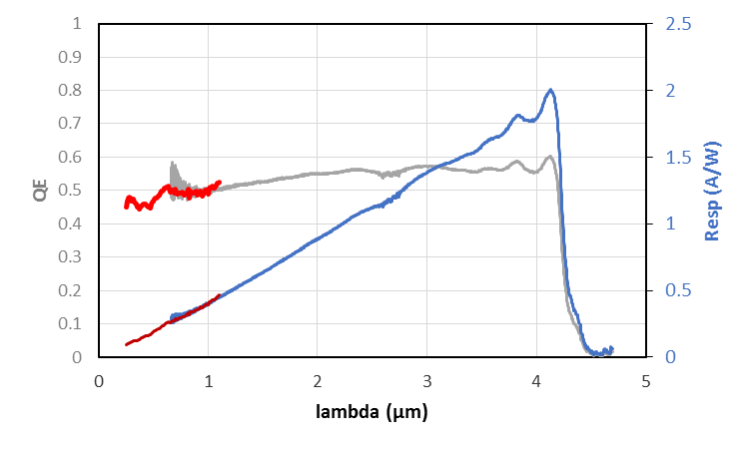
Spectral QE for Diffusion extracted
Narrow gap photodiode (ex MCT)
ROIC
O. Gravrand, JEM 40(8) p. 1781, 2011
interconnect
MCT
IR
Without CZT substrate:
  Flat QE on a very wide spectral band
  From IR up to visible… and UV!

Slide 12
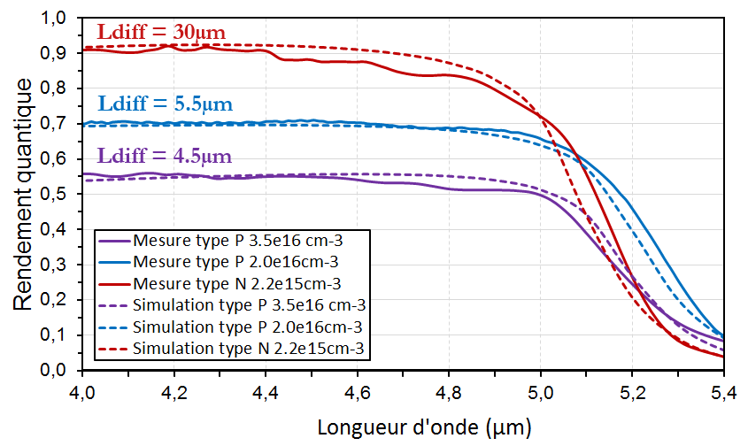
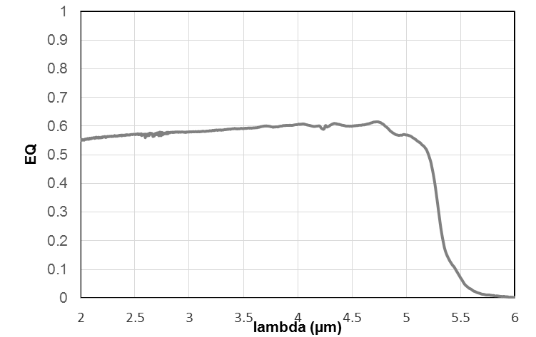
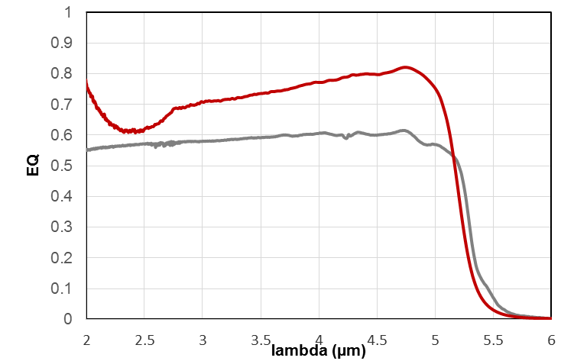
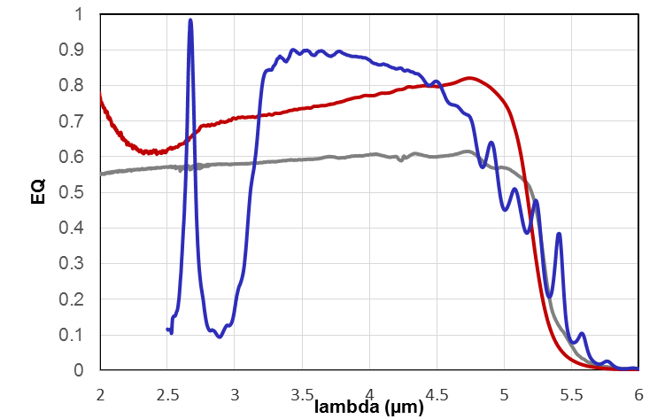
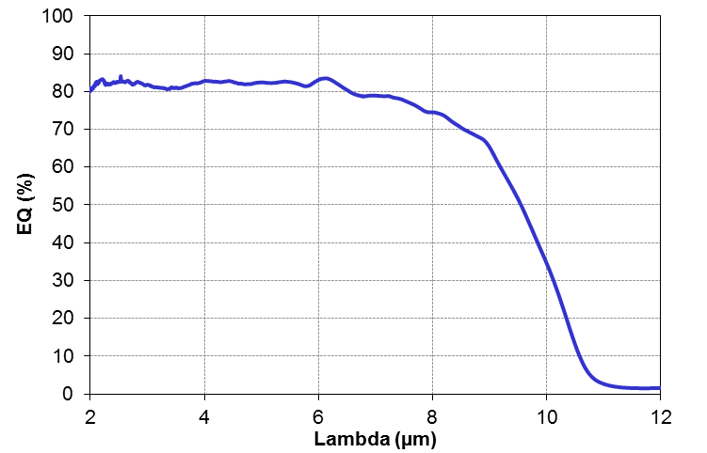
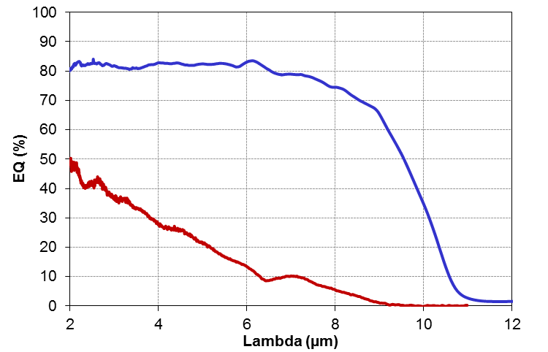
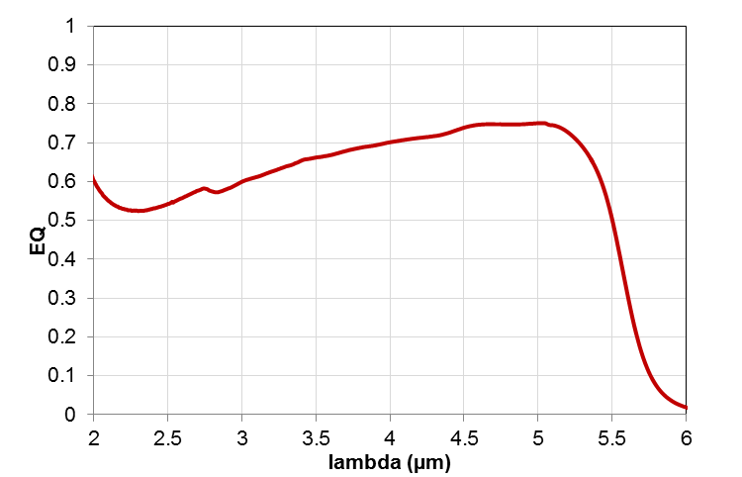
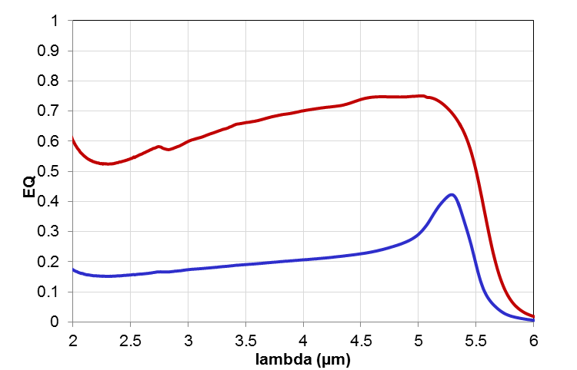

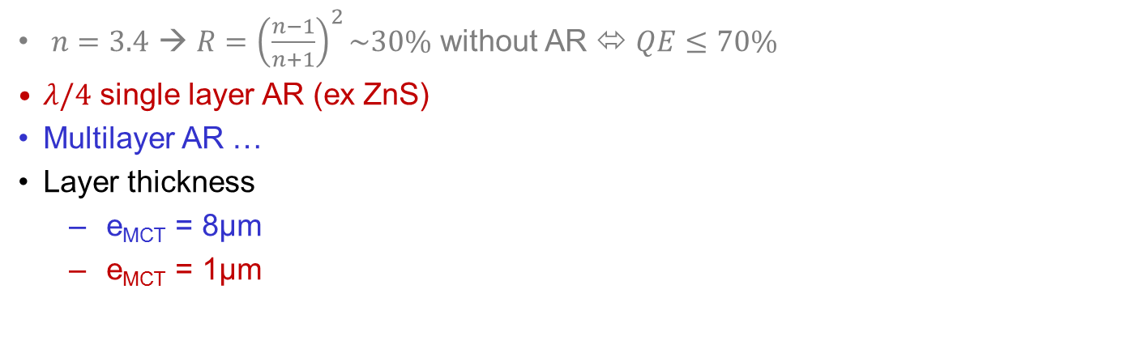
Spectral QE for Diffusion extracted
Narrow gap photodiode (ex MCT)
PhD J. Berthoz
Projet Vermisel 2005
O Gravrand QSIP 2012
ROIC
interconnect
Beer Lamber
Diffusion
MCT
IR
$n=3.4$ → $R={\left(\frac{n−1}{n+1}\right)}^{2}\sim 30\%$ without AR ⬄ $QE≤70\%$
$λ/4$ single layer AR (ex ZnS)
Multilayer AR …
Layer thickness
  e_{MCT} = 8µm
  e_{MCT} = 1µm
Electrical collection efficiency
  L_{d} = 20µm (e_{MCT}=20µm)
  L_{d} = 6µm
Pixel optical area
→ pixel fill-factor
= QE net loss

Slide 13
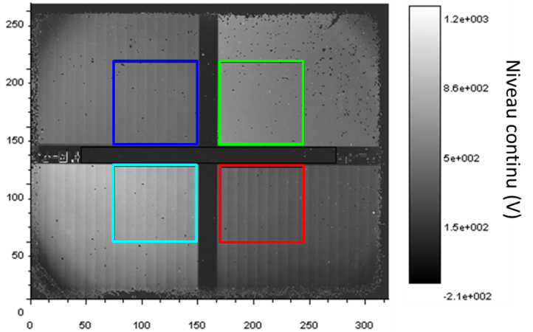
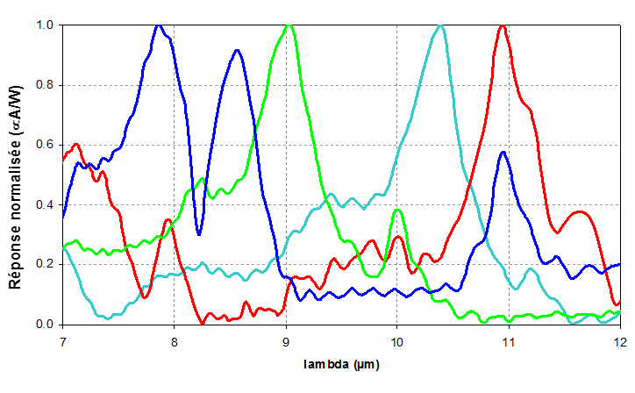
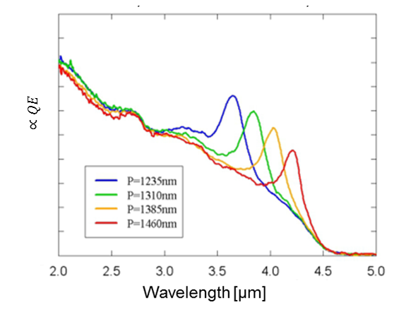
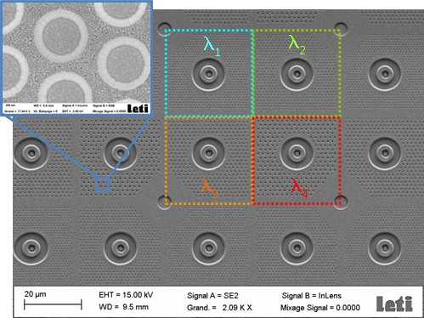
Pixel level filtering
Incident interface metaljic filters (IDEP 2012)
Diode contact nano texturation in order to tailor the spectral shape
and optimise dark current
PhD E. Lesmanne
PhD M. Duperron
2013

Slide 14
Outline
General introduction about IR detection
FOM for IR detection/imaging
Tailoring the photocurrent
Understanding the dark currents
Impact ionization for APDs
Focus1: Ultra high performances for very low fluxes
Focus2: High operating temperature
Conclusion

Slide 15
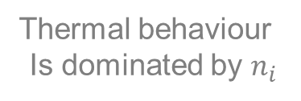

PN junction dark currents
N and P sides : Auger et SRH generation → diffusion limit
SCR:
  No Auger in SCR
  SRH in SCR= GR
Surface currents
  Local degradation $τ_{SRH}$
E_{V}
VHg
MCT specificity
SRH on E_{V}
BC
E_{F}
E_{R}
P: N_{A}
In Bump
BV
In Bump
N: N_{D}
ZCE
SCR
VHg
VHg
VHg
In
In
P_{VHg}
VHg
Vhg
In
In
CMT
VHg
N_{In}
In
In
In
VHg
Thermal behaviour
Is dominated by $n_{i}$
MCT N/P :VHg
MCT P/N :In

Slide 16
≠ recombination mechanisms
≠ Mechanisms limiting mino lifetime:
E
BC
f
i
i
f
f
i
hν
k
BV
Heavy h+
BV
Light h+
Auger 1
Limiting N type
Auger 7
Limiting P type
Radiative
Schockley-Read-Hall
2 e⁻
→ 1 h⁺_{heavy}+1 e⁻
1 h⁺_{light} + 1 e⁻
→ 2 h⁺_{heavy}

Slide 17
Mino carrier Lifetime battlefield…
LW, T=77K
Kinch 05, JEM 34(6) p880 (2005)
MCT n
MCT p
LETI MCT:V_{Hg}
LETI MCTT:In
CMT : τ_{SRH}>2-20 µs
MCT p
τ Auger7
Youngdale94, APL64(23) p3160
τ Auger1
Pellegrino 09, SPIE7298 67
Rhem 14, SPIE9070 0T
InAs/InAsSb:
Ga free SL2 450 ns
τ VHg
Lin 14, JEM43(9) p3184
InAs/GaSb
35 ns
InAs/GaInSb
SL2 : τ_{SRH}=6 ns
T2SL
theo
τ (s)
T2SL
expt
Doping (cm⁻³)
PhD B. Delacourt

Slide 18
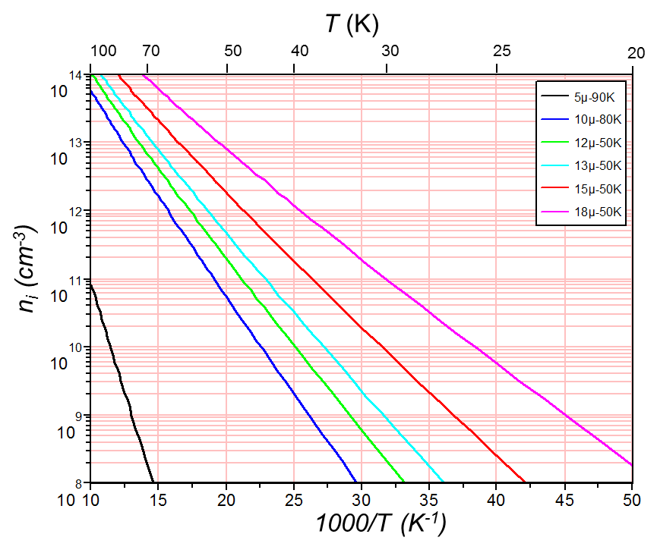
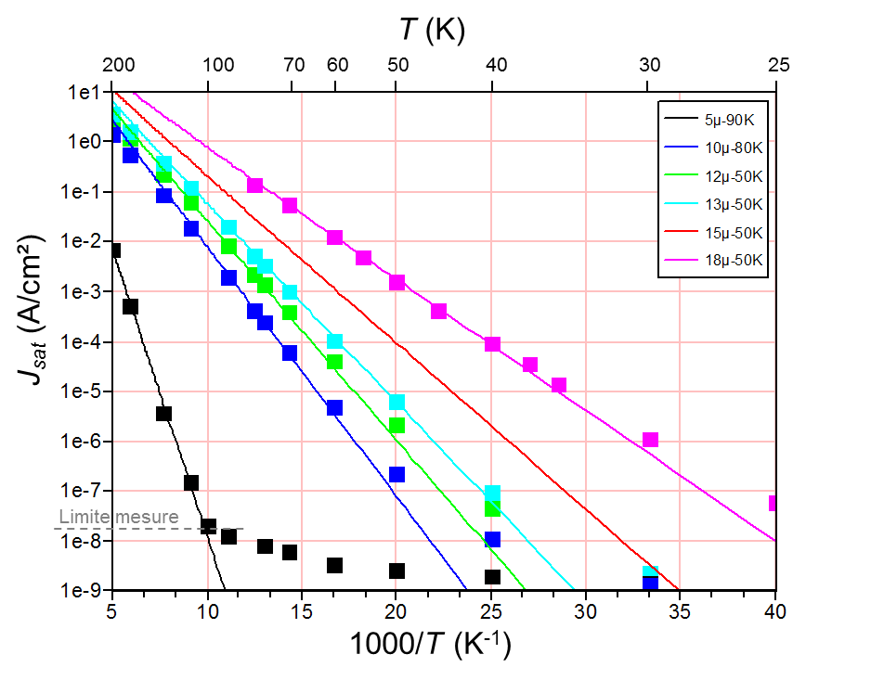
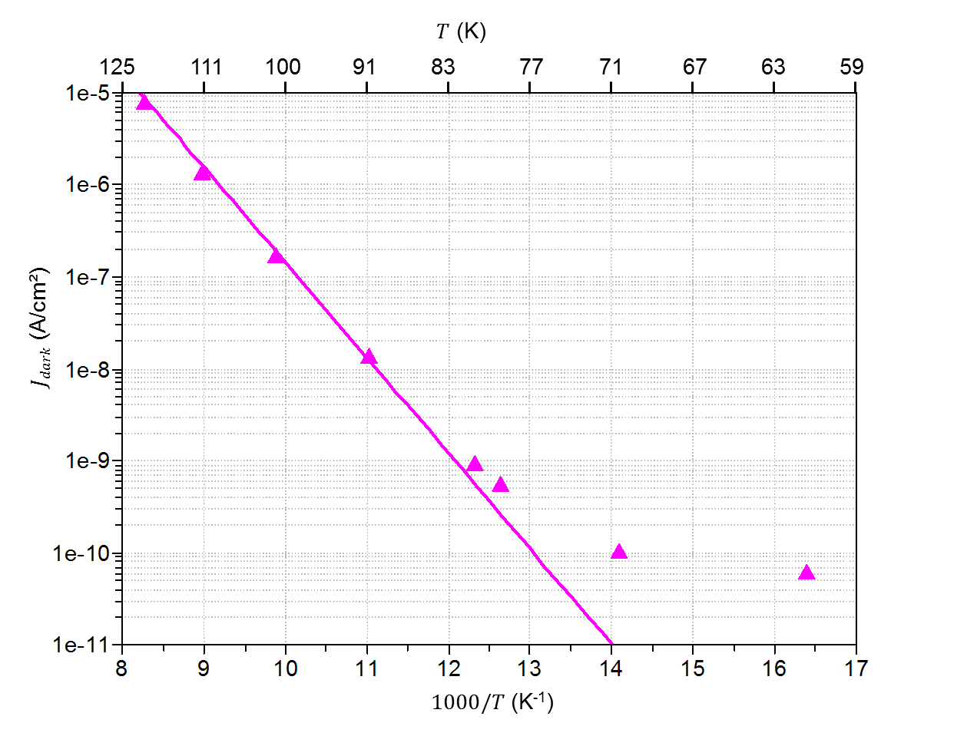
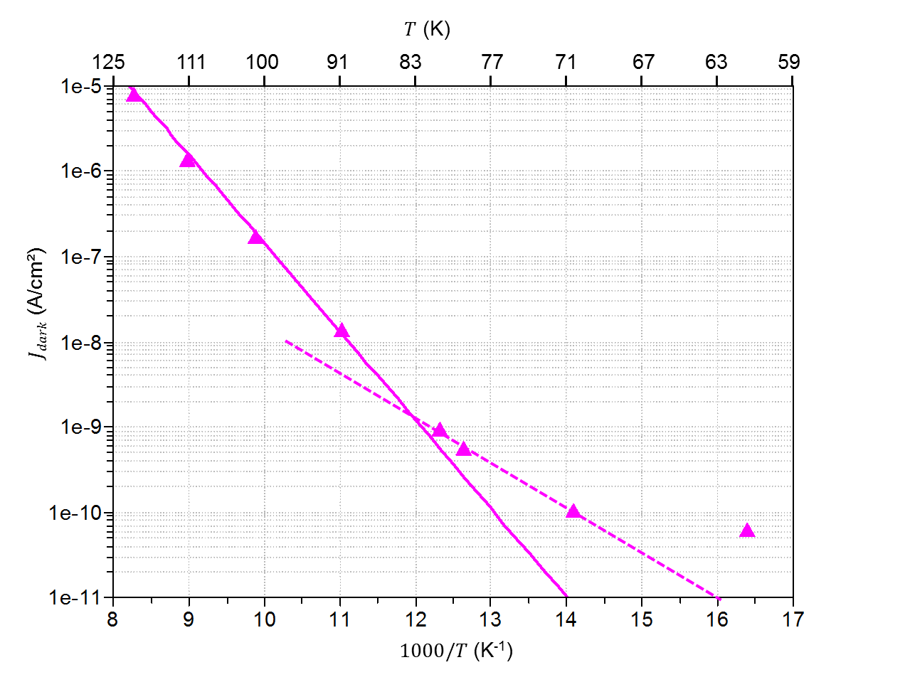
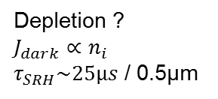

MCT n/p VHg = std process @ Sofradir
Diffusion
$$J_{dark}∝n_{i}^{2}$$
$τ\sim 2ns$
O Gravrand, To be published
JEM 2016
Depletion ?
$J_{dark}∝n_{i}$
$τ_{SRH}\sim 25µs$ / 0.5µm
G.L.Hansen, JAP54 (1983) p1639
Gravrand, JEM, 36(8), p981, (2007)
Hg vacancy (VHg) = P type dopant in MCT (control by annealing T°)
Short lifetime =
  Low diffusion length
  High dark current

Slide 19
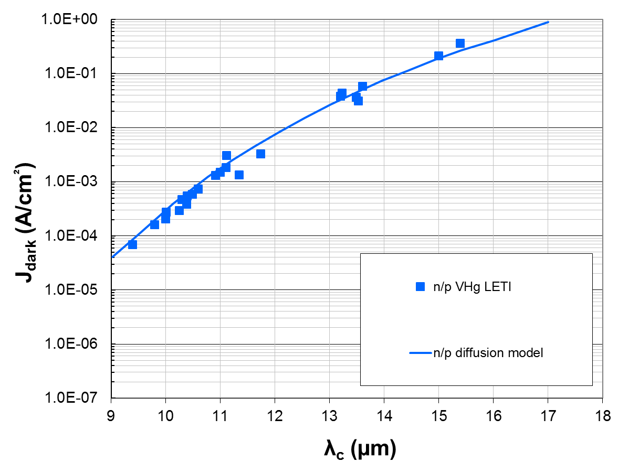
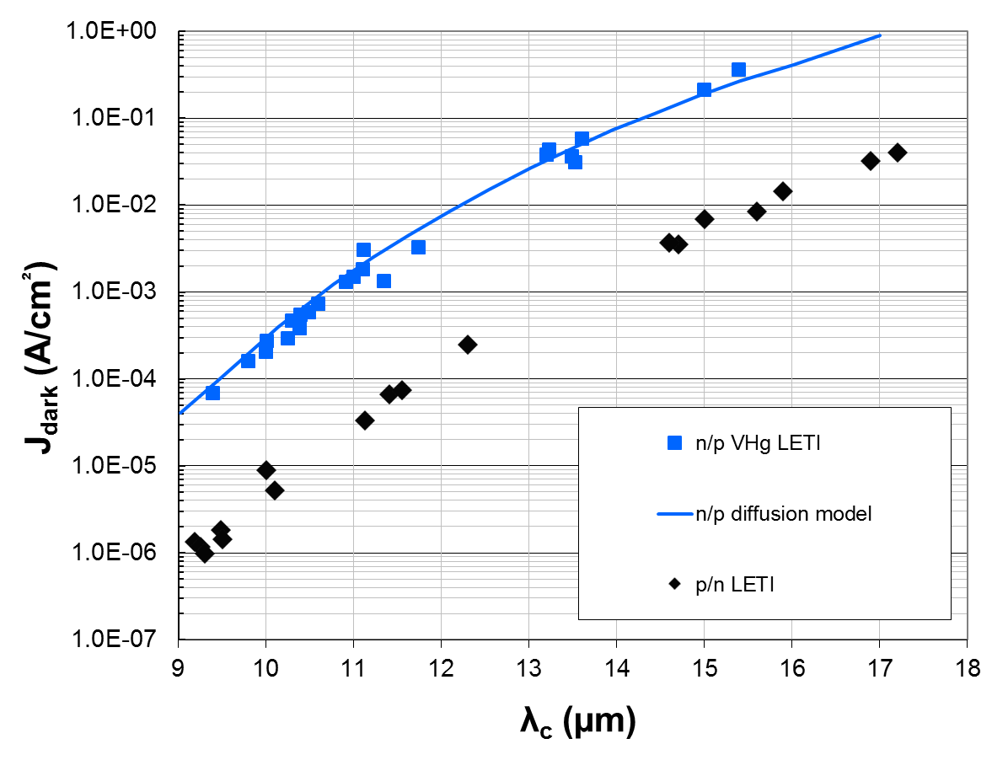
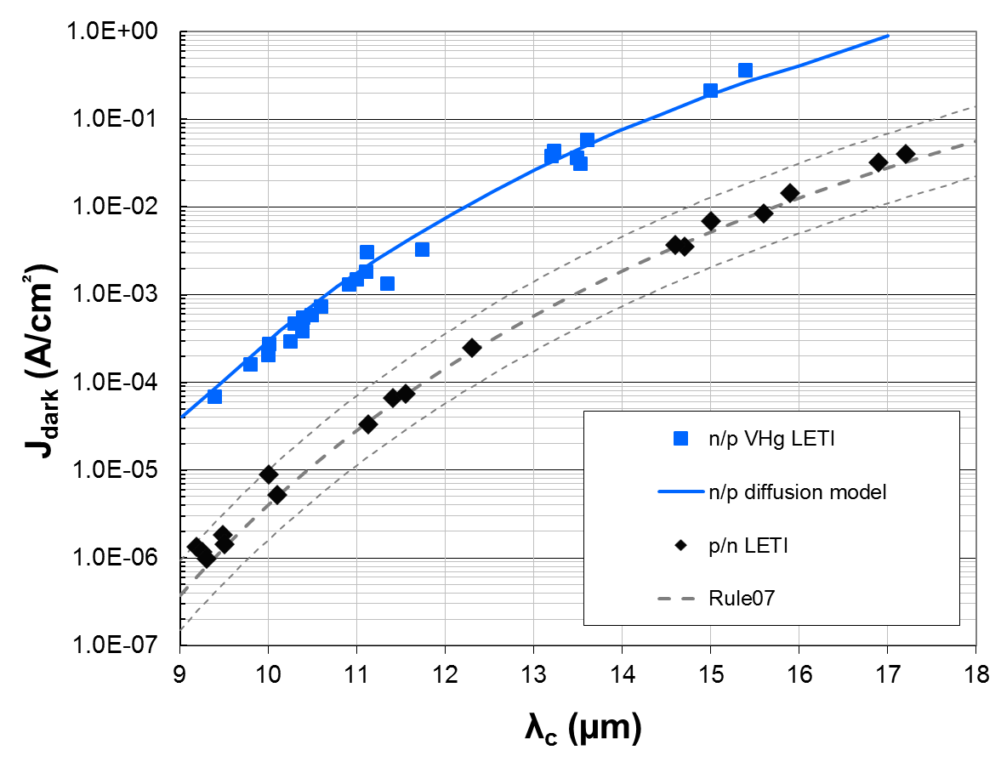
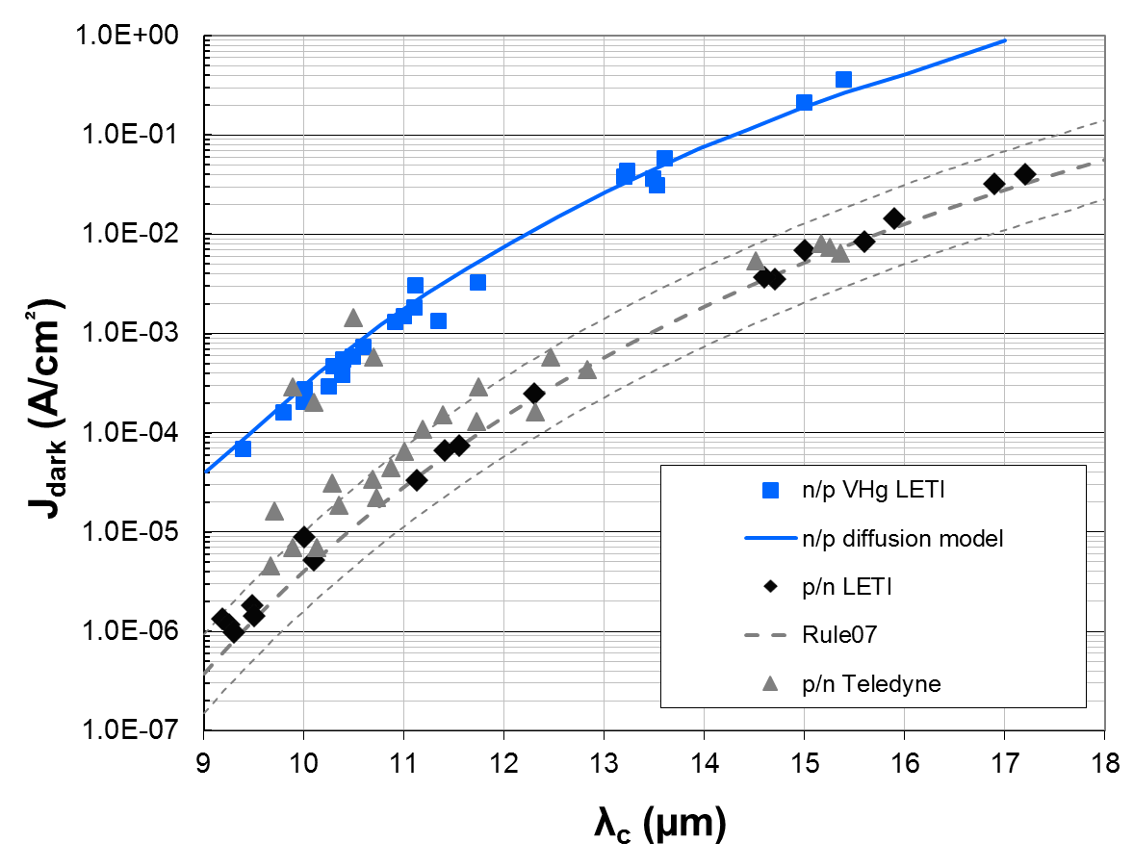
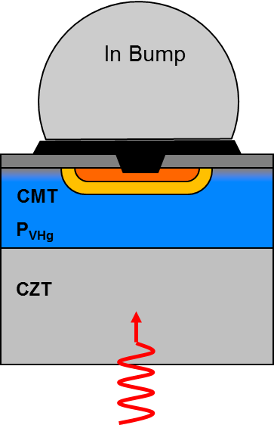



Switch to extrinsic N:In doping
T=78K
O. Gravrand, SPIE 636118–10 (2006)
O. Gravrand, JEM 38(8), (2009)
N. Baier, SPIE87042P (2013)
O. Gravrand, JEM 2016, to be published
W. Tennant, JEM, 37(9), p1406 (2008)
T. Chuh, SPIE 5563 p19 (2004).
P:VHg doping
  → Short lifetime (~ns), SRH VHg recombinaison
Extrinsic N:In doping
  Longer lifetime (~µs) Auger1
  Larger $L_{d}=\sqrt{kTµτ}$ → higher $EQ$
→ Gain close to x100 on $I_{dark}$
Notes:
Coupure psn jusqu’à 20µm à 50K
? A refaire avec les points psn en orange?

Slide 20





Dark current optimisation for diffusion extracted extrinsic photodiode
MCT p/n
T=150K
λ_{c}=5µm
τ_{SRH}=20µs
T2SL
τ = 10xτ_{AugerMCT}
τ_{SRH}=80ns
PhD B. Delacourt
Auger1: $τ_{A1}=\frac{2n_{i}^{2}}{n\left(n+p\right)}τ_{A1i} ∝\frac{τ_{A1i}}{N_{d}^{2}}$
$τ_{A1i}$ : Beattie & Landsberg
(FF=0.47) in extr. regime
τ (s)
SRH
f
i
i
Schockley-Read-Hall
Auger 1
Limite le type N
2 e⁻ +1 h⁺_{lourd}
→ 1 e⁻
O. Gravrand, “Challenges for ultimate HOT quantum IR detectors,”
SPIE 8631, 2013
N_{d} (cm⁻³)

Slide 21

Dark current optimisation for diffusion extracted extrinsic photodiode
MCT p/n
T=150K
λ_{c}=5µm
τ_{SRH}=20µs
T2SL
τ = 10xτ_{AugerMCT}
τ_{SRH}=80ns
Material intrinsic property
Lower n_{i} by design for T2SL?
Need a highly absorbing material
to minimize diffusion volume
N_{d}~1e15cm⁻³
⬄Rule07
N_{d}~6e16cm⁻³
τ N_{d} (s.cm⁻³)
Caution
High doping=
lower L_{diff}
lower QE ?
O. Gravrand, W. Hassis, and J. Rothman, “Challenges for ultimate HOT quantum IR detectors,”
SPIE, vol. 8631, Invited Paper, p. 50, 2013
N_{d} (cm⁻³)

Slide 22


From single diode to focal plane array
Ideally we want all pixels identicals!
  TV/4 = 320x256 = 81 920 px
  TV = 640x512 = 327 680 px
Nice Gaussian distributions?
  Mean performances, PRNU, DCNU…
  Dispersion, operability = 1- defectuosity
[nA]
O. Gravrand, JEM 38(8), (2009)
n/p Ext
n/p VHg
Notes:
Faire une bonne diode c’est bien…Faire un plan focal, c’est plus dur…

Slide 23


Impact ionisation for MCT APDs
APD = Avalanche Photodiode
Photocurrent pre-amplification in the jonction
Overcome read out electronic noise
In Bump
In Bump
electron
hole
P: N_{A}
P_{VHg}
P_{VHg}
CMT
BC
CMT
PhD G. Perrais
(2009)
E_{F}
E_{R}
N: N_{D}
BV
/!\ tunnel current limitation
Single e- multiplication
(no hole Xcation)
quasi deterministic P_{ionisation}
Low additional noise
$i_{n}=\sqrt{2qI}$ before amplification
$i_{n}=M×\sqrt{2qI×F}$ with gain $M$
$F=\frac{RSB_{in}}{RSB_{out}}\sim 1.1−1.2$ XS noise
  Impact Ionisation
  1e- → 2e⁻ + 1h⁺
  ⬄
  (Auger7)⁻¹
BC
G. Perrais,JEM36(8) p963(2007)
BV

Slide 24


What is interesting in this APD gain?
Alternative: Current pre-amplification with avalanche gain before RO in order to deconstrain proximity electronics design
APD gain + F~1 for MCT allows to extend the detection range at low photon nb
Shot limit σ_{N}²=<N>
⬄ i_{n}²=2qI
wo Gain, RO noise
Std -------- σ_{RN}=100e
Top ____ σ_{RN}=50e
Sténopé
SFD 2011 σ_{RN}=9e
APD MCT σ_{RN}=50e
M=30 F=1
APD Si and/or 3-5
σ_{RN}=50e
M=30 F=2
M=30 F=5
F=RSB_{in}/RSB_{out}
Input equ.
RO noise
= 50e /30
Photon nb = <N>
9e
RO noise= 50e
100e
Notes:
Limite absolue de SNR : pour une diode parfaite en N²/s où s=N.
Ajoute le bruit de lecture du CL : plus le flux est faible, moins on fait ressortir le signal. Ex cas sténopé.
Cas des APD à F>1 ➔ dans des applications fort flux, à cause de l’excès de bruit, on perd de l’information ! Tous les APD ne sont pas bons pour toutes les applications !

Slide 25
Outline
General introduction about IR detection
FOM for IR detection/imaging
Tailoring the photocurrent
Understanding the dark currents
Impact ionization for APDs
Focus1: Ultra high performances for very low fluxes
Focus2: High operating temperature
Conclusion

Slide 26

Very high performance issue
Notes:
Graphique Arhenius

Slide 27

Very high performance issue
PN junction
N type
absorbing layer
E_{c}
CZT substrate
E_{F}
E_{v}
P type
cap

Slide 28


Very high performance issue

Slide 29

Very high performance issue
PN junction
N type
absorbing layer
E_{c}
CZT substrate
E_{F}
E_{v}
P type
cap
SCR currents
Surface currents

Slide 30

Very high performance issue
Jonction PN
N type
absorbing layer
E_{c}
CZT
E_{F}
E_{v}
X
P
SCR currents
Surface currents
Material and process
quality improvement
Burried junction risk
Barrier formation on the VB
E_{B}<kT : QE loss at low T°
(thermionic curent at high T°)
Heterostructure Photodiode

Slide 31

Very high performance issue

Slide 32


















NIR high performance issue
LETI-SAp 2012
2.5µm p/n planar MBE/CZT
NIRLFSA phase 1
Ongoing caracterisation…
APD FPA / SFD ROIC
ROIC1 SFD p15 TV/2
LETI-SAp 2012
2,03µm p/n planar MBE/CZT
NIRLFSA phase 1
λ_{c}=2.5µm @ 78K
V_{RST}=800mV
Tint=5s
Diffusion VHg $τ=10ns$
LETI-SAp 2012
1.96µm n/p planar LPE/CZT
NIRLFSA phase 1
Diffusion VHg $τ=10ns$
$$J_{dark}′=\frac{J_{{dark}_{mes}}}{M}$$
Jdark (A/cm²)
SAp 2015
2.08µm p/n planar LPE/CZT
NIRLFSA phase 3
SAp 2015
2.08µm p/n planar LPE/CZT
NIRLFSA phase 3
GR $τ_{SRH}=10µs$
$$W_{SCR}=×3$$
ROIC2 SFD p15
TV
SAp 2015
2.12µm p/n planar MBE/CZT
NIRLFSA phase 3
GR $τ_{SRH}=50µs$
SAp 2015
2.12µm p/n planar MBE/CZT
NIRLFSA phase 3
56e/s/px_{30µm}
56e/s/px_{30µm}
LETI 2014
3µm n/p APD LPE/CZT
M=1
ROIC2 CTIA
p30TV/2
1e/s/px
M=7,5 / V=6.3V
0.1e/s/px
0.04e/s @ 45K
Temperature (K)
λ_{c}=3µm @ 80K

Slide 33
Outline
General introduction about IR detection
FOM for IR detection/imaging
Tailoring the photocurrent
Understanding the dark currents
Impact ionization for APDs
Focus1: Ultra high performances for very low fluxes
Focus2: High operating temperature
Conclusion

Slide 34


HOT issue
HOT = High Operating Temperature
SWAP: Size Weight And Power (Price)
Cryo Machines
  Cooler engine lifetime
  Consumption
Expected as a (very?) large market for IR detectors…
Important commercial issue
Large technical issues:
  Dark current reduction
  Defectuosity management
  Very low pixel pitches expected…

Slide 35









HOT dark current issue
AlAsSb
T (K)
Shtrichman 2012, SPIE83532Y
250
167
125
100
83
71
Klipstein 2011, SPIE80122R
InAsSb
GR
180K
150K
80K
τ_{SRH}=300ns
InSb SCD [Shtrichman12]
GR
Epi-InSb SCD [Shtrichman12]
NBN barrier devices
nBn, 0.6V, InAsSb SCD
[Klipstein11]
nBn, 1.2V
F#/2 300K λ_{c}=5.3µm
J_{dark} (A/cm²)
F#/2 300K λ_{c}=4.1µm
τ_{SCR}=150ns
Rule07
λ_{c}=4.1µm@150K
Rule07 ⬄ MCT
λ_{c}=5.3µm@80K
1000/T (K⁻¹)
Notes:
Tblip red 201K – blue 195K

Slide 36


The real FOM is the noise…
MW (λ_{c}=5.53µ@77K) n/p VHg (var size)
Bruit 1/f
i_{n} ∝ I
i_{n} (A/√Hz) [10;30Hz]
Shot noise
i_{n} = √2qI
Low T°
= low current
High T°
= high current
I_{dark} (A)
All photodiodes have intrinsic 1/f noise sources
  @ low currents, shot noise usually dominates
  @ high currents, 1/f appears…
@ higer T°, shot noise usually don’t dominates any more!

Slide 37



For the FPA point of view
J_{dark} (A/cm²)
Shot noise
i_{n}² (A²/Hz/cm)
P:VHg
N:In
  Some px are more affected by 1/f than others
  Noise operability degradation (distribution tails )
  Limitation before the shot – 1/f knee T°
  ➔ Material and process improvement to minimize 1/f noise sources
PhD A. Brunner

Slide 38








XS noise histogram examples…
InSb TV/4 p30µ 80K Tint = 1.4ms / Cint = 455fF BB25°C
MCT p/n MW TV p15µ 130K Tint = 4ms / Cint = 480fF BB20°C
Population Cumulée
Probabilité Cumulée
Cumulated probability (gausso-arithmetic scale)
Population
$$i_{n}/\sqrt{2qI}$$

Slide 39


Conclusions
Science :
  ROIC glow is limiting ultimate performances
  APDs allows to push the detection limits to very low photon nb
  More pixels, larger overall area → very large formats
HOT MW:
  Today structures (150K)
    Improve defectivity improving material and process quality
    Blue or red MW ?, MCT vs InAsSb ?
  Up coming structures (>150K)
    Decrease the dark current below rule07
    Change doping to be limited by Auger7 instead of Auger1?
    Fully depleted PiN diodes (very high SRH required >ms)
    Confinement structures to decrease Idark generation volume
2kx2k 10µm pitch FPA @ LETI (mockup)
  2k x 2k 15µm pitch = 3 cm
  4k x 4k 10µm pitch = 4cm

Slide 40



Real imaging of a Valence Band….
Barrette Timbre Poste MW (LETI)
Valence

Slide 41






acknowledgments
DEFIR : laboratoire commu) LETI-Sofradir
DGA : Direction générale de l’armement
ESA: European space agency
CNES: Centre national d’études spatiales
FOCUS: IR detection for science (Labex)

Slide 42



Thanks to all others…
Mega pixel MW FPA 10µm pitch MCT LETI

