Slide 1





Antimonide materials and devices
Eric Tournié
University of Montpellier and CNRS, France
Institut d’Electronique et des Systèmes, UMR 5214
eric.tournie@umontpellier.fr

Slide 2
Outline
Antimonide-based compound semiconductors (ABCS)
InAsSb/InAs and InSb/InAs mid-IR LEDs
GaSb-based laser diodes: edge-emitting diodes and VCSELs
InAs/AlSb quantum-cascade lasers
GaSb/InAs type-II superlattice photodetectors
ABCS compounds for plasmonics and solar cells ?
Conclusion – perspectives

Slide 3
Outline
Antimonide-based compound semiconductors (ABCS)
InAsSb/InAs and InAs/InSb mid-IR LEDs
GaSb-based laser diodes: edge-emitting diodes and VCSELs
InAs/AlSb quantum-cascade lasers
GaSb/InAs type-II superlattice photodetectors
ABCS compounds for plasmonics and solar cells ?
Conclusion – perspectives

Slide 4
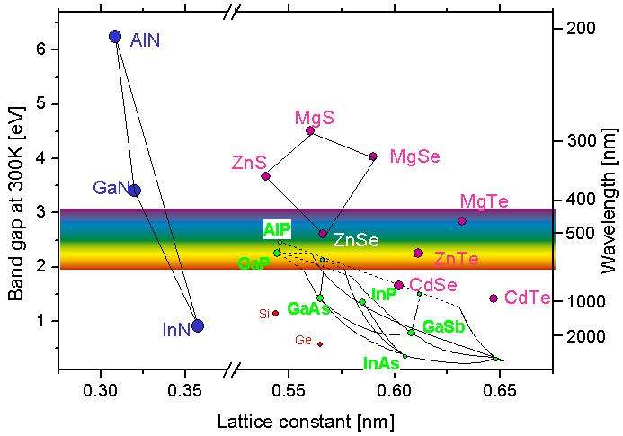
Antimonide-based compound semiconductors (ABCS)
The semiconductors based on GaSb, InAs, AlSb, InSb and their alloys:
AlGaAsSb, GaInAsSb, AlGaInAsSb…
Generally grown on GaSb or InAs substrates
These compounds are also known as the "6.1Å SC" , the "GaSb technology"

Slide 5
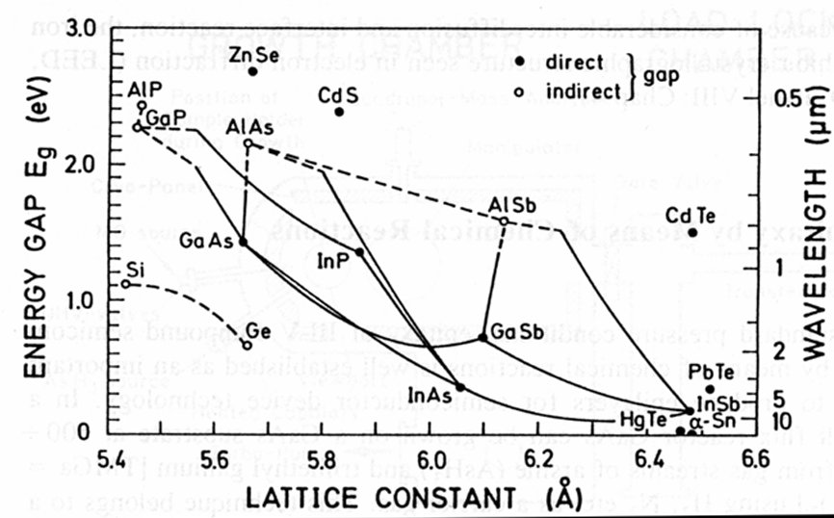
Antimonide-based compound semiconductors
Large bandgap range :
        0.1 – 2 eV
☞ Band gap engineering
Various band alignments:
Type I, Type II, Type III
Large band offsets:
ΔE_{c} = 0 – 2 eV
ΔE_{v} = 0 – 0.5 eV
AlSb
AlAs
GaAs
GaSb
InSb
☞ Band offset engineering
0.72 eV
1.6 eV
X
0.18 eV
1.4 eV
InAs
2.2 eV
Large lattice parameter range:
0.36 eV
☞ Lattice matching is an issue
5.65 Å
a ~ 6.1 Å
6.47 Å

Slide 6
ABCS: effective masses, mobilities
 | AlAs | AlSb | GaAs | InP | GaSb | InAs | InSb | Si | Ge
m_{e}* / m₀ | 0.083 | 0.102 | 0.066 | 0.073 | 0.042 | 0.023 | 0.014 | 0.15 | 0.044
m_{hh}* / m₀ | 0.409 | 0.336 | 0.377 | 0.6 | 0.222 | 0.26 | 0.244 | 0.54 | 0.28
µ_{e} (300 K) (cm². V⁻¹.s⁻¹) |  |  | 8500 | 5400 | 3000 | 40 000 | 77 000 | 1400 | 3900
µ_{h} (300 K) (cm². V⁻¹.s⁻¹) |  |  | 400 | 200 | 1000 | 500 | 850 | 450 | 1900
Low masses, high mobilities….

Slide 7
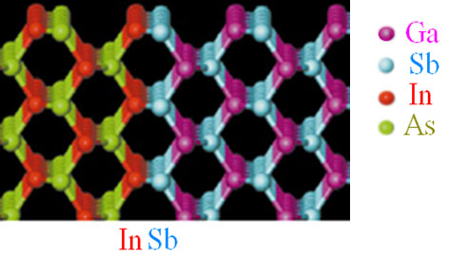
ABCS: no common atom interfaces
Some materials combinations exhibit no-common atom interfaces:
  GaSb / InAs
  AlSb / InAs
⇒ Careful Interface engineering
d _{{111}}
[100]
GaSb (9 MLs)
InSb
⊗
InAs (9 MLs)
TEM: A. Trampert, PDI-Berlin
InAs/AlSb
InAs/GaSb

Slide 8
No common atom InAs / GaSb superlattice: interfaces matter!!
InAs 4 ML
GaSb 3 ML
InSb 1 ML
GaSb 3 ML
In |  | On |  |  | On
As |  |  |  |  | On
Ga | On |  | On |  |  |  | On
Sb | On | On | On |  |  | On | On

Slide 9
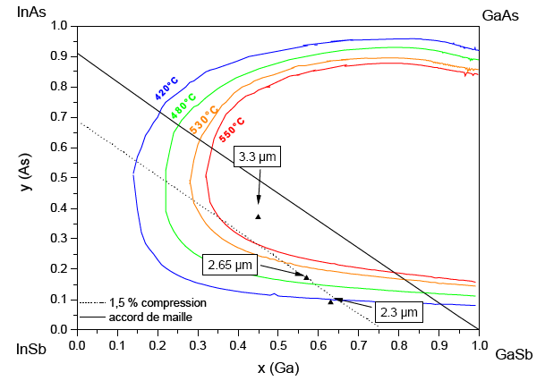
Antimonide-based compound semiconductors
GaInAsSb alloy
Large miscibility gaps: metastable and unstable alloys…

Slide 10
Antimonide-based compound semiconductors
ABCS compounds and heterostructures:
    “low temperature” materials: T_{m}(InSb) = 515 °C, T_{m}(GaSb) = 712 °C (GaAs: 1238 °C)
      low temperature growth: 400 °C < Tg < 520 °C
  Unstable/metastable compounds
  High-Al content in many devices
  Lack of MOVPE developments (efforts starting in the US?)
Molecular-beam epitaxy (MBE) is the only growth technique giving high-quality heterostructures (till now).
GaSb and InAs substrates:
  always conductive
  2 to 4 inch, 5 inch under development
  few producers of good quality substrates: high price (~400 €/ 2 inch)
  thermal deoxydation remains an issue
Doping properties:
  Si = p-type dopant in III-Sb compounds but InAs and InSb
  Te = preferred n-type dopant
  Be = p-type dopant

Slide 11
Antimonide-based compound semiconductors
Unrivaled band gap range ☺
Large band offsets ☺
Type I to type III alignments ☺
Low effective masses ☺
Two group-V elements ☺ 😐 ☹
No common atom interfaces ☺ 😐 ☹
Complex (quat-/pent-anary) alloys ☹
Large mismatch range (-8% / +7 %) ☹
ABCS are well adapted to:
high frequency, low power devices
opto devices operating the IR, particularly mid- and far- IR

Slide 12
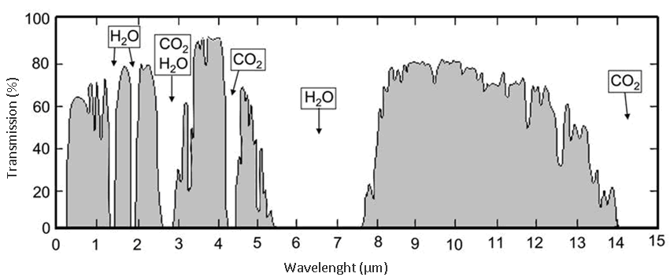
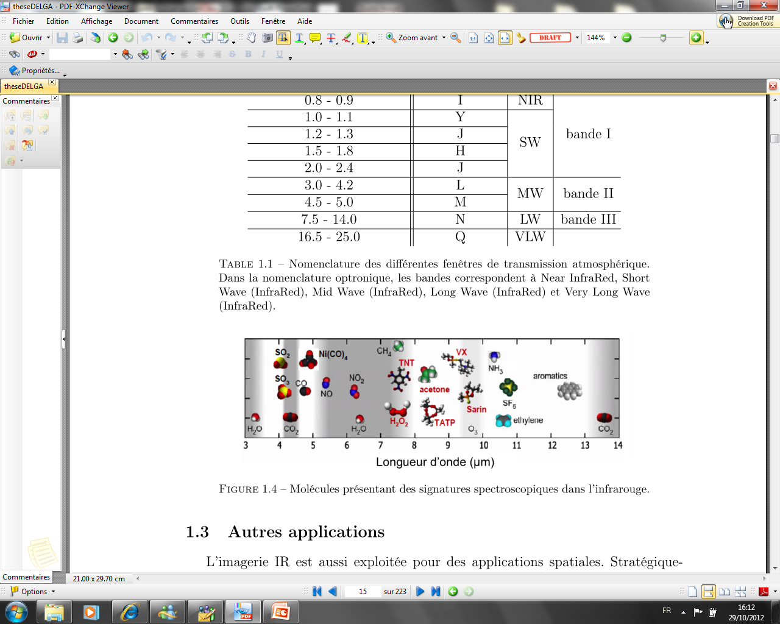
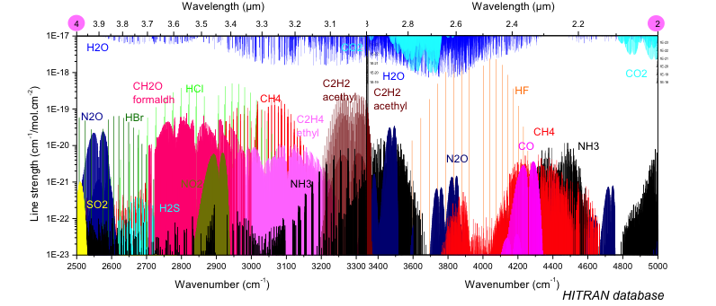
The mid infra-red
Mid-IR
Transparence windows of the atmosphere
Strong absorption lines of many “interesting” gases

Slide 13
Outline
Antimonide-based compound semiconductors (ABCS)
InAsSb/InAs and InSb/InAs mid-IR LEDs
GaSb-based laser diodes: edge-emitting diodes and VCSELs
InAs/AlSb quantum-cascade lasers
GaSb/InAs type-II superlattice photodetectors
ABCS compounds for plasmonics and solar cells ?
Conclusion – perspectives

Slide 14
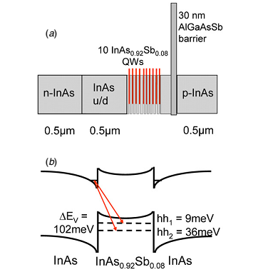
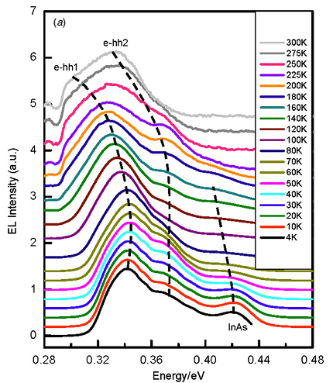
Type-II InAsSb/InAs mid-IR LEDs
Carrington et al. SST 24, 075001 (2009)
See WP4 discussion

Slide 15
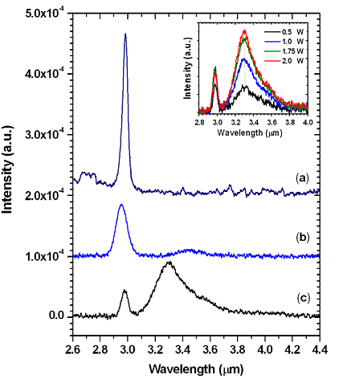
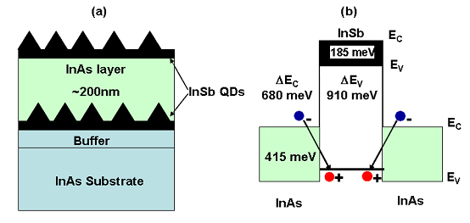
Type-II InSb/InAs mid-IR LEDs
Zhuang et al. J. Phys D 41, 232003 (2008)
See WP4 discussion

Slide 16
Outline
Antimonide-based compound semiconductors (ABCS)
InAsSb/InAs and InSb/InAs mid-IR LEDs
GaSb-based laser diodes: edge-emitting diodes and VCSELs
InAs/AlSb quantum-cascade lasers
GaSb/InAs type-II superlattice photodetectors
ABCS compounds for plasmonics and solar cells ?
Conclusion – perspectives

Slide 17
GaSb-based type-I QWs laser diodes
The basic device in the GaSb technology: typical band-structure design
AlGaAsSb or AlGaInAsSb
waveguide
Energy
Al_{0.9}Ga_{0.1}As_{0.07}Sb_{0.93}:Te
Lower cladding
Al_{0.9}Ga_{0.1}As_{0.07}Sb_{0.93}:Be
Upper cladding
GaSb :Te Substrate
GaSb:Be p-type contact layer
Ga_{1-x}In_{x}As_{y}Sb_{1-y} QWs
~0.8 µm
~1.5 µm
~1.5 µm
Growth direction
Lattice-matched Al_{0.9}Ga_{0.1}As_{0.08}Sb_{0.92} cladding layers
Lattice-matched AlGaAsSb or AlGaInAsSb waveguide
Strained (ε ~1.5 – 2%) GaIn(As)Sb quantum wells

Slide 18
GaSb-based type-I QWs laser diodes: band-offset management
2 µm < λ < 3 µm: GaInAsSb / AlGaAsSb (quaternary materials)
3 µm < λ: GaInAsSb / AlGaInAsSb (quaternary/pentanary materials)

Slide 19
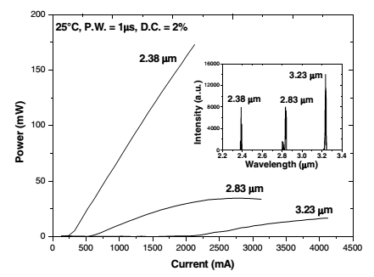
GaSb-based type-I QWs laser diodes
Gad et al., Semicond. Sci. Technol. 28 (2013) 015015
Fabry-Perot laser diodes cover the whole 1.5 – 3.3 µm wavelength range
P_{out} ↓ when λ↑
See, e.g., Tournié & Baranov, Semiconductors and Semimetals, vol. 86, pp. 183 – 226 (2012).

Slide 20
Buried Grating GaSb-based DFB lasers
2nd order DFB
Gaimard et al. , Appl. Phys. Lett. 104, 161111 (2014)

Slide 21
Buried Grating: λ ~ 3 µm
15°C:
Threshold current: 220 mA
Optical power per facet: 2 mW
Same values on FP lasers from the same wafer
SMSR = 30 dB
Total continuous tuning for a fixed T : 2.5 nm
I
T
10 x 900 µm
1st order DFB, Λ = 485 nm, duty 50 %
Gaimard et al., Opt. Express 23, 19118 (2015).

Slide 22

6 µm apertured monolithic GaSb VCSEL @ 2.3 µm
6 µm
CW operation up to 70°C
Threshold ~ 1.9mA at 30°C
Single mode with SMSR > 20dB
Large tunability ~14 nm
Max output power 100 µW at 10°C
Sanchez et al., Opt. Express 20, 15540 (2012).

Slide 23
Outline
Antimonide-based compound semiconductors (ABCS)
InAsSb/InAs and InSb/InAs mid-IR LEDs
GaSb-based laser diodes: edge-emitting diodes and VCSELs
InAs/AlSb quantum-cascade lasers
GaSb/InAs type-II superlattice photodetectors
ABCS compounds for plasmonics and solar cells ?
Conclusion – perspectives

Slide 24
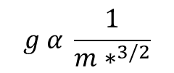
InAs/AlSb: very good intrinsic properties for QCLs
m*=0.023
Gain in QCL
m*=0.045
$$g α \frac{1}{{m∗}^{3/2}}$$
m*=0.067
Key parameters : ΔE_{c} =2.3 eV
m*=0.023
ΔL=0.8 eV
High gain
Short wavelength
Long wavelength

Slide 25
Short wavelength InAs/AlSb QCLs
3 µm
More details on InAs/AlSb QCLs in: Teissier, Baranov, et al.

Slide 26
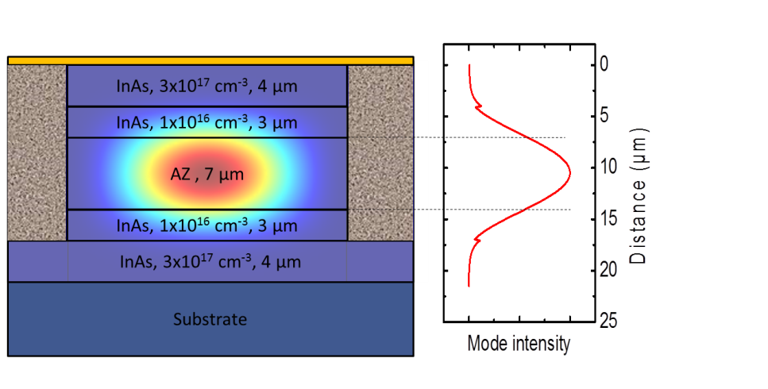
Long wavelength InAs/AlSb QCLs (dielectric waveguide)
Bahriz et al., Opt. Expr. 23, 1523 (2015)
Total thickness 21 µm. Growth time ~ 24h…
50 μm
J_{th} = 4.3 kA/cm² at 300 K / P (80 K) ≈ 120 mW / P(300 K) ≈10 mW / T_{max} = 353 K
PROMIS – Workshop - Sheffield
Notes:
Compromis entre faible perte et recouvrement avec la zone active
Simplification du process
Spacer peu dopé

Slide 27
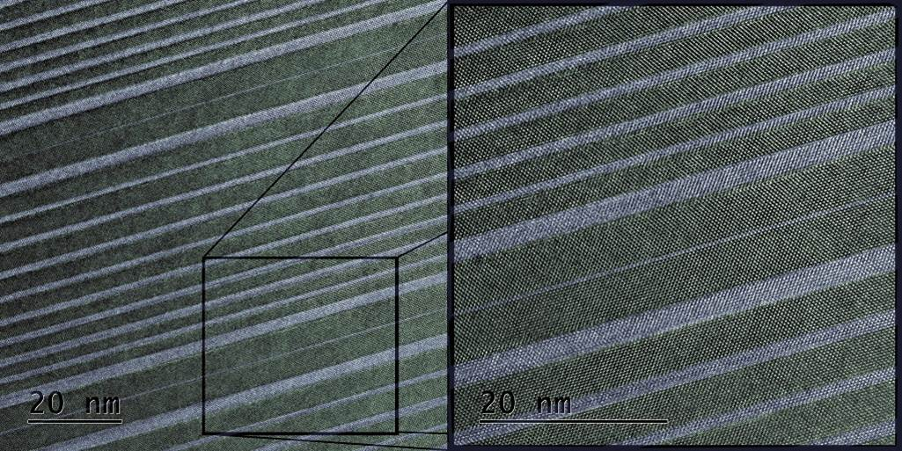
InAs/AlSb QCLs: growth control
0.3 ML AlSb barrier
3-2
2-1
3-2
2-1
12 nm
=> Very thin barrier acts
in good agreement with calculation
TEM image from D. Alloyau, C. Ricolleau, G. Wang (MPQ, Univ Paris Diderot)

Slide 28
Outline
Antimonide-based compound semiconductors (ABCS)
InAsSb/InAs and InSb/InAs mid-IR LEDs
GaSb-based laser diodes: edge-emitting diodes and VCSELs
InAs/AlSb quantum-cascade lasers
GaSb/InAs type-II superlattice photodetectors
ABCS compounds for plasmonics and solar cells ?
Conclusion – perspectives

Slide 29
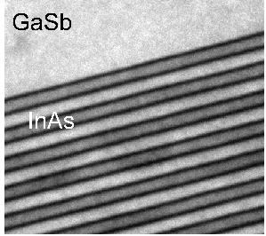
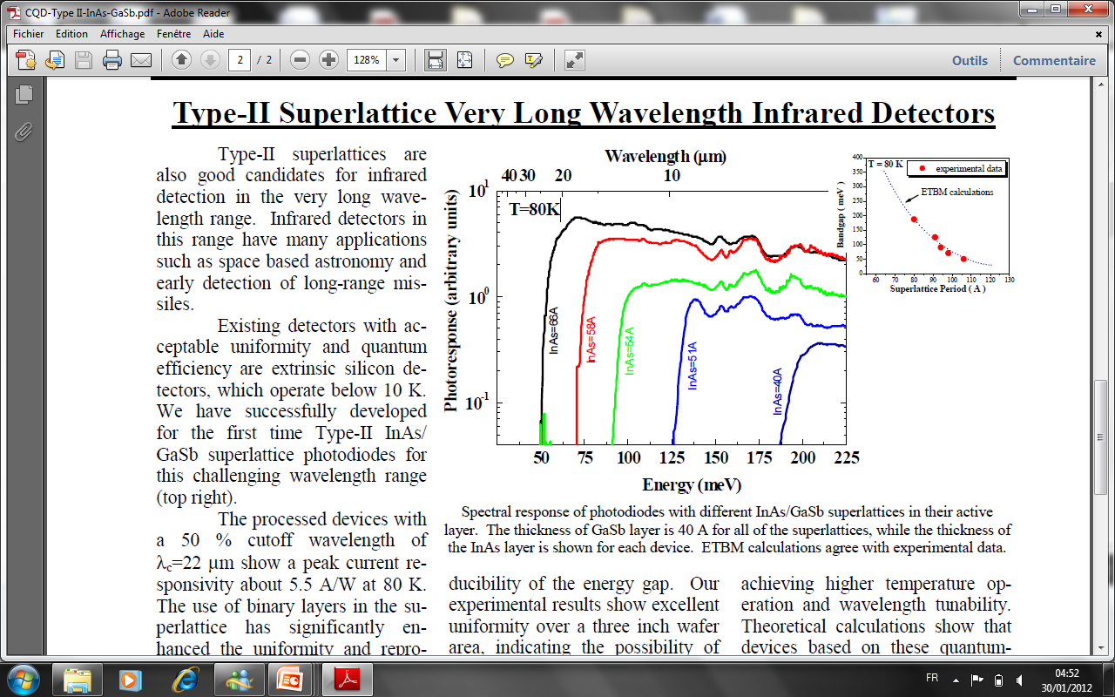
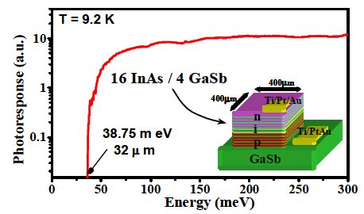
GaSb/InAs superlattice photodetector
Cut-off tuning from SWIR to VLWIR
depending of SL’s period (InAs+GaSb layers)
GaSb (40Å) (3Å=1ML)
MWIR
hν
I_{ph}
InAs (n)
A
VLWIR
InAs/GaSb
SL
GaSb (p)
LWIR
Buffer GaSb (p)
SL : active zone of a pin junction
➔ PV detector

Slide 30
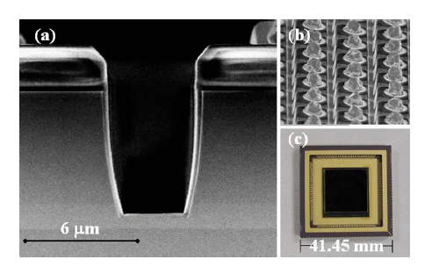
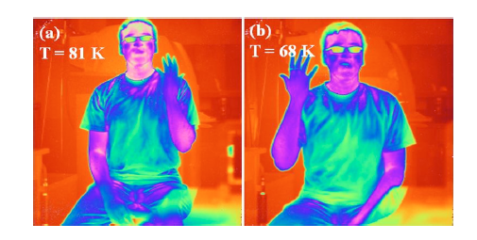
GaSb/InAs superlattice photodetector
1kx1k FPA, l_{C} = 11 µm
substrat GaSb (N) 3’’
J_{dark}= 3.3x10⁻⁴ A.cm⁻², QE = 78%
State of the art pixels
Manurkar et al. Appl. Phys. Lett. 97, 193505 (2010): Razeghi’s group, Northwestern Uni, USA
Cf. Christol, Rodriguez, et al.

Slide 31
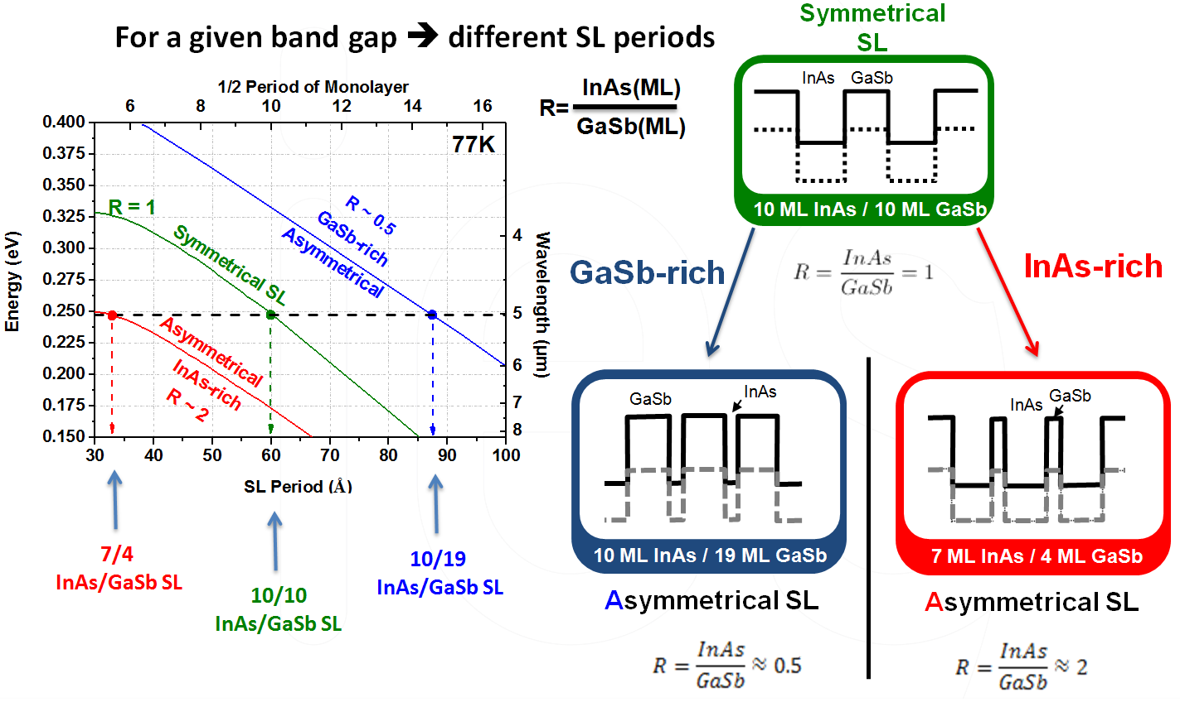
GaSb/InAs superlattice photodetector
31
31

Slide 32
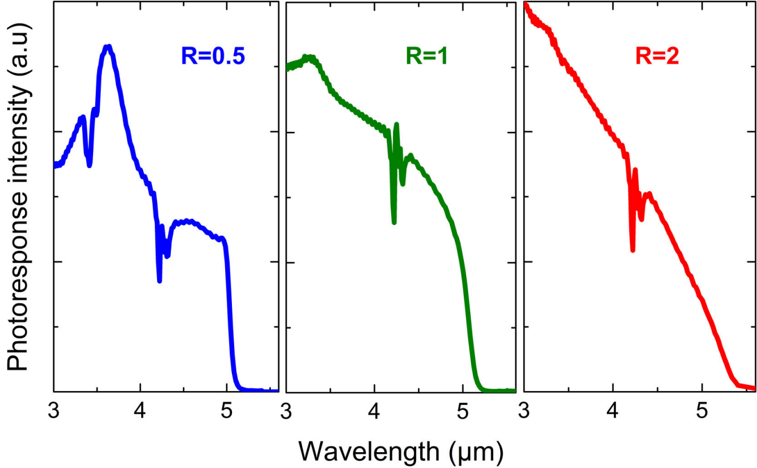
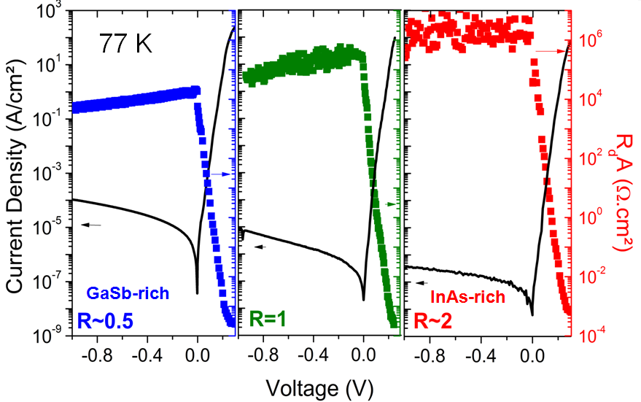
GaSb/InAs superlattice photodetector
GaSb-rich
R = 0.5
Symmetric
R=1
InAs-rich
R = 2
Same cut-off wavelength but very different spectral responses and electrical properties…
Origin ?
Impact on detector performances ?
⇒ Under study !
Christol et al., SPIE Proc. 9370, 93701Z (2015)

Slide 33
Outline
Antimonide-based compound semiconductors (ABCS)
InAsSb/InAs and InSb/InAs mid-IR LEDs
GaSb-based laser diodes: edge-emitting diodes and VCSELs
InAs/AlSb quantum-cascade lasers
GaSb/InAs type-II superlattice photodetectors
ABCS compounds for plasmonics and solar cells ?
Conclusion – perspectives

Slide 34
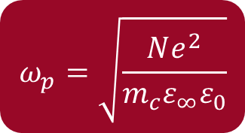
‘‘All-semiconductor’’ plasmonics
$$ω_{p}=\sqrt{\frac{Ne^{2}}{m_{c}ε_{∞}ε_{0}}}$$
InAsSb:
Lattice-matched onto GaSb
High-doping level (> 5 x10¹⁹ cm⁻³)
Low effective mass
(a)
GaSb
535 nm
[001]
InAsSb
[110]
GaSb
[110]
500 nm
Taliercio et al., Opt. Express, to be published.
See WP4 discussion

Slide 35
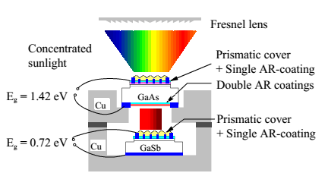
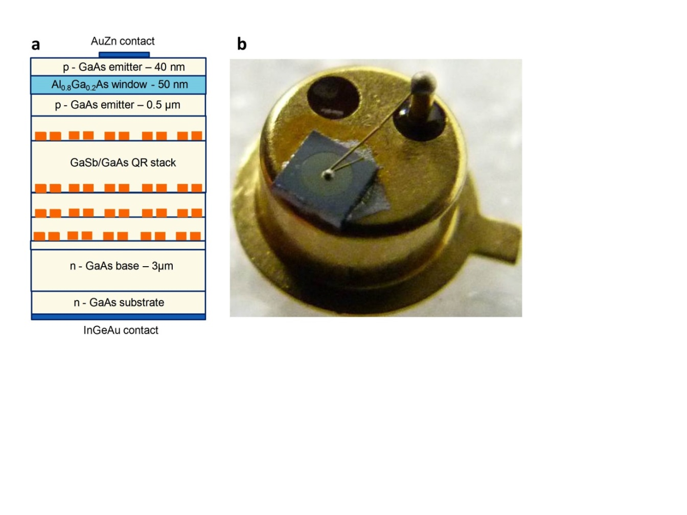
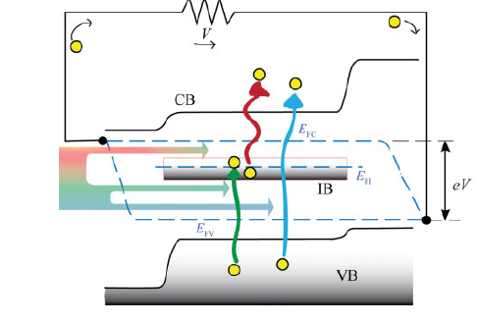
GaSb-based solar cells
Mechanically stacked GaAs/GaSb tandem cells
= 31% @ 100 suns
Bett et al., Appl. Phys . A 69, 119 (1999)
Intermediate band solar cells (U Lancaster)
III-Sbs cover the whole bandgap range adapted to multi-junction solar cells.
See WP3 discussion

Slide 36
Outline
Antimonide-based compound semiconductors (ABCS)
InAsSb/InAs mid-IR LEDs
GaSb-based laser diodes: edge-emitting diodes and VCSELs
InAs/AlSb quantum-cascade lasers
GaSb/InAs type-II superlattice photodetectors
ABCS compounds for plasmonics and solar cells?
Conclusion – perspectives

Slide 37
Conclusion
July 2015
QW GaN
QW/QD InP
IBCL GaSb: CW
QCL GaAs
QW GaSb: CW
QW/QD GaAs
on Si
QCL InP
λ (µm)
1
2
3
4
5
9
20
QCL InAs/AlSb: pulsed
The GaSb technology has been progressively maturing in the last decade.
Various designs are available to cover the whole MIR wavelength range:
  Type-I QW laser diodes or VCSELs: 2 – 3.5 µm
  Type II QWs or QDs LEDs: > 3.5 µm
  QCLs: 3 – 20+ µm
  ICLs: 3.5 – 6 µm (see Vurgaftman et al., J. Phys. D. 48, 123001 (2015)).
High performance MWIR photodetectors

Slide 38
Perspectives
Mature buried-grating DFB lasers
Extend λ beyond 20 µm with InAs/AlSb QCLs
LWIR photodetectors
Integrate GaSb-based devices on Si and SOI
Extend bandgap range with dilute nitride or bismide alloys
……………………………………………………………
Demonstrate PROMISed devices
Thank you for your attention

Slide 40
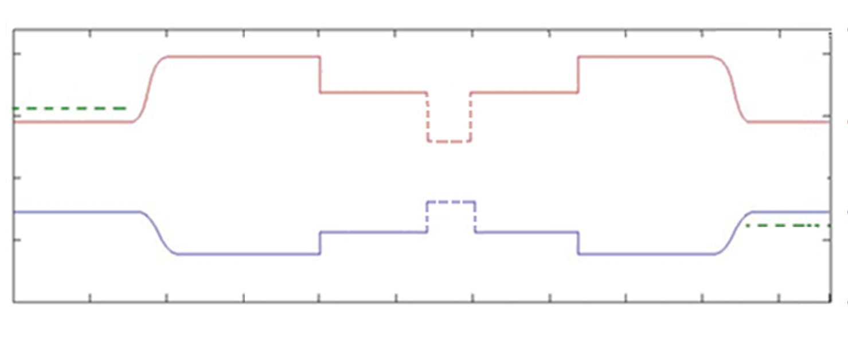
Antimonide-based optoelectronic devices
GaInAsSb / AlGa(In)AsSb type-I QWs
  Edge-emitting laser diodes: 1.5 – 3.4 µm
  VCSELs: 2 – 2.6 µm
GaInSb /InAs « W » QWs
  Interband cascade laser diodes: 3.5 – 6 µm
AlSb /InAs type-II QWs
  Quantum cascade lasers: 2.6 – 20 µm
GaSb /InAs type-III superlattices
  photodetectors: 2 – 30 µm

Slide 41
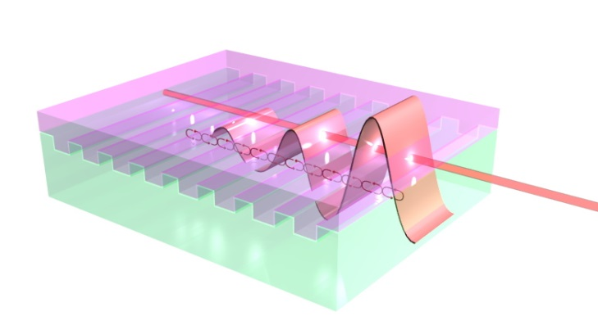
Distributed-feedback (DFB) lasers for single-frequency emission
Introduction of a Bragg grating to modulate the refractive index along the waveguide :
Amplification of the optical mode with the same periodicity
Coupled modes theory :
  Coupling efficiency : κ (cm⁻¹) → strongly related to the grating geometry

Slide 42
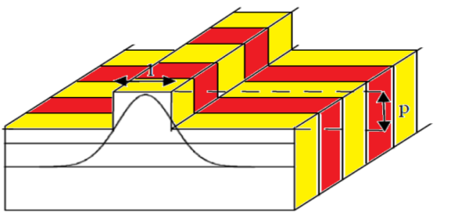
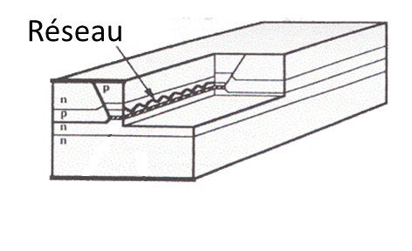

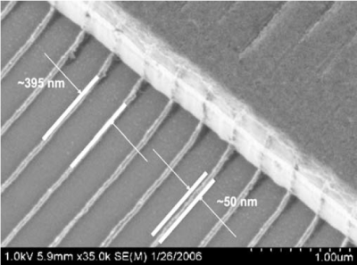
DFB lasers: coupling effects
Semiconductor devices: 2 types of coupling
Losses-coupling (Δα)
Index-coupling (Δn)
Lateral direction
Δn_{eff}
Longitudinal direction
Transverse direction
Complex (Cr) LC-DFB
grating
©
Buried grating usual with InP lasers
GaSb lasers: no attempt yet

Slide 43

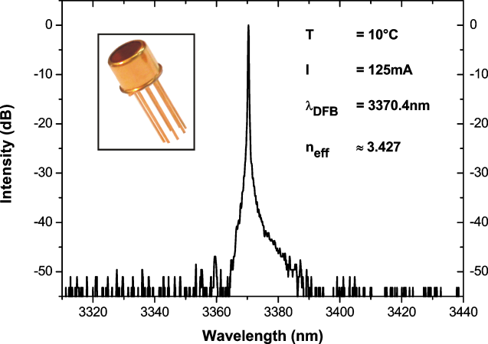


GaSb-based DFB lasers: loss coupling
SMSR = 25 dB
Tuning range = 3 nm
CW operation up to 38°C
I_{th} = 80 mA @ 20°C
P_{max} = 3 mW
LPN
Barat et al., App. Phys. B 90, 201 (2008)
Works well but:
low output power
complex processing
SMSR > 35 dB
Tuning range = 2.5 nm
CW operation up to 38°C
I_{th} = 90/140 mA @ 10°C/20°C
P_{max} = 1.7 mW à 10°C
Naehle et al., Electron. Lett., 47, 46 (2011)

Slide 44
GaSb-based DFB lasers: buried grating
Grating order: need of a compromise!
  High order → more diffraction losses BUT easier technology implementation
  κ depends on order and duty cycle
Parameters chosen to get κL ~ 1.25, with :
2nd order (λ = 2 → 2.7 µm)
1st order (λ = 3 µm)
Mesa
Waveguide
Lower Cladding

Slide 45
Buried Grating: λ ~2.4 µm
40dB
15°C:
Threshold current: 35mA
Optical power per facet: 25 mW
Same values on FP lasers from the same wafer
SMSR = 40 dB
Total continuous tuning for a fixed T : 4.5 nm
10 X 650 µm
2nd order DFB, Λ = 696 nm, duty 70%
Gaimard et al., Opt. Express, to be published

Slide 46
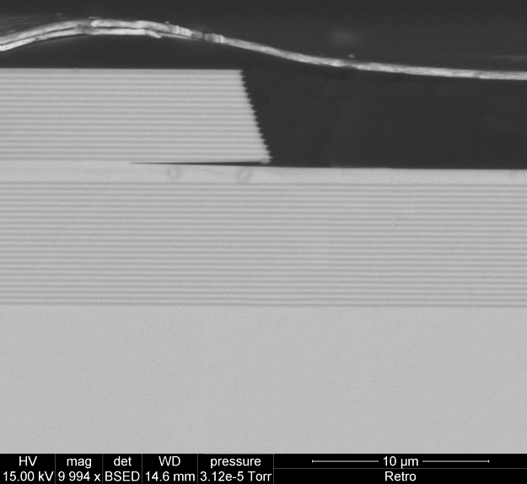
Apertured GaSb VCSELs
Top epitaxial n-DBR
AlAs_{0.08}Sb_{0.92}/GaSb 20 pairs: (R > 99.8%)
top-contact
Light
Active region:
- 5 x Ga_{0.65}In_{0.35}As_{0.1}Sb_{0.9} QW - Al_{0.35}Ga_{0.65}As_{0.03}Sb_{0.97} barriers
(1-2% lattice mismatch)
Bottom epitaxial n-DBR
24 pairs AlAs_{0.08}Sb_{0.92}/GaSb
Δn ~ 0.6 ⇒ R > 99.9%
n-GaSb substrate
back-contact
Apertured TJ
n⁺ InAs/ p⁺ GaSb
MBE growth of the monolithic VCSEL:
  total thickness ~ 12 – 15 µm (14 – 17 hours growth)
Lateral selective etching of TJ (Sanchez et al., SST 27, 085011 (2012))
Apertured VCSEL Process
PROMIS – Workshop - Sheffield

Slide 47
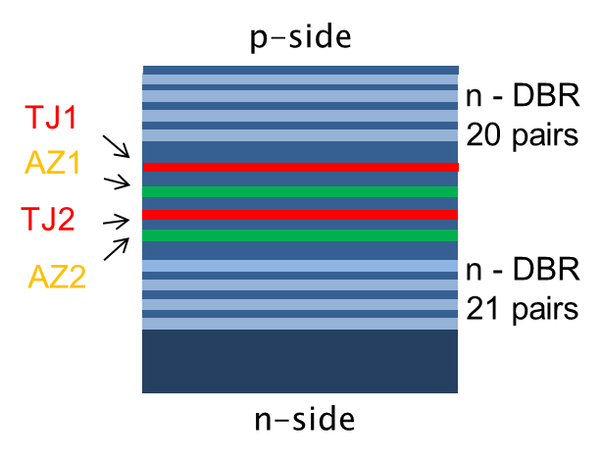
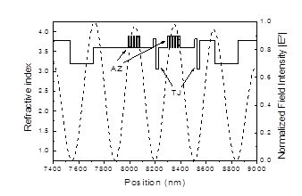
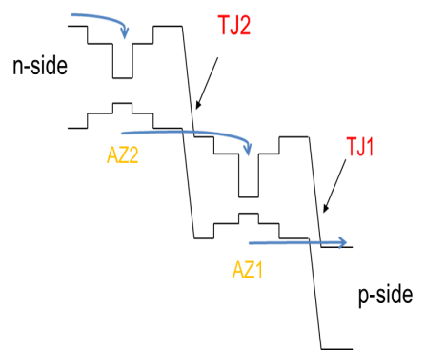
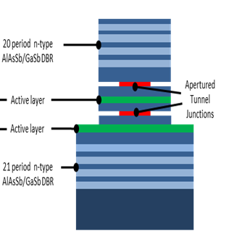
Cascaded GaSb VCSELs
CW operation up to 70°C
Max output power 1 mW
WPE ~5 %
Sanchez et al., PTL 25, 882 (2013); J. Phys D 46, 495101 (2013)

Slide 48
Interband cascade lasers (ICLs): band diagram
(NRL, USA; U. Würzburg, Germany)
Revue: Vurgaftman et al., J. Phys. D, 48, 123001 (2015).
Disadvantage:
Spatially indirect (but good good gain for thin QWs)
3D Density-of-States
Advantages:
(1) Excellent electrical confinement
(2) Access to much longer λ
1st Proposed: R. Q. Yang (1995)
Design Improvements: Meyer & Vurgaftman (1996-1997)
1st Experimental Demo: U. Houston & Sandia (1997)
Further Development: ARL, Maxion, JPL, U. Oklahoma, U. Würzburg

Slide 49
Full layered structure
Active ICL stages surrounded by separate confinement & optical cladding layers, each separated by transition regions
Full structure: 7–8 μm thick &
> 3000 layers (takes 7-8 hours to grow)
Lattice-Matching: Each region carefully strain-compensated to minimize dislocations
Yield: Surprisingly high – Most NRL ICL wafers produce
high-quality lasers
n⁺-InAs Cap (0.02μm)
Transition
n-InAs/AlSb SL Clad (≈ 2 μm)
Transition
GaSb SCL
Transition
Active ICL Stages
“W” QWs + Injectors
5x
Transition
GaSb SCL
Transition
n-InAs/AlSb SL Clad (≈ 4.0 μm)
≈900x
Transition
n⁺-GaSb Buffer & Substrate
Notes:
49

Slide 50
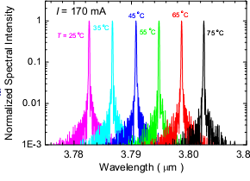
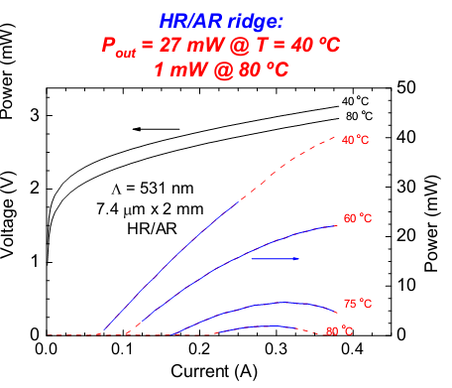
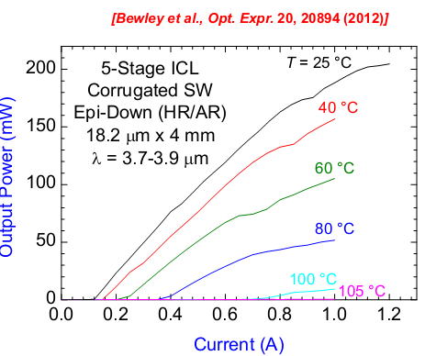
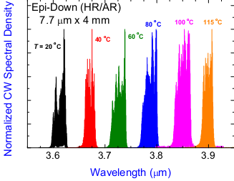
Figures of merit
Vurgaftman et al., Nature Com. 2, 585 (2011)
Single mode
High power
Revue: Vurgaftman et al., NJP 11, 125015 (2009), Meyer et al., Photonics West 2013
Notes:
50

