Slide 1

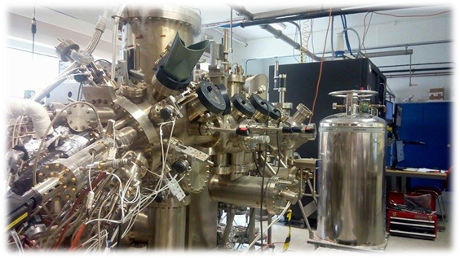




Dilute Nitrides for the Mid-infrared
A. Krier, M. Kesaria, Q. Zhuang
Physics Department Lancaster University, UK
A .V. Velichko, O.Marakovsky, D. Paola, A. Patane
School of Physics and Astronomy, University of Nottingham, UK
A. Polimeni, S. Birindelli, M. Capizzi
Physics Department, CNISM, Sapienza Università di Roma, Italy
PROMIS Summer School
Montpellier 2016

Slide 2
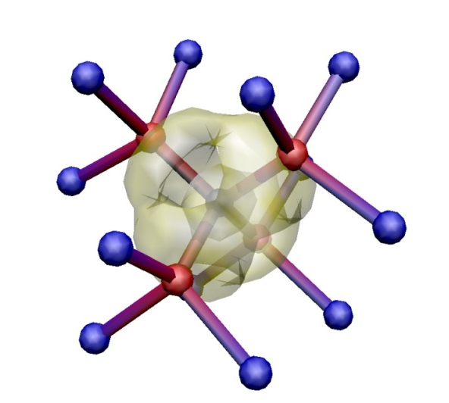
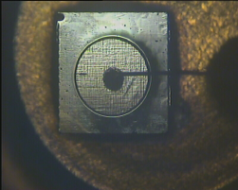

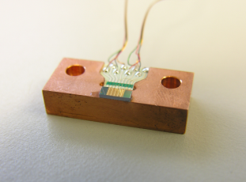
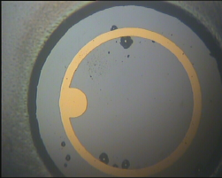
Outline
  Motivation
  MBE growth on InAs and GaAs
  Structural and optical properties
  Annealing and Hydrogenation
  Devices
N

Slide 3
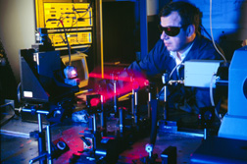
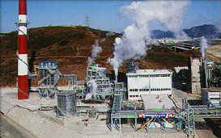

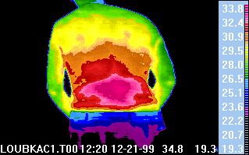
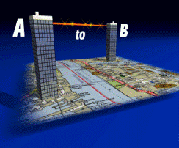
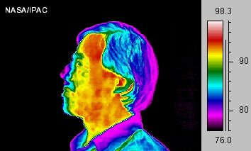
Motivation
Gas sensors - optical absorption;
CH₄, CO₂, CO
Industrial process control
Spectroscopy
Thermal imaging
Bio-medical diagnostics
Free space optical communications
(3-5 μm)
Military - infrared countermeasures
Principal gas absorptions in the mid-infrared
For these applications we need LEDs, lasers and detectors operating at Room Temperature

Slide 4
Mid-infrared - main challenges
imbalance in the DOS of InAs
Auger recombination (CHSH)
Inter-valence band absorption (IVBA)
Inadequate electrical confinement
small band offsets
No SI substrates
Addition of N :
- flexible wavelength tailoring
without complex growth
- de-tuning of CHSH resonance
Auger suppression
CB
1
1’
2’
E_{g}
InAsN dilute nitride alloys offer some possibilities for improvement??
HH
Δ₀
2
LH

Slide 5
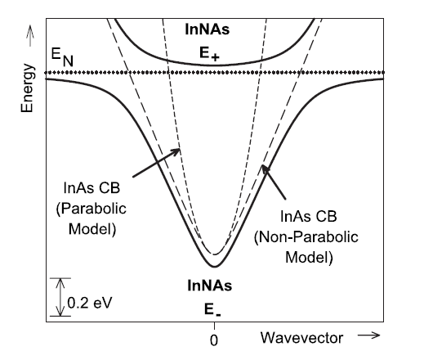
Band anti-crossing
Extended-localized state interaction
An empirical model
Anticrossing/repulsion between conduction-band edge and localized states
decreases the band gap
introduces minigap(s) at low k-value in the CB
GaAsN
E₊
E_{N}
E_{CB}
E₋
W. Shan et al., Phys. Rev. Lett. 82, 1221 (1999)

Slide 6
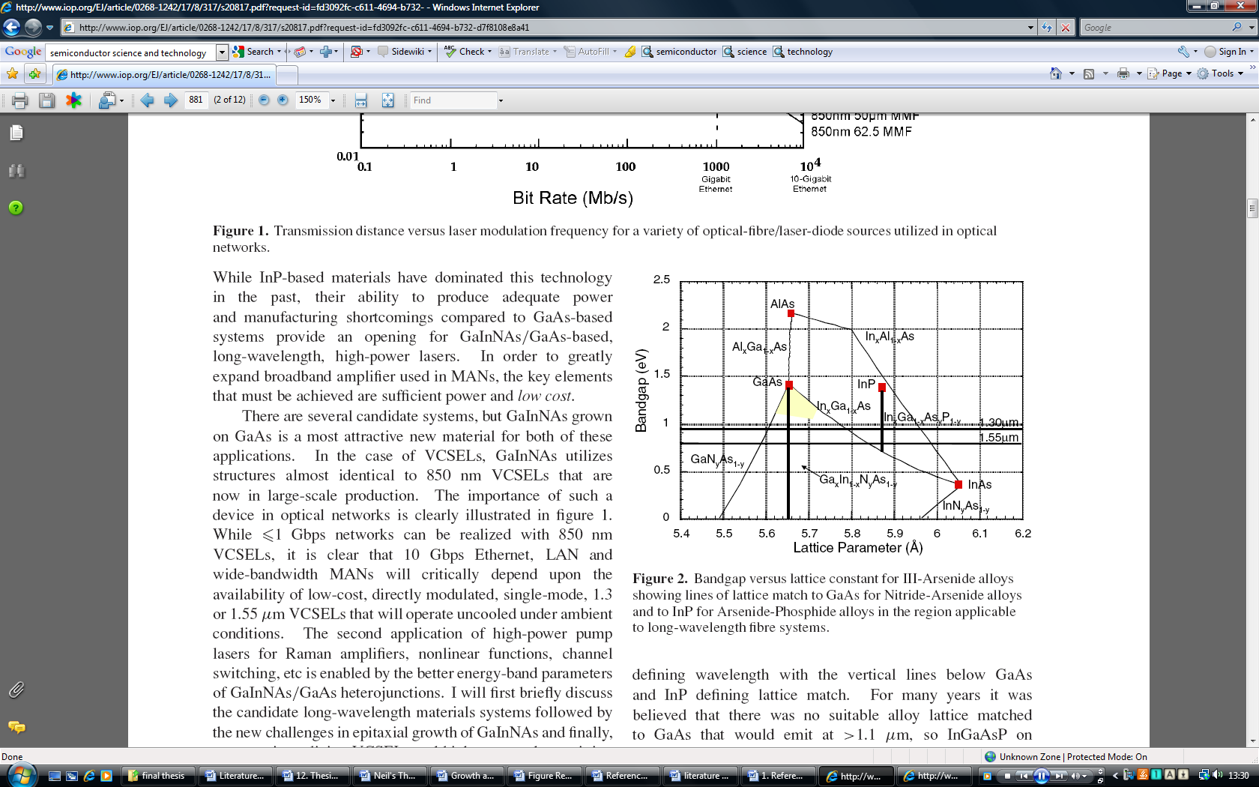
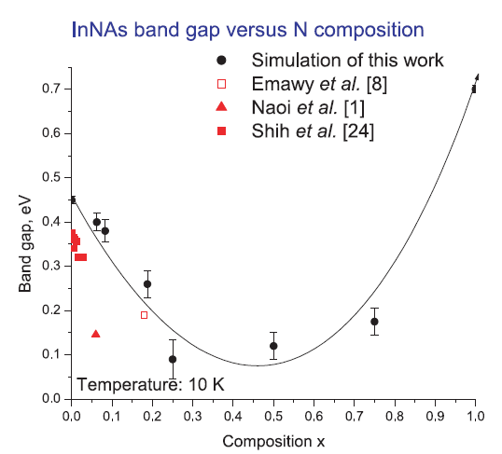
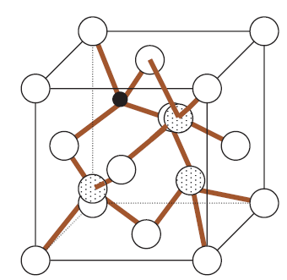
Dilute nitrides
D. Sentosa, X. Tang,a, and S.J. Chua, Eur. Phys. J. Appl. Phys. 40, 247–251 (2007)
InAs
InN
N introduces tensile strain (on InAs or GaAs)
disorder and strong bowing
N
Harris, J. S. Semiconductor Science and Technology 17, 880 (2002)

Slide 7
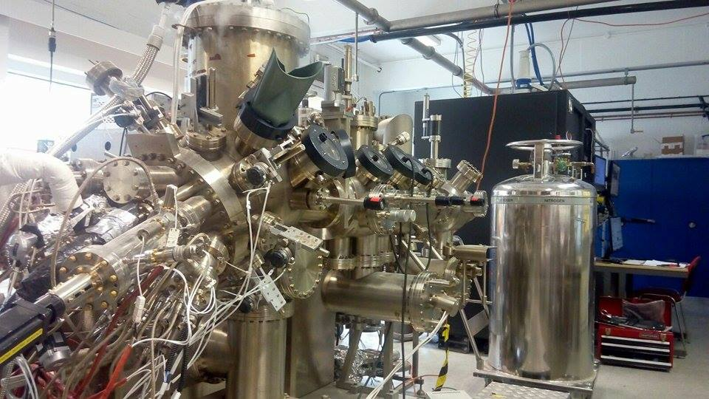
MBE Growth on InAs and on GaAs
V80 Molecular Beam Epitaxy (VG)
with RF Plasma Nitrogen source, As and Sb valved cracker cells (EPI)
Ga, In, Al and dopants GaTe and Be
Sample | T_{G} | Flux - As | Flux - N₂ | Plasma Power | N Content %
A0276 | 485 | 6.6x10-6 | n/a | n/a | n/a
A0282 | 420 | 2.2x10-6 | 6.12x10-7 | 160 | 0.6
A0285 | 442 | 2.2x10-6 | 6.12x10-7 | 160 | 0.2
A0299 | 376 | 2.2x10-6 | 6.3x10-7 | 160 | 1.0
A0300 | 450 | 2.8x10-6 | 5.0x10-7 | 160 | 0.4
Large parameter space for InAsN
InAsN successfully grown on InAs with N < 2% and PL observed out to 4.5 µm
For growth on GaAs
Optimum growth at substrate temperatures between 400⁰C- 440⁰C
Nitrogen plasma setting fixed at 160 W with flux of 5x10⁻⁷ mbar
Growth rate of ~1µm per hour
InAs control sample was grown under the same conditions

Slide 8
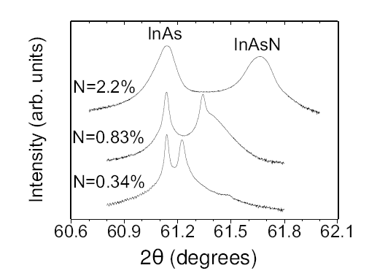
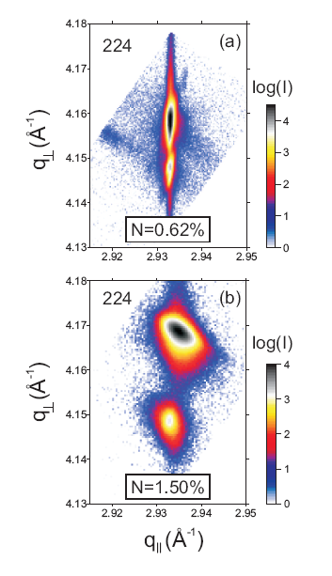

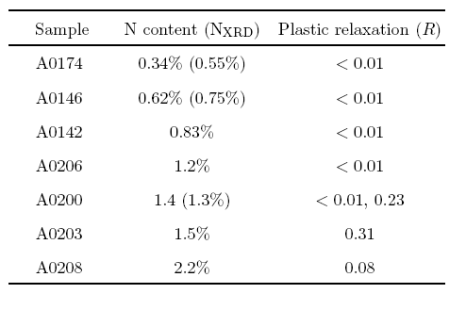
X-ray diffraction
2 different layer peaks obtained - 2 dominant N compositions
Plastic relaxation
Vertical and horizontal lattice deformations obtained
Gives relaxed lattice const.
and plastic deformation R
Layers with N< 1.2% are pseudomorphic
Bragg maps narrow in q_{II}
N > 1.2% more diffuse scattering from misfit dislocations & defects
Onset of plastic relaxation at N~ 1.4%
N=0.83% - tail indicates vertical N composition gradient
N=0.34% - thickness fringes – good interface quality
Growth rate decreases with increasing N
asymmetrical (224) reflections obtained for all samples

Slide 9
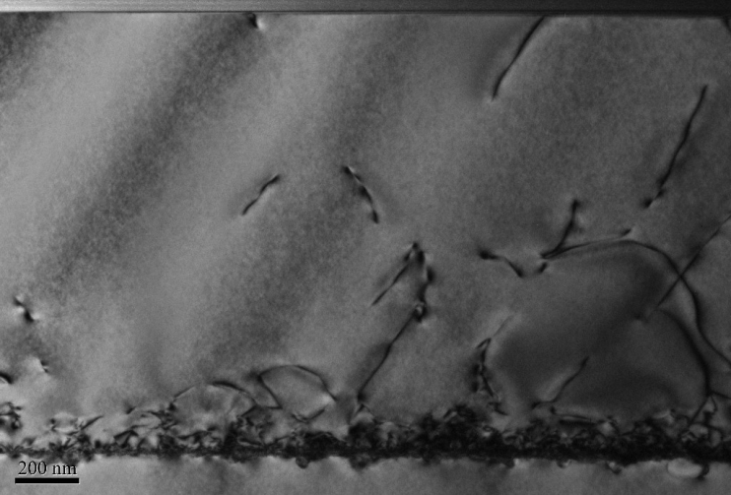
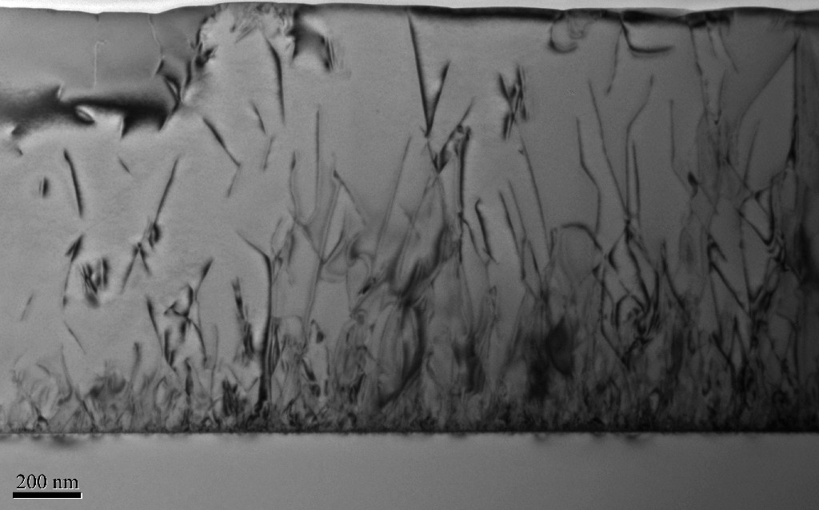
SIMS and TEM analysis
Ga
As
InAs/GaAs
In
200 nm
N
InAsN(1%) /GaAs
200 nm
N is uniform
No evidence of unintentional impurities (C, O etc.) as-grown InAsN is of high purity
Analysis of secondary ion peaks from CsAsN⁺ enables accurate N determination
-comparison with XRD data – N content is ~5% larger than determined from XRD
Significant incorporation of non-substitutional N
Higher dislocation density in InAsN – but obtain increase in PL
Localisation, non-uniform PL emission from regions around dislocations?

Slide 10
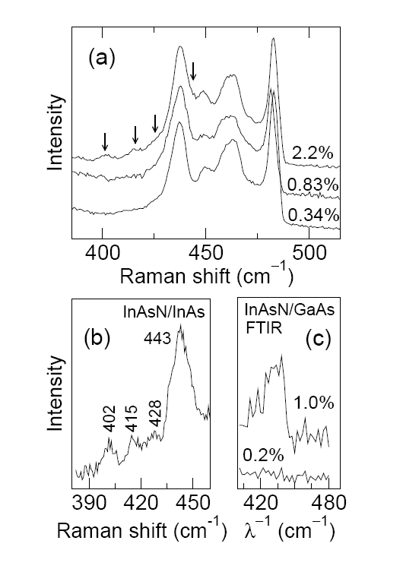
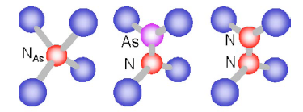
Raman spectroscopy
Weak InAs modes at 405 and 425 cm⁻¹ and
2nd order InAs optical modes at 435, 450, 460 and 480cm⁻¹
Additional N related features at 402, 415, 428 and 443 cm⁻¹
(Wagner et al. N ~ 1.2 %)
N related features
2nd order InAs modes
N_{AS}
As -N
N-N
difference spectrum of highest N – lowest N content
443 cm⁻¹ feature - also detected in FTIR
NAs LVM from substitutional ¹⁴N_{As}
402 cm⁻¹ and 415 cm⁻¹ peaks from non-substitutional N-N or As-N split interstitials, (N antisites or interstitial N) rather than N-In-N complexes
and As -N produce deviations from Vegard’s law
(Calculations predict N-N split interstitial at 419 cm⁻¹
but also predict that the As-N split interstitial lies well above the LVM in GaAsN)
Ibanez et al, JAP (2010)

Slide 11
Electrical properties InAsN on GaAs
Phonon scattering
impurity scattering
1000 nm n-type InAs(N)
Semi-insulating GaAs substrate
N reduces electron mobility
µ is limited by electron scattering by N-atoms, -pairs and clusters
Model for GaAsN predicts a strong reduction of the mobility and electron mean free path due to the N-levels
Weak dependence of µ on N-content compared to GaAsN due to the proximity of the N-related states to the CBE
Impurity scattering dominant at high N
Residual carrier conc. increases for N >0.4%
N incorporation introduces native donor states
A. Patanè et al Appl. Phys Lett. 93, 25106 (2008)

Slide 12
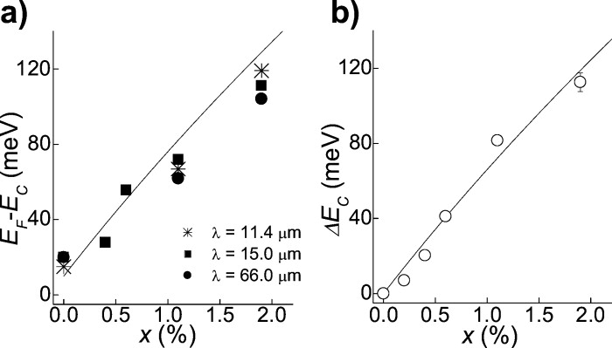
InAsN - Cyclotron Resonance
Pinning of the Fermi level
The increase of electron density with increasing N indicates a pinning of the Fermi level and implies a substantial density of native donor states
O. Drachenko et al. APL 98, 162109 (2011)

Slide 13
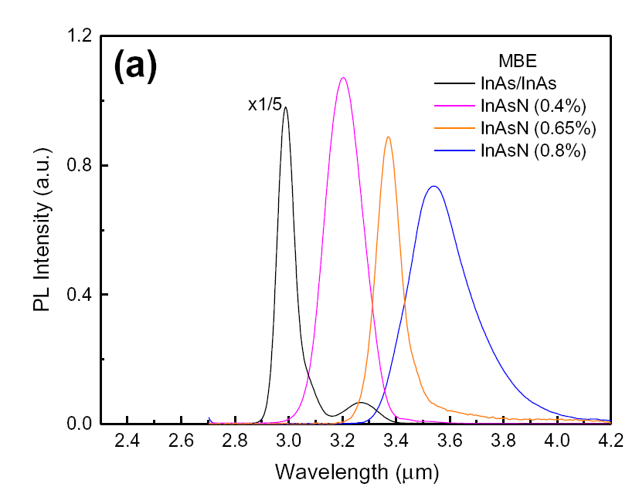

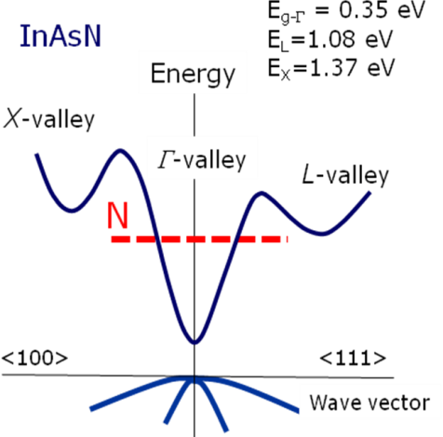
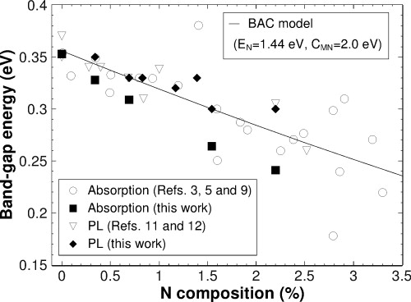
Photoluminescence InAsN on InAs
Incorporation of small amounts of N into III-V’s causes conduction band anti-crossing leading to reduction in band gap
Good agreement with band anti-crossing model
(60 meV per 1%N)
Long low energy tail appears - localisation
C_{MN} = 2.5 eV at 4 K
caused by uneven nitrogen distribution- composition fluctuations or point defects

Slide 14
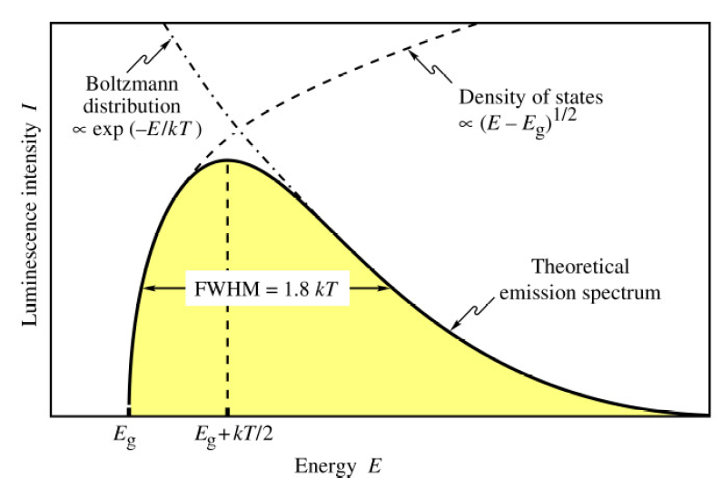
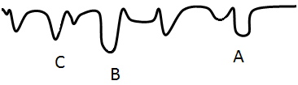
Photoluminescence Lineshape
PL is Gaussian at low T
As T increases becomes asymmetric with high energy tail
extends well above E_{g}
Lineshape - 2 effects
Localization at low T
Free carrier emission at high T
Conduction Band
Valence Band
J. Appl. Phys. 108, 103504 (2010)

Slide 15
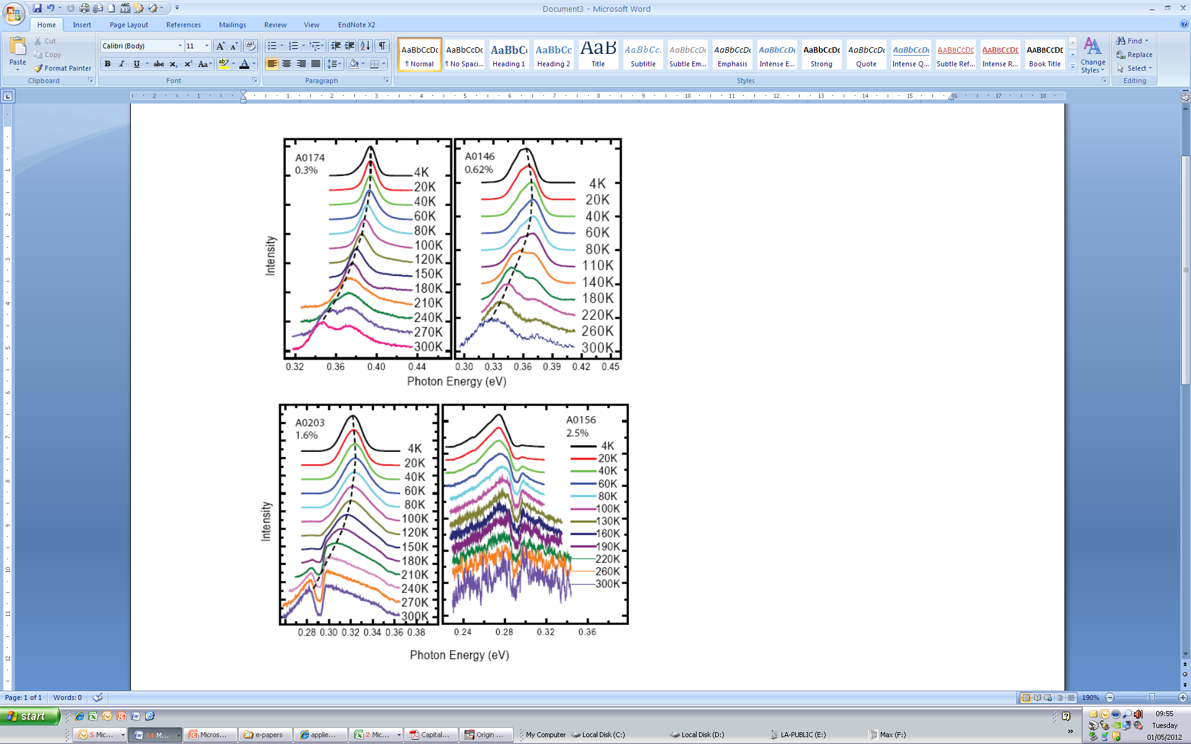
PL analysis temperature dependence
InAsN(1%) exhibits very weak temperature quenching ~ 8x
PL emission obtained up to room temperature without annealing
Peak wavelength near 4 µm – appropriate for CO₂ detection

Slide 16
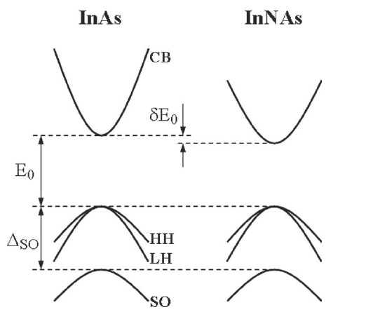
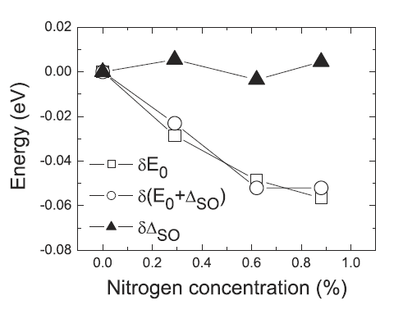
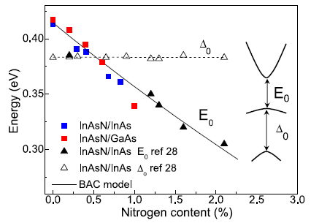
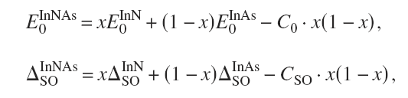
InAsN Photoreflectance
Solid lines are fits to
Where, x is the N content
N does not change Δ_{so}

Slide 17
InAsN on GaAs
4K PL
PL obtained from InAsN on GaAs across the mid-IR spectral range with addition of small quantities (~ 1%) of nitrogen
Good agreement with band anti-crossing model
Inclusion of nitrogen improves the peak intensity InAsN > InAs on GaAs
Photoreflectance shows Δ₀ is constant with increasing N
Activation energy increases with increasing N content – CHSH Auger detuning
improved PL

Slide 18
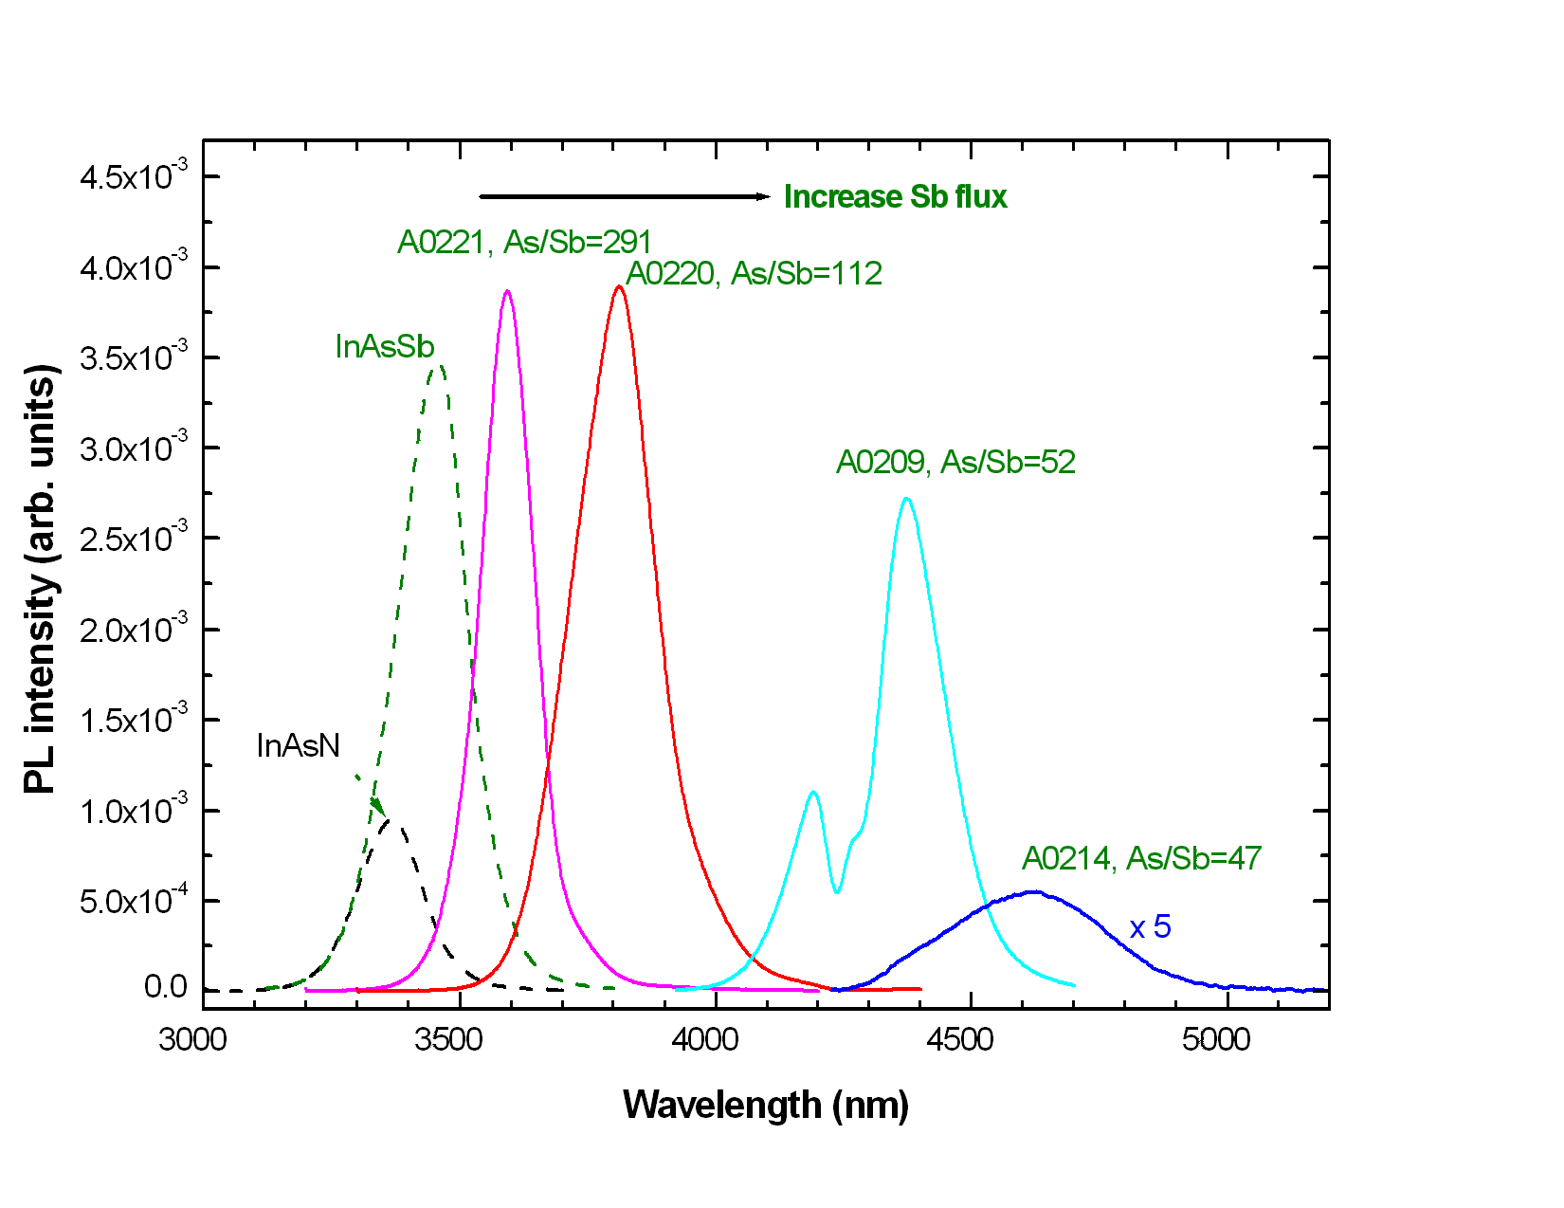
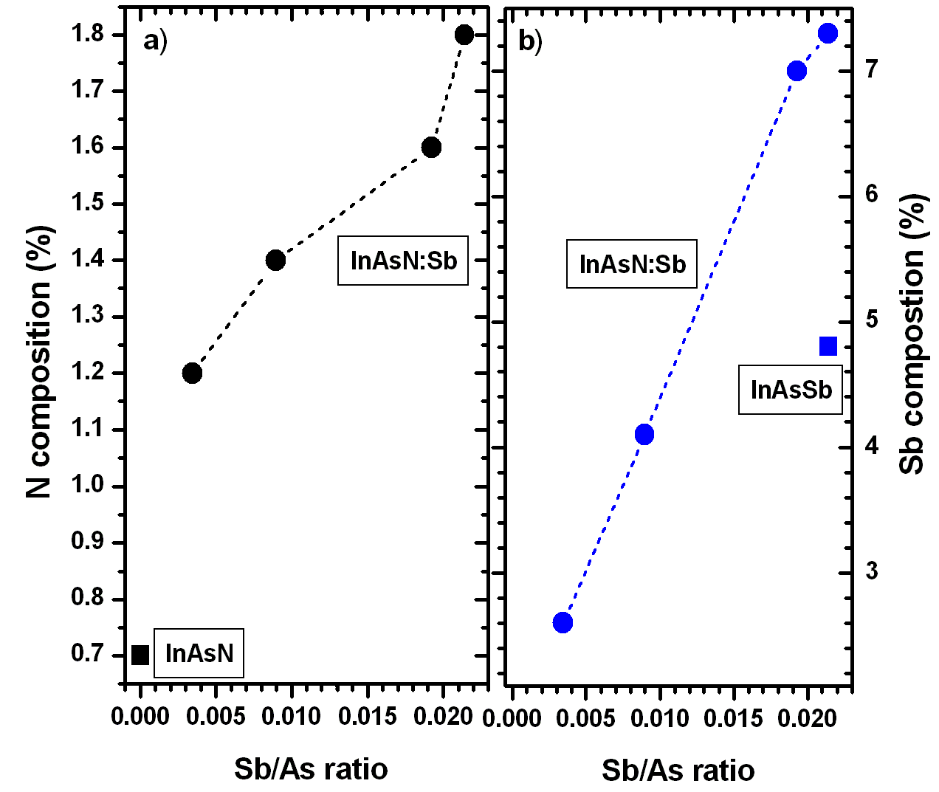
Adding Sb - MBE growth of InAsSbN
InAs
Conduction band
Adding N to InAs
Adding Sb to InAs
E_{g}
Valence band
Increasing N
Tensile strain
Increasing Sb
Compressive strain
N is hard to incorporate
Use Sb to reduce lattice mismatch increase N incorporation improve quality
Sb acts as surfactant to maintain 2D growth and reduces point defects - improves PL
Red-shift of emission wavelength
– need less N to reach longer wavelengths
Sb reduces N surface diffusion length - increases N incorporation ~ 2.5x
Reduction of Sb segregation induced by N - increases Sb incorporation ~1.5x

Slide 19
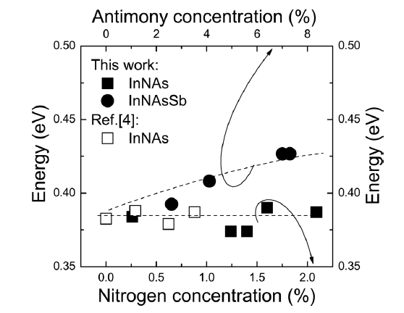
Photoreflectance
Δ_{so} > E₀ Auger suppression
Advantage of InAsNSb over InAsN
In-plane strain for layers grown on InAs
can be tuned from tensile to compressive
- Tailor polarization in QW to be either TE or TM
Sb increases confinement in valence band
- dominant polarisation is TE (e₁-hh₁)
Spin orbit splitting In InNAs & InAsNSb
Incorporation of Sb increases Δ_{so} and decreases E₀
N does not change Δ_{so}
Both Sb and N reduce E₀
~ 5 meV per 1% of Sb
~ 60 meV per 1% N
Kudrawiec et al. APL 99, 011904 (2011)

Slide 20
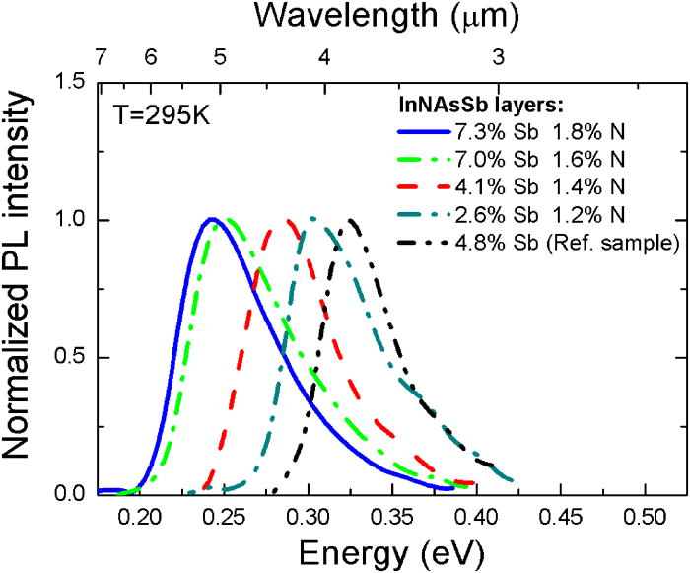
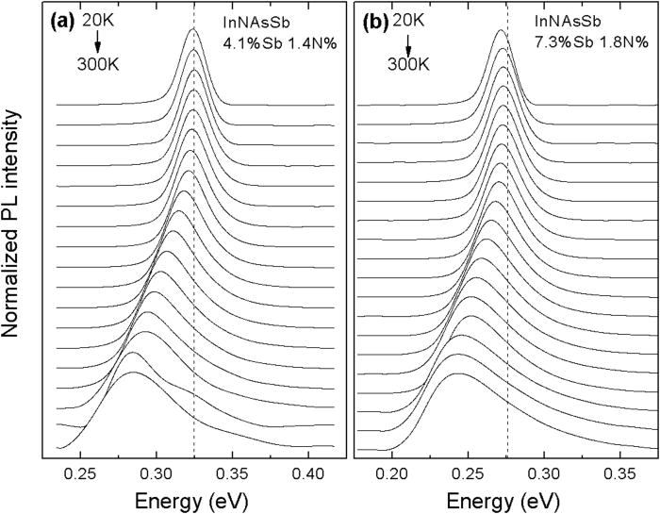
InAsSbN Photoluminescence
Strong PL at room temperature
- good optical quality
Asymmetric shape
Narrow energy gap – free carrier emission is important
Especially > 100 K
High energy tail extends well above E_{g}
Gaussian at low T
PL peak lower than E_{g} determined from PR
Characteristic S-shape but with weak carrier localisation
Stokes shift <10 meV
smaller than for InAsN
Composition fluctuations or point defects reduced due to surfactant effect of Sb
Latwoska et al, Appl. Phys. Lett 102, 122109 (2013)

Slide 21
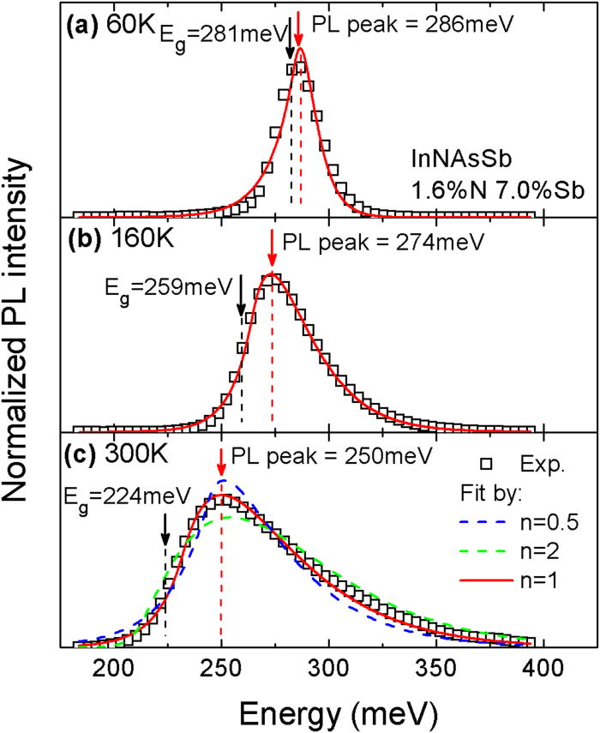


Photoluminescence curve fitting
Fit using
Includes localized and band-band transitions
A = scaling factor
E_{cr} = energy of crossover between equations
K = smoothing parameter
σ relates to slope of DOS
Set K = k_{B}T/σ and E_{cr} = Eg + k_{B}T/σ
n= 0.5 to 2 for momentum conserving non-conserving transitions
Best fit when n=1
Black arrows – E_{g} determined from PL fitting
Red arrows – PL peak
Note the difference which increases with T
Latwoska et al, Appl. Phys. Lett 102, 122109 (2013)

Slide 22
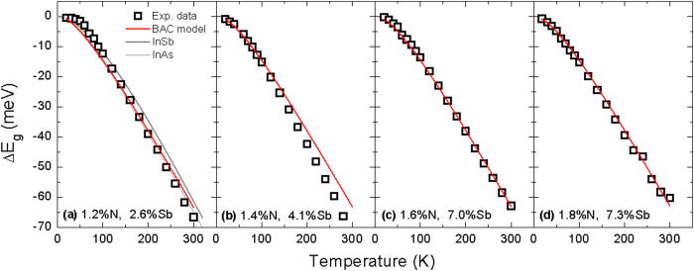

Temperature dependence of bandgap
Comparison of change in energy gap with T
InNAsSb 65 meV
InAs 66 meV
InSb 62 meV
whereas 1% N in GaAs reduces T dependence of E_{g} by 40%
BAC model gives good agreement
T dependence of Eg in InNAsSb is not
sensitive to N due to large separation between E_{N} and E_{M} (~ 1 eV)

Slide 23
Rapid thermal annealing of InAsN/GaAs
Rapid thermal annealing (RTA): 30 sec in N₂
4K PL enhanced by 25-30 times due to a reduction in SRH recombination
RT PL intensity increased only moderately
RTA causes reduction in point defects but not in Auger recombination
Slight blue shift (10 meV) in PL emission peak energy: due to small decrease in N ~0.1%

Slide 24
Increase in PL efficiency of RTA InAsN/InAs
4K PL enhanced by 25-30 times due to reduction in SRH recombination
Slight blue shift (17 meV) in PL emission peak energy: due to decrease in N ~0.15%
Kesaria, M. et. al . Infrared Physics & Technology 2015, 68, 138-142

Slide 25
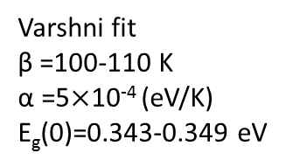

Passivation of localized states & Temperature Quenching
InAsN(1%)/GaAs
as-grown
InAsN(1%)/GaAs
InAs/GaAs
E_{g}(T)=E_{g}(0) $–\frac{α T^{2}}{(T+β)}$
Conduction Band
Varshni fit
β =100-110 K
α =5$×$10⁻⁴ (eV/K)
E_{g}(0)=0.343-0.349 eV
Introduction of N reduces thermal quenching
But, RTA increases thermal quenching rate
Localisation is reduced
Valence Band
RTA reduces localisation and improves N compositional uniformity

Slide 26
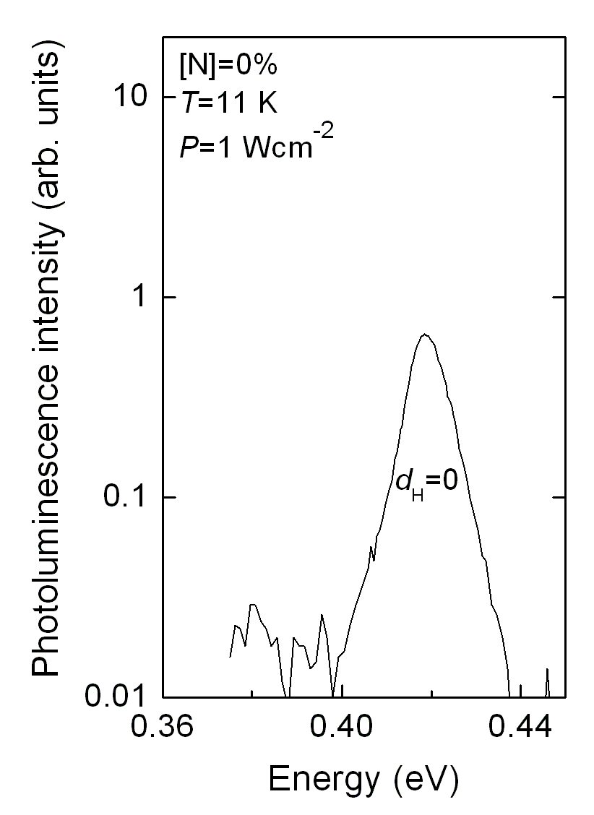
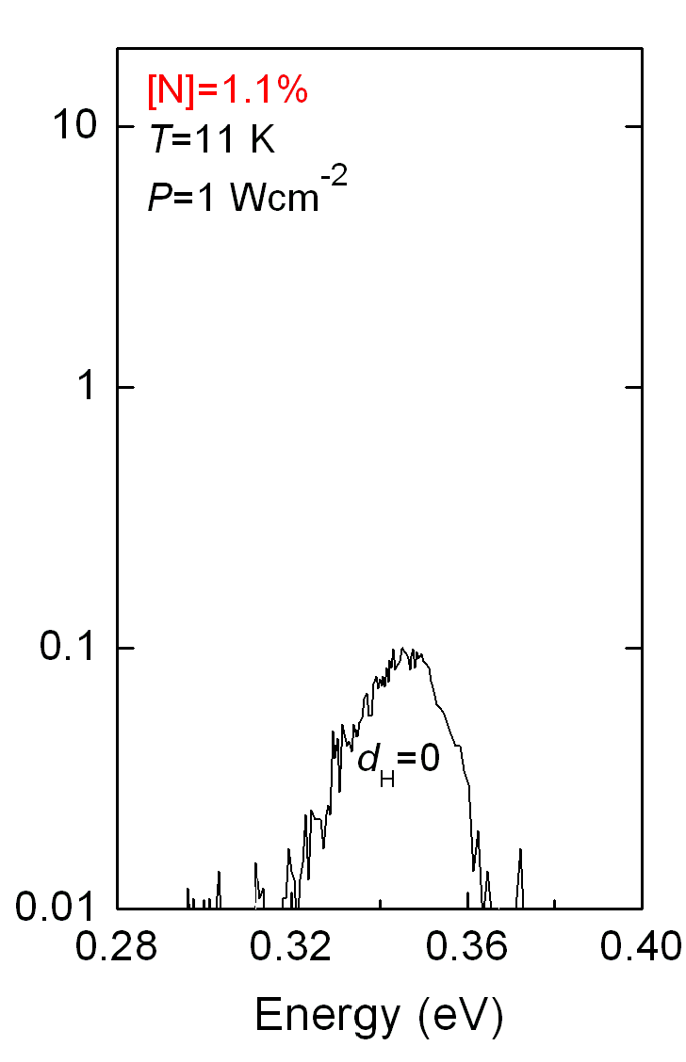
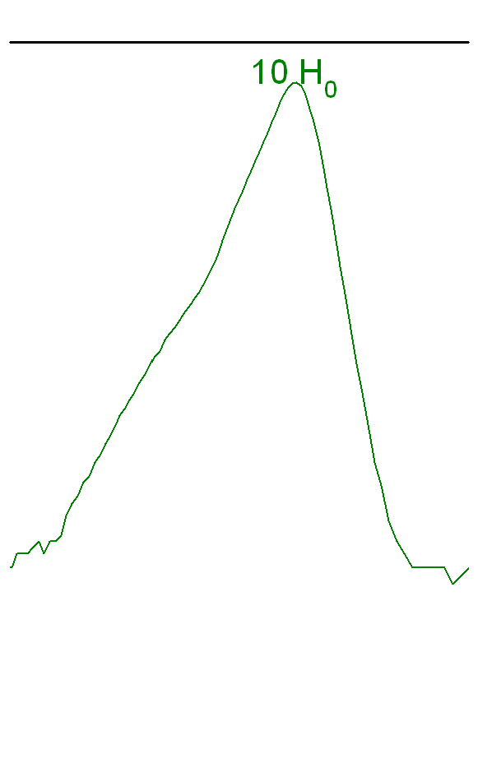
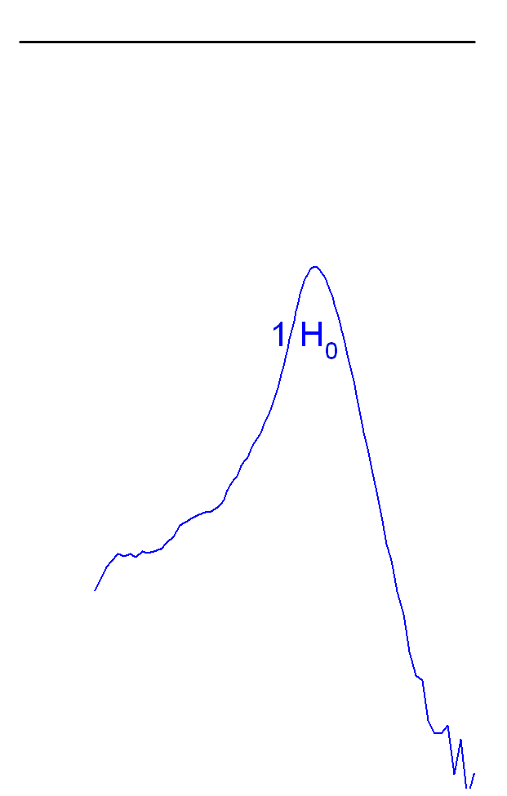
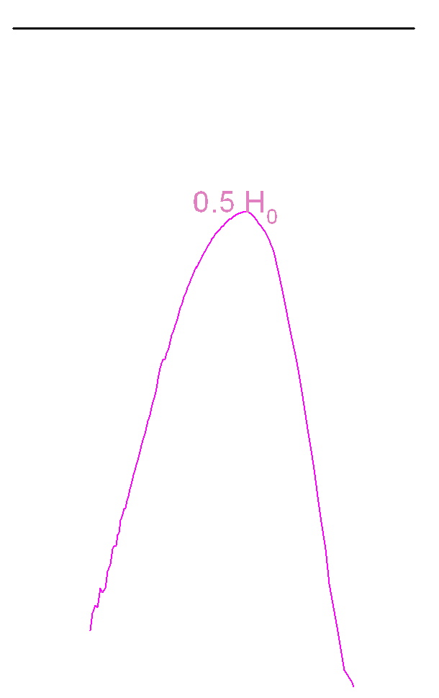
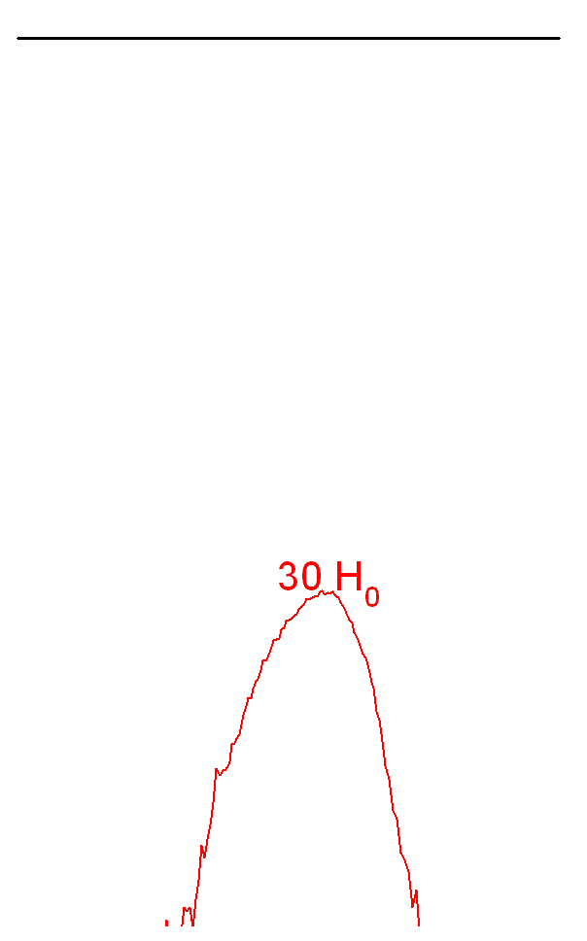
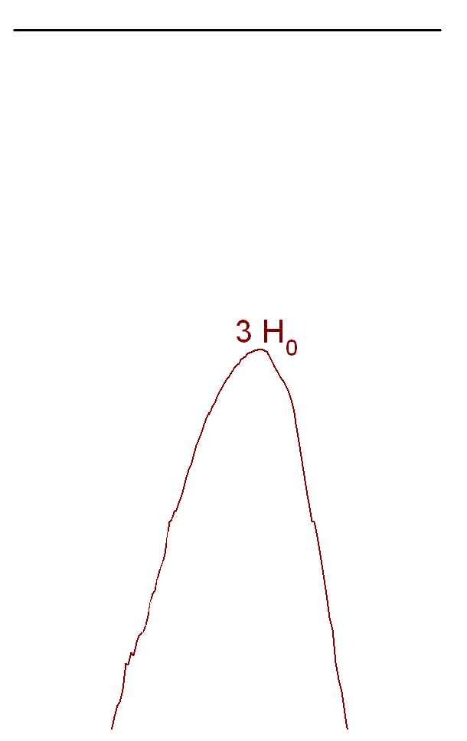
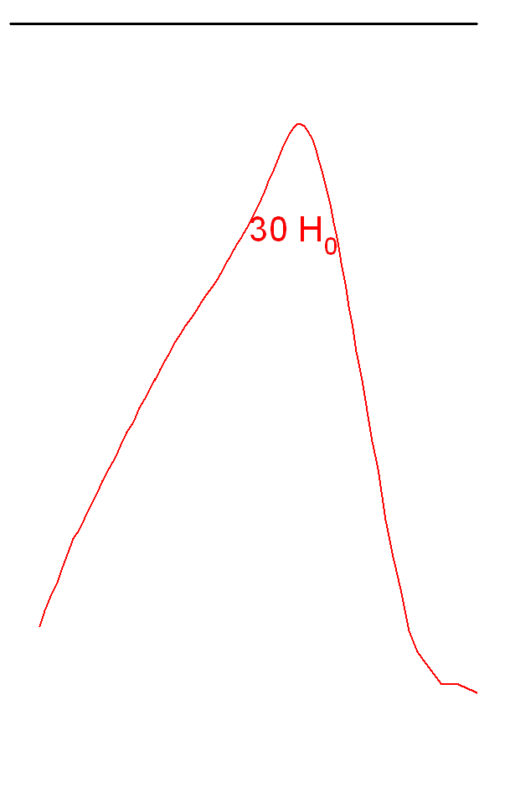
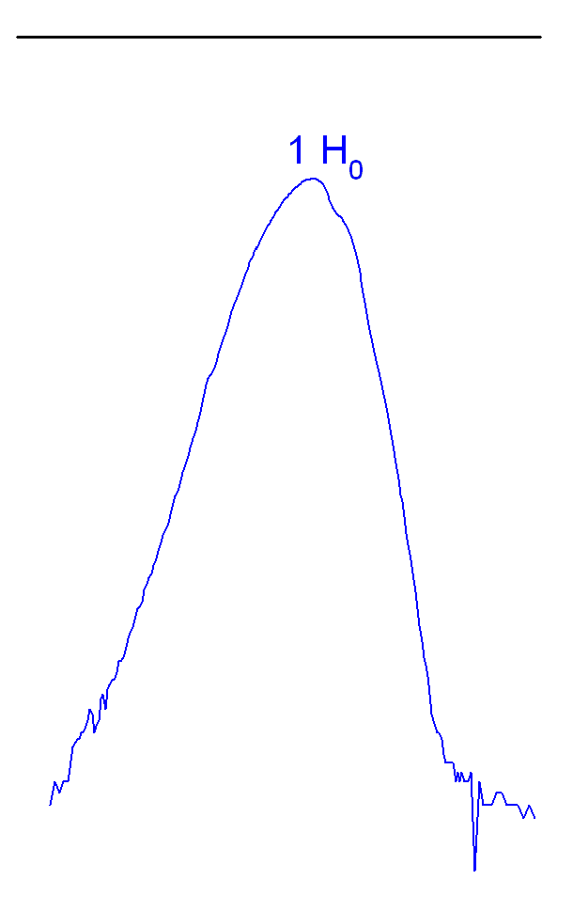
H irradiation - Increase in PL efficiency
T_{H} = 250 °C
H-dose H₀ = 1×10¹⁶ cm⁻²
[N]=0, InAs
PL efficiency first increases with H dose, reaches a maximum value
then it saturates and decreases at higher H doses
The same behavior is observed for [N]≠0, In(AsN)
Notice that hydrogenation conditions and H doses resulting in maximum increment in PL efficiency depend on [N]

Slide 27





Hydrogen diffusion and trapping: SIMS
T_{H} = 250 °C
[N]=0
[H]=10×10¹⁶ cm⁻²
D diffuses −see inset− to the InAs/GaAs interface, where it is trapped and accumulates
[N]=1.1%
[H]=1×10¹⁶ cm⁻²
X-TEM
X-TEM images highlight a non-homogeneous concentration of threading dislocations at the InAs/GaAs highly mismatched interface
D diffuses and traps (at N sites)
D does not reach the InAs/GaAs interface

Slide 28
Passivation of localized states
As-grown samples:
High density of localized states
S-shaped of E_{peak} vs T
- RT emission is not achieved
Temperature (K)
[H] = 1×10¹⁶ cm⁻²
Hydrogenated samples:
- PL efficiency increases
localized states are passivated, E_{peak}
increases
- a sizable RT emission is achieved

Slide 29
Thermal recovery of the as-grown PL efficiency
[N]=1.1%
[H] = 1×10¹⁶ cm⁻²
attempt frequency value typical of N-H local modes
Two activation energies two different nonradiative defects are passivated by H

Slide 30



InAsN QW lasers on InP
InAsN ridge lasers operating up to 2.6 µm have been demonstrated – grown by gas source MBE
limited by N incorporation and critical thickness
4 QW InAsN/InGaAs on InP (5μs pulse width, 500 Hz repetition rate)
Max. operating temperature 260 K with T₀ = 110 K
Decreasing growth temp incorporates more N
….but reduces QW quality
D. K. Shih, H, H. Lin, and Y. H. Lin, IEE Proc. Optoelectronics 150, 253 (2003)

Slide 31
InAsSbN / InAs MQWs
100 nm InAs Capping Layer
10x InAsNSb /InAs QW
(12x24 nm)
Growth of the MQWs calibrated using the same growth method of previously grown InAsNSb bulk layers
200 nm InAs Buffer Layer
InAs substrate
200 nm InAs Buffer layer grown at 480°C
10x InAsSbN/InAs QW grown at 420°C
  Growth rate of 0.5µm per hour
  Nitrogen plasma setting fixed at 160 W with flux of 6×10⁻⁶ mbar
100 nm InAs Capping Layer grown at 480°C
As flux kept at minimum for growth of InAs layers

Slide 32

InAsSbN/InAs MQW 4K photoluminescence
N =1%, Sb 6%
Band alignment determined by modification of InAsSb - Type II alignment with conduction and valence band offsets of 39 & 82 meV
ADDITION OF N :
  Reduction in overall strain Reduction of
  band gap
  Conduction band further reduced by BAC model
  Reduction of 63 meV
No blue-shift with excitation power - Type I QW
3.48 µm
3.62 µm (expt.)

Slide 33


InAsSbN MQW LED
300 K EL
p-i-n diode containing 10x
InAsSbN QW in active region N =1%, Sb 6%
Longest wavelength dilute nitride
light emitting device to date
C-H
absorption
p InAs
InAsNSb MQW
n InAs
InAs (100) substrate
p⁺-InAs
n⁺-InAs
4 K EL
InAsSbN e-hh1
InAsSb e-hh1
InAsSb e-hh2
LED output power : 6 µW at 100 mA drive current and internal RT efficiency ~ 1%

Slide 34
Comparison with InAsSb
InAsSbN MQW LED
N =1%, Sb 6%
InAsSbN e-hh1
InAsSb e-hh1
InAsSb e-hh2
Comparison of the temperature dependence of the EL with that of type II InAsSb/InAs reveals more intense emission at low temperature
Improved temperature quenching up to T~200 K where thermally activated carrier leakage becomes important and further increase in the QW band offsets is needed
Increasing the nitrogen content above 0.5% reduces the band gap sufficiently such that the energy gap E_{o} becomes less than Δ_{so} effectively detuning the CHSH Auger recombination mechanism

Slide 35
InAsSbN MQW p-i-n photodetector
R₀A ~1/n
R₀A ~1/n²
Cut-off λ ~ 4 μm
Ideality factor = 1.6
R₀A
T<120 K generation-recombination dominates
T>220K diffusion limited recombination is dominant
Capacitance at 0V =2.54 nF
Built in potential = 0.19 V
Carrier concentration = 8.3x10¹⁷ cm⁻³

Slide 36


In(AsN) Resonant Tunnelling Diodes (RTDs)
A multi-layered p-i-n RTD structure grown by MBE with an InAsN QW layer embedded between two InAlAs barriers.
Optical mesa diodes and TO5 headers for electrical and optical studies

Slide 37
Low-T current-voltage characteristics
Extended negative differential resistance (NDR);
Ohmic region at low bias voltages;
Additional resonance features in the differential conductance.

Slide 38
Following the NDR from low to room temperature
The NDR is not observed in InAs and is weakly affected by T
Two transport processes
Thermal diffusion
Zener tunnelling
through N-related states
(50 meV below CB)

Slide 39
Magneto-tunnelling Spectroscopy (MTS)
An e⁻ travelling a distance s under the effect of an electric field F and a transverse magnetic field B gains
Δk_{y}
B_{x}
Energy
e
Wave vector
The tunnelling current can be expressed as an overlap integral of emitter and 0D
states in k-space:
Mapping |ψ|²
in k-space
Δk ~ B
ψ_{0D}
k
Sakai, J.-W. et al Probing the wave function of quantum confined states by resonant magnetotunneling, Phys. Rev. B 48, 5664 (1993)
Vdovin E.E. et al. Imaging the Electron Wave Function in Self-Assembled Quantum Dots. Science 290, 122-124 (2000)

Slide 40
Summary
Successful MBE growth of InAsN directly onto InAs and GaAs substrates with N up to ~ 2%
Behaviour of N in InAs different to N in GaAs
Fermi level pinning and native donor states
PL covers the mid-infrared (2-5 μm) spectral range in good agreement with the BAC model
Localisation and free carrier effects are important in interpretation of PL spectra
N reduces band gap but has little effect on T sensitivity
Photoreflectance shows N has no effect on Δ_{o ,} Auger CHSH de-tuning is possible
Addition of Sb increases N incorporation –structural and optical properties
- improved and bright PL obtained from Type I InAsSbN/InAs MQWs
First long wavelength dilute N LED operating at 300 K
good prospects for device applications if electron concentration can be controlled

Slide 41
RTA reduces native point defect concentration & improves material uniformity
4K PL intensity increased by ~ 20x
Elimination of deep fluctuations in conduction band leads to reduced localization in annealed samples but causes an increase in thermal quenching
Increasing doses of H irradiation of In(AsN) leads to a passivation of localised states
and an increase in PL efficiency ~20x at low H doses
First InAsN resonant tunnelling diodes – MTS to probe localised defect states

Slide 42



Acknowledgements
  A. Patane Nottingham University Transport measurements
  R. Beanland & A. Sanchez University of Warwick TEM
  J. Ibanez University of Madrid Raman spectroscopy
  R. Kudrawiec Institute of Physics, Wroclaw Photoreflectance
O. Drachenko Helmholtz-Zentrum
M. Helm Dresden-Rossendorf Cyclotron resonance studies
M. Schmidbauer Leibniz-Institute, Berlin X-ray diffraction measurements
  S. Birindelli, M. De Luca,
  A. Polimeni and M. Capizzi CNISM and Physics Department Hydrogenation studies
  Sapienza Università di Roma, Italy
  We are grateful for financial support provided from EPSRC (EP/J015849/1) and the EU Marie Skłodowska-Curie ITN -PROMIS (H2020-MSCA-ITN-2014-641899)

