Slide 1


MODELING OF LINEAR AND NONLINEAR PROPERTIES OF NIGHT-TIME
HEART RATE VARIABILITY
Mateusz Soliński, Jan Gierałtowski, Jan Żebrowski
Faculty of Physics, Warsaw University of Technology, Warsaw, Poland
Notes:
Mat

Slide 2
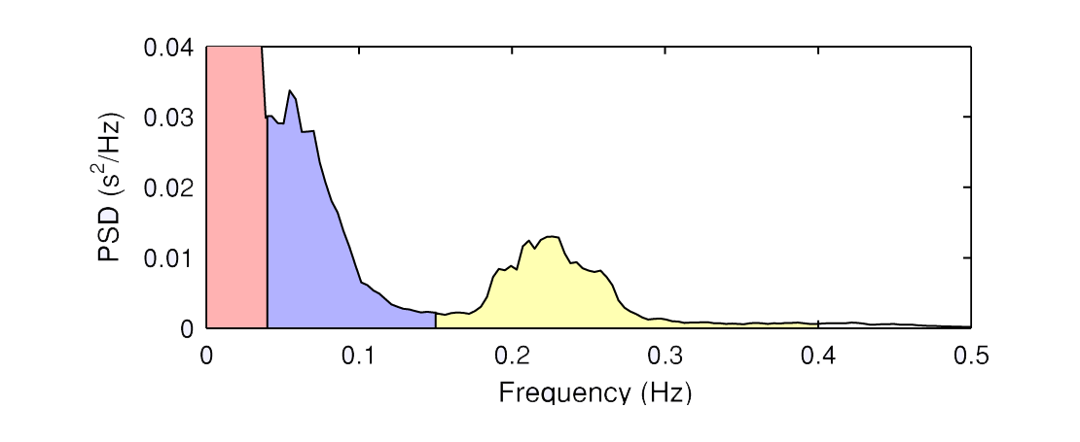
INTRODUCTION
heart rate variability (HRV) is a nontrivial signal with a wide spectrum of frequencies and complex fluctuations
we can find some interesting models of HRV in the literature proposed by Ivanov et al. (2001), Lin (2002), McSharry et al. (2002) or Kantelhard et al. (2003)
the vagal contribution and the sympathetic nervous system, operate on the heart rate in the high frequency (HF) and low frequency (LF) ranges (Parati et al. 2006, Mainardi 2009)
however, the majority (ca. 95%) of the signal total power is determined by very low frequency (VLF) and ultra-low frequency (ULF) components
VLF
LF
HF
Notes:
Dodać gdzieś odniesienia do poprzednich modeli

Slide 3
HYPOTHESES
the dominating component of heart rate variability is random
Notes:
Wybrać jedno

Slide 4
HYPOTHESES
the dominating component of heart rate variability is random
random component is combined with other non-stochastic components
e.g., the interaction with breathing
Notes:
Wybrać jedno

Slide 5
HYPOTHESES
the dominating component of heart rate variability is random
random component is combined with other non-stochastic components
e.g., the interaction with breathing
sleep architecture has a significant effect on HRV (Kantelhardt et al. 2003)
Notes:
Wybrać jedno

Slide 6
DATA
HRV database*:
34 night-time RR time interval series from healthy adults: 6 females, 28 males
mean age: 34y (16-54y),
Sample frequency: 128 Hz,
less than 5% of ectopic beats in each recording
Hypnogram-EEG database**:
30 hypnograms derived from complete electroencephalogram (EEG) recordings from healthy adults: 4 female, 26 males
mean age: 40.8 y (23-57y)
specific sleep phases were identified by a qualified neurologist in 5-min windows with a 20-s offset.
*anonymous Holter electrocardiogram (ECG) database of the Institute of Cardiology (Warsaw, Poland)
**database of the Faculty of Psychiatry, Warsaw University of Medicine (Warsaw, Poland)
Notes:
Magda

Slide 7
REFERENCE MODEL
(for comparison analysis)
P. E. McSharry, G. Clifford, L. Tarassenko, and L. A. Smith, “Method for generating an artificial RR tachogram of a typical healthy human over 24-h,” Comput. Cardiol. 29, 225–228 (2002).
with update:
P. E. McSharry and G. Clifford, “A statistical model of the sleep-wake dynamics of the cardiac rhythm,” Comput. Cardiol. 32, 591–594 (2005).
Main features:
generating RR time series using the inverse Fourier transform obtained from a bimodal power spectrum that is a sum of two Gaussian distributions
mechanism switching between the states of sleep and wake
Notes:
Magda

Slide 8
MODEL DESCRIPTION
Notes:
Magda

Slide 9
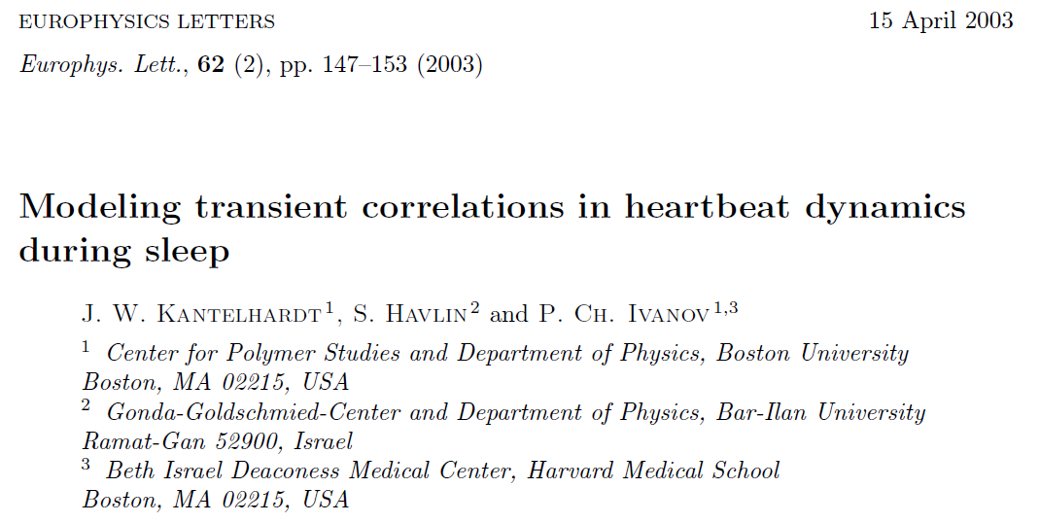
I. STARTING POINT: MODEL OF HEART RATE
VARIABILITY FOR THE DIFFERENT SLEEP STAGES
Features:
stochastic properties
focused on transient correlations, i.e., correlations in the finite segments of the signal in which change occurs gradually or abruptly according to physiological function
simulate HRV in different sleep stages
Notes:
Magda

Slide 10
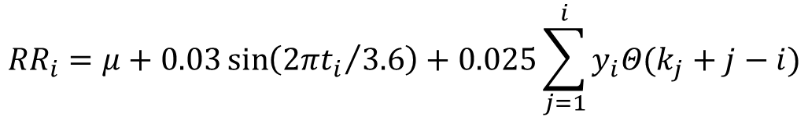
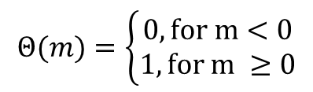
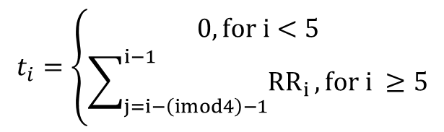
I. STARTING POINT: MODEL OF HEART RATE
VARIABILITY FOR THE DIFFERENT SLEEP STAGES
Main equation:
$${RR}_{i}=μ+0.03\sin\left({2πt_{i}}/{3.6}\right)+0.025\sum_{j=1}^{i}{y_{i}Θ(k_{j}+j−i)}$$
periodic component
(cardio-respiratory coupling)
stochastic compontent
baseline
Symbols:
$$t_{i}=\left\{\begin{aligned}0, for i<5 \\ \sum_{j=i−\left(imod4\right)−1}^{i−1}{{RR}_{i}}, for i ≥5\end{aligned}\right.$$
$$Θ(m)=\left\{\begin{aligned}0, for m<0 \\ 1, for m ≥0\end{aligned}\right.$$
µ - constant
k_{j,} y_{i,} - random variables
(different distrinution in
each sleep stage)
Notes:
Magda

Slide 11
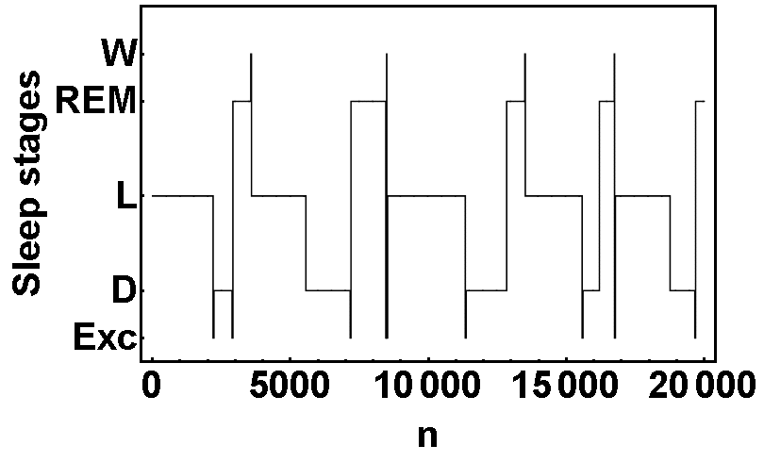
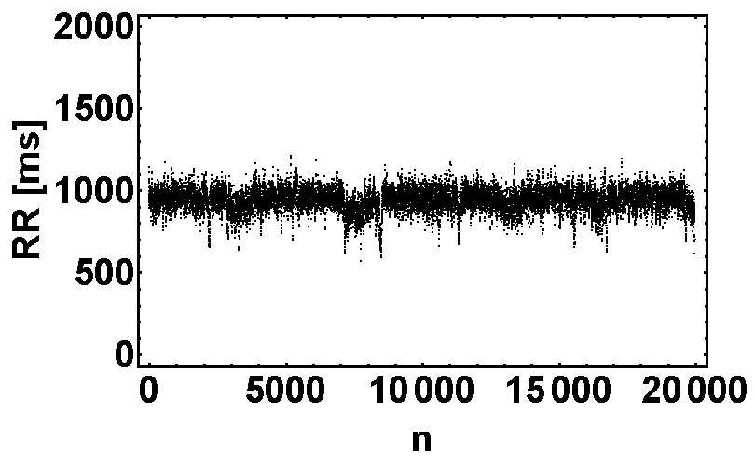
I. STARTING POINT: MODEL OF HEART RATE
VARIABILITY FOR THE DIFFERENT SLEEP STAGES
a
b
FIG. 1. Hypnogram consisting of cyclic sets of sleep stages as suggested by Kantelhardt et al. (a) and the synthetic RR time series obtained from this concept (b).
Notes:
Magda

Slide 12
II. SYNTHETIC HYPNOGRAM
(based on own ideas)
Two features:
probabilities of the transitions between all possible pairs of phases
probability distribution of phase durations
I half of sleep – matrix of probability |  |  |  |  |  | Sleep stage occurrence [%]
Sleep stage | L | D | REM | W | EXC
L | - | 0,478 | 0,049 | 0,052 | 0,422 | 59,3
D | 0,752 | - | 0,000 | 0,017 | 0,221 | 27,6
REM | 0,760 | 0,000 | - | 0,119 | 0,121 | 4,9
W | 0,049 | 0,000 | 0,89 | - | 0,060 | 5,4
Exc | 0,484 | 0,038 | 0,301 | 0,177 | - | 2,7
II half of sleep – matrix of probability |  |  |  |  |  | Sleep stage occurrence [%]
Sleep stage | L | D | REM | W | EXC
L | - | 0,222 | 0,092 | 0,113 | 0,573 | 66,5
D | 0,776 | - | 0,020 | 0,041 | 0,163 | 10,8
REM | 0,691 | 0,003 | - | 0,182 | 0,124 | 07,6
W | 0,087 | 0,000 | 0,803 | - | 0,110 | 12,1
Exc | 0,386 | 0,000 | 0,364 | 0,250 | - | 3,0
Gamma distribution: light sllep (L), deep sleep (D), REM.
Exponential distribution: wake stage (W)
Exercise episodes: 30 samlpes per event
TABLE I. Probability matrices of transitions between all possible pairs of sleep stages, together with the percent of occurrence of the sleep stages in the complete time series.
Notes:
Magda

Slide 13
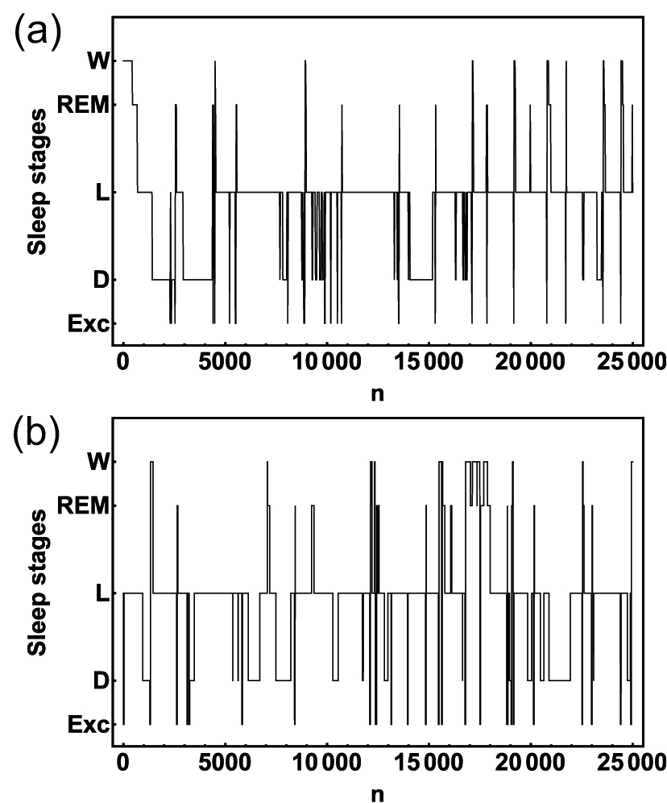
II. SYNTHETIC HYPNOGRAM
(based on own ideas)
Two features:
probabilities of the transitions between all possible pairs of phases
Probability distribution of phase durations
Gamma distribution: light sllep (L), deep sleep (D), REM.
Exponential distribution: wake stage (W)
Exercise episodes: 30 samlpes per event
FIG. 2. Real hypnogram obtained from a healthy person (a) and a synthetic hypnogram generated using our model (b).
Notes:
Magda

Slide 14
III. ADDITIONAL MODEL EXTENTIONS
remove discontinuities in the signal during sleep stage change
Notes:
Magda

Slide 15
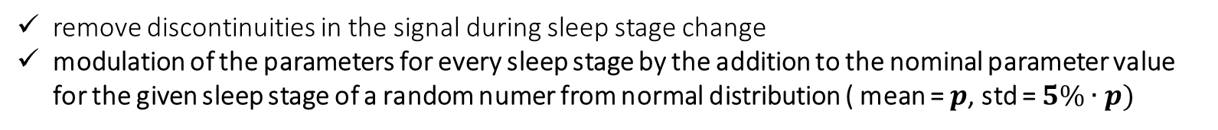
III. ADDITIONAL MODEL EXTENTIONS
remove discontinuities in the signal during sleep stage change
modulation of the parameters for every sleep stage by the addition to the nominal parameter value for the given sleep stage of a random numer from normal distribution ( mean = $p$, std = $5\%∙p)$
Notes:
Magda

Slide 16
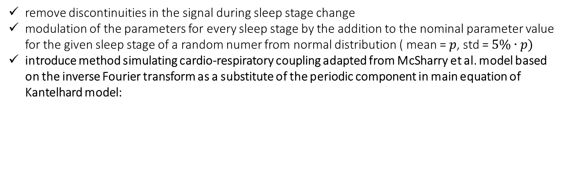
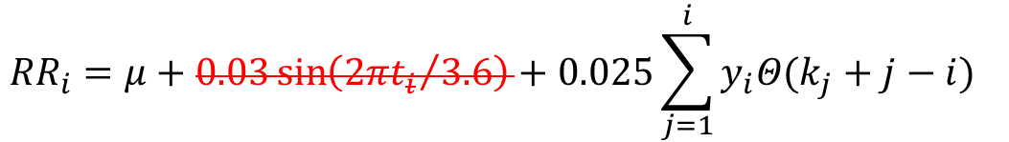
III. ADDITIONAL MODEL EXTENTIONS
remove discontinuities in the signal during sleep stage change
modulation of the parameters for every sleep stage by the addition to the nominal parameter value for the given sleep stage of a random numer from normal distribution ( mean = $p$, std = $5\%∙p)$
introduce method simulating cardio-respiratory coupling adapted from McSharry et al. model based on the inverse Fourier transform as a substitute of the periodic component in main equation of Kantelhard model:
$${RR}_{i}=μ+0.03\sin\left({2πt_{i}}/{3.6}\right)+0.025\sum_{j=1}^{i}{y_{i}Θ(k_{j}+j−i)}$$
Notes:
Magda

Slide 17
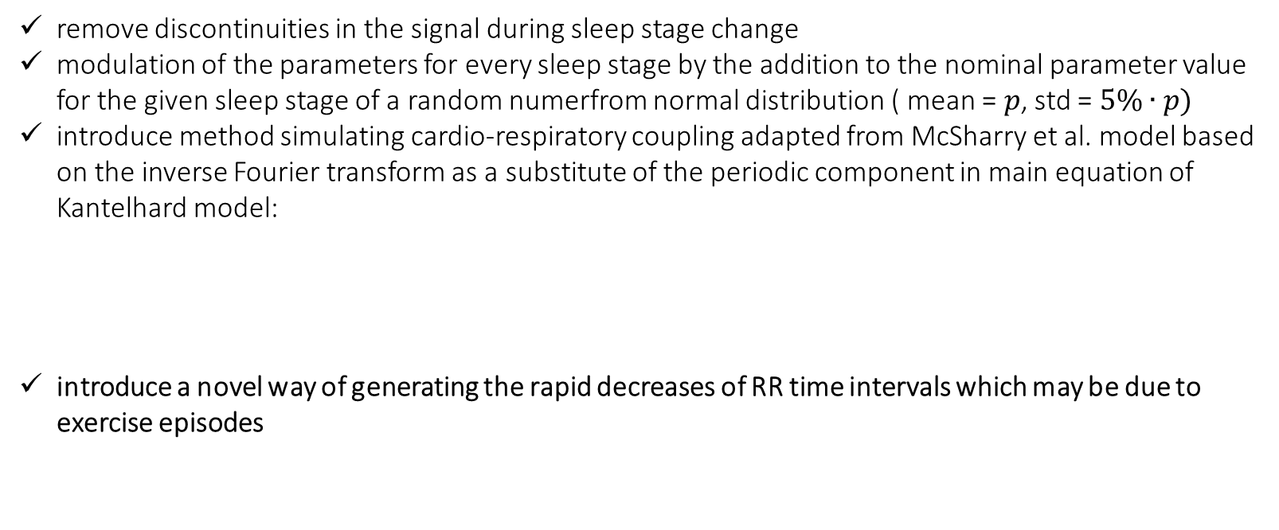
III. ADDITIONAL MODEL EXTENTIONS
remove discontinuities in the signal during sleep stage change
modulation of the parameters for every sleep stage by the addition to the nominal parameter value for the given sleep stage of a random numerfrom normal distribution ( mean = $p$, std = $5\%∙p)$
introduce method simulating cardio-respiratory coupling adapted from McSharry et al. model based on the inverse Fourier transform as a substitute of the periodic component in main equation of Kantelhard model:
introduce a novel way of generating the rapid decreases of RR time intervals which may be due to exercise episodes
$${RR}_{i}=μ+0.03\sin\left({2πt_{i}}/{3.6}\right)+0.025\sum_{j=1}^{i}{y_{i}Θ(k_{j}+j−i)}$$
Notes:
Magda

Slide 18
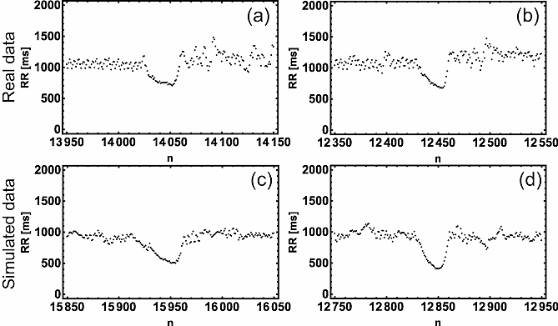
III. ADDITIONAL MODEL EXTENTIONS
introduce of a novel way of generating the rapid decreases of RR time interval lengths which may be due to exercise episodes
­FIG3. Comparison between the characteristic rapid decreases of the RR intervals observed in real data (a-b) and their synthetic equivalent (c-d).
Notes:
Magda

Slide 19
RESULTS
Notes:
Magda

Slide 20
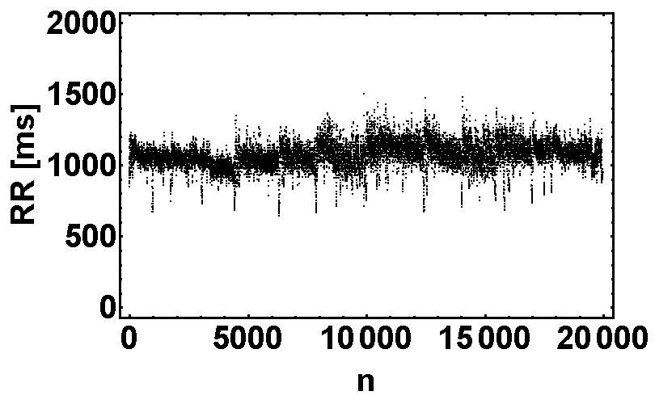
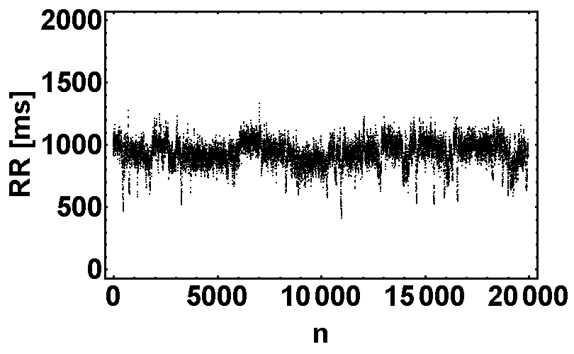
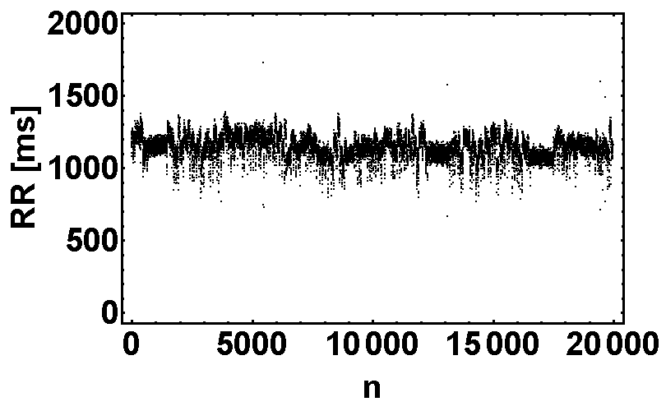
I. TACHOGRAMS
a
c
b
FIG4. Tachograms obtained for the real data (a), the RR interval time series from McSharry model (b) and from our model (c).
Notes:
Magda

Slide 21
II. STANDARD ANALYSIS
TAB2. Results of standard linear analysis methods in the time domain and LF/HF ratio averaged over 34 RR interval time series generated by our model, the McSharry model and over the set of real RR interval recordings.
 | Our Model | McSharry | Real data
Mean [ms] | 926±10 | 1138±4 | 979±87
SD [ms] | 99±4 | 78±2 | 93±24
RMSSD [ms] | 44,9±0,3 | 51,0±0,9 | 53±21
pNN50 [%] | 12,3±0,2 | 15,8±0,2 | 12,0±8
LF/HF | 1.7±0.2 | 1.2±0.1 | 2.2±1.7
Notes:
Magda

Slide 22
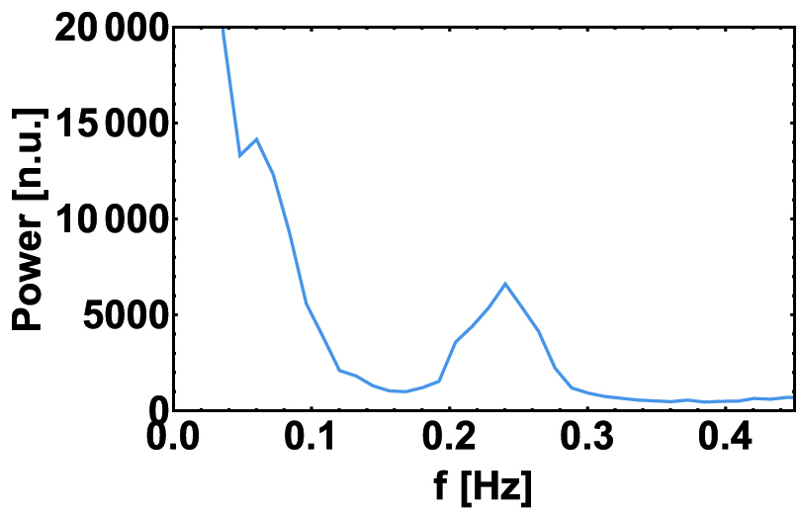
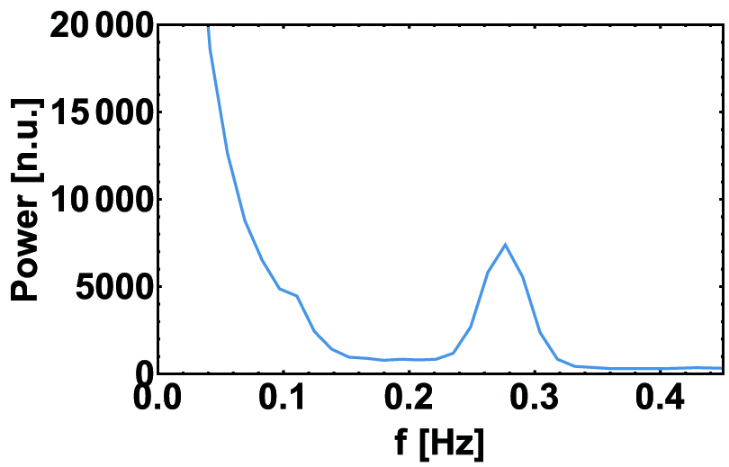
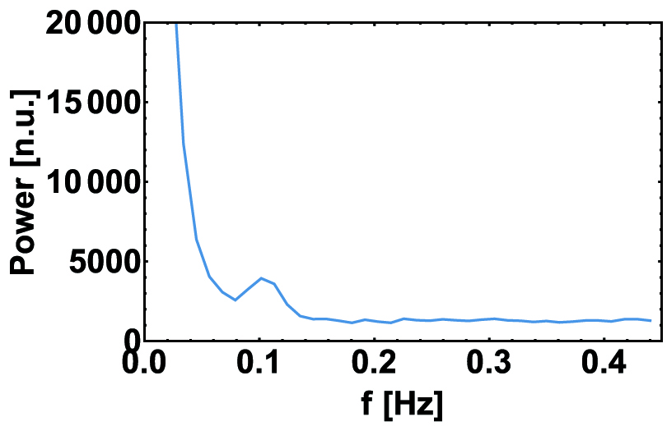
III. PERIODOGRAMS
a
c
b
FIG5. Power spectrum obtained from real data (a), the McSharry model (b) and the synthetic signals generated using our model (c).
Notes:
Magda

Slide 23
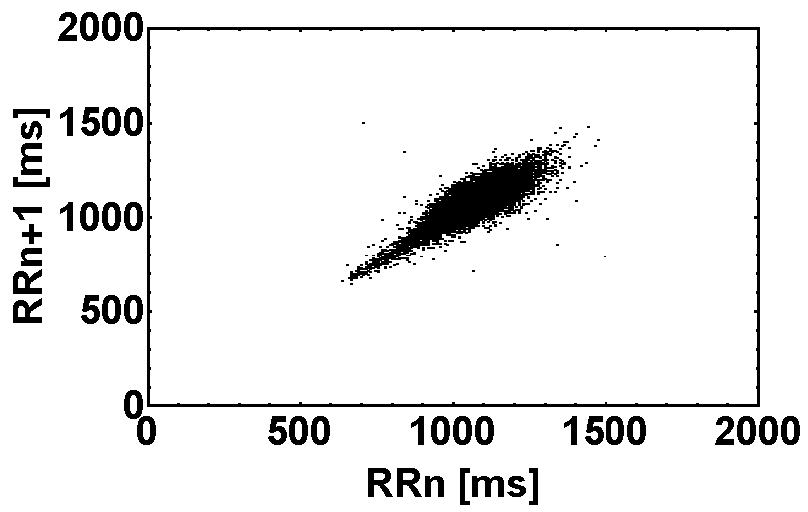
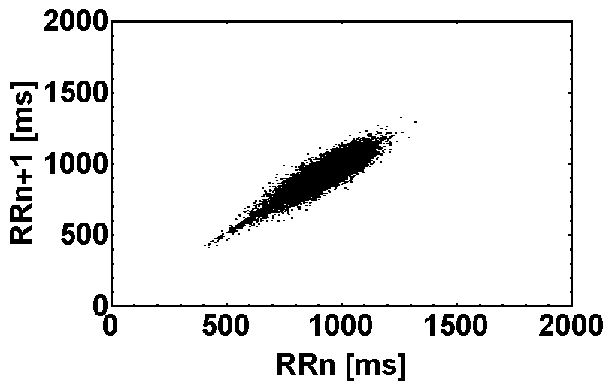
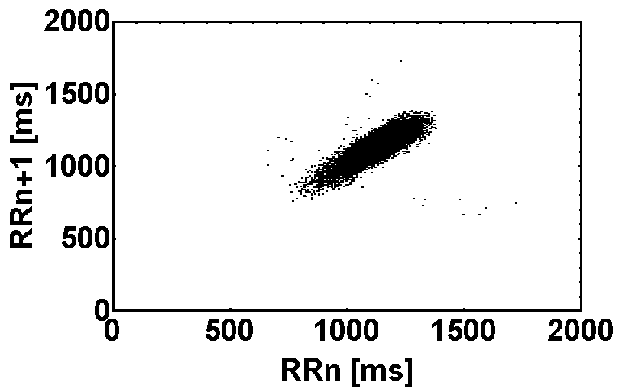
IV. POINCARÉ PLOTS
a
c
b
FIG6. Poincaré plots of signals from real data (a), McSharry et al. model (b) and our model (c).
Notes:
Magda

Slide 24
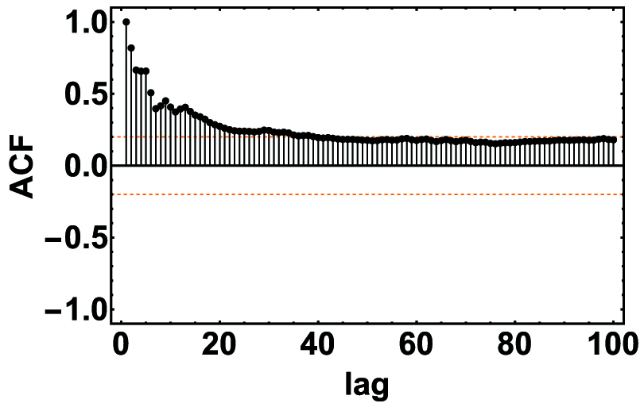
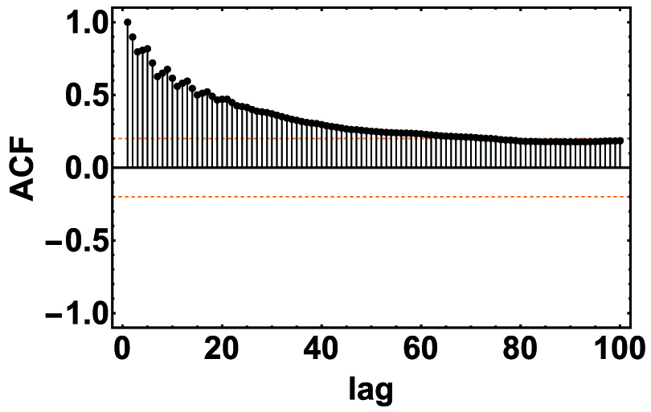
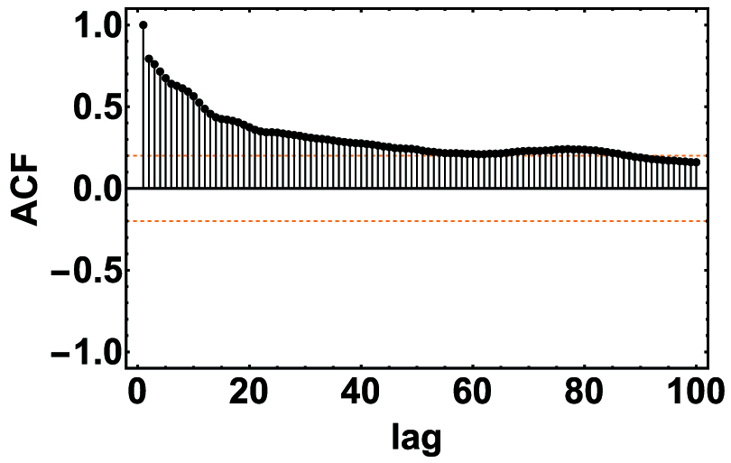
V. AUTOCORRELATION FUNCTION
a
c
b
FIG7. Autocorrelation functions calculated for the real dataset (a), McSharry et al. model (b) and our model (c).
Notes:
Magda

Slide 25
VI. MULTIFRACTAL MULTISCALE ANALYSIS
76% surfaces meet MMA criteria
4% surfaces meet MMA criteria
FIG8. Mean h(q,s) surfaces obtained using the MMA method and calculated from datasets of the real data (a), McSharry et. al (b) and our model (c).
Notes:
Magda

Slide 26
DISCUSSION
the properties of nighttime RR interval time series are not homogenous but depend strongly on the sleep stage (see also Solinski et al. 2014, Kantelhardt et al. 2002)
the autonomic nervous system during sleep exhibits sleep stage specific activity (see also Kantelhardt et al. 2002)
manipulating some properties of our model, we were able to control the multifractal properties of the generated signals
Notes:
Magda

Slide 27
DISCUSSION
manipulating some properties of our model, we were able to control the multifractal properties of the generated signals
without any modifications
effect of breathing variability
on HRV is removed
exercise episodes are removed
FIG. 9. Hurst surfaces for an RR interval time series obtained from our model - all based on the same hypnogram but differing in certain modifications of the model properties.
Notes:
Magda

Slide 28
SUMMARY
We simulate hypnograms
  one of the strengths of our model is the easy to interpret parameters that define the sleep architecture (i.e., the probability of transitions between the sleep phases)
we present a method for simulating healthy human HRV depending on sleep architecture
  http://physionet.org/physiotools/mhrv/
Rapid, short decreases of RR intervals!
variation of parameters allows to simulate cases of sleep disorders (e.g., sleep apnea and insomnia) and even impossible or rare structures of sleep architecture, e.g., sleep without REM or deep stage, sleep with many transitions to wake stage, etc., as well
model should help in separating the effect of the sleep architecture from the other factors acting on heart rate variability properties
Notes:
Magda

Slide 29

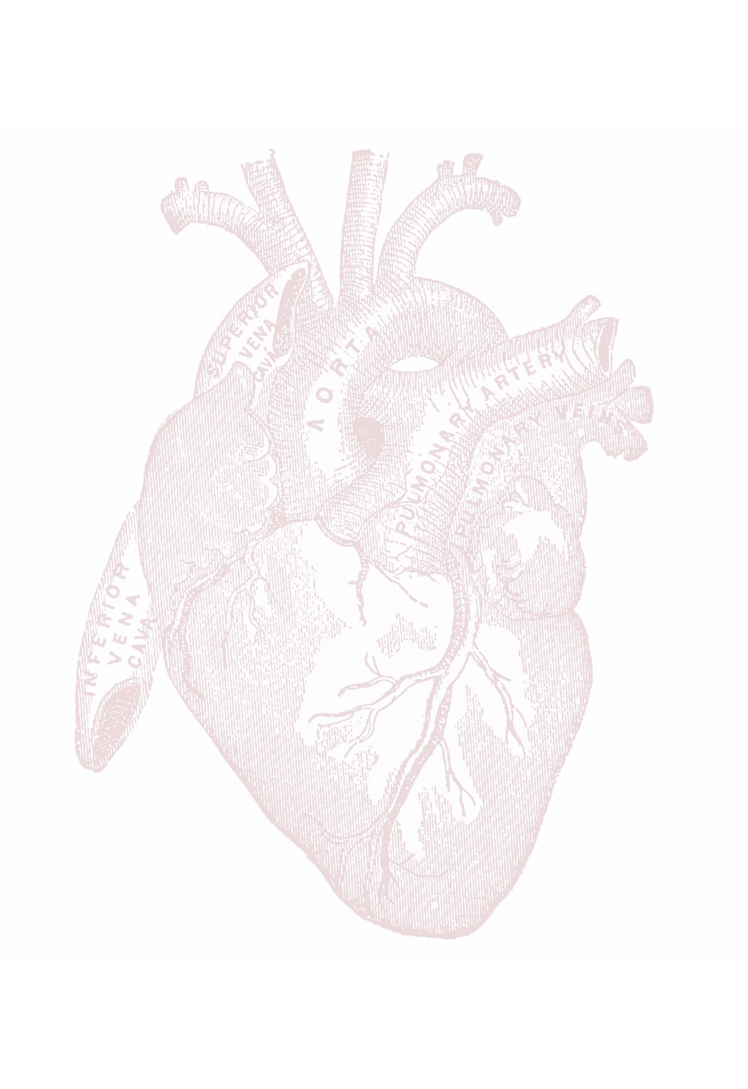
THANK YOU FOR ATTENTION!
Notes:
All

