Slide 1


Tensorial transfer entropy w lancaster
Tensorial selfTransfer Entropy (TsTE) of RR heart interbeet signals and healthy aging
Danuta Makowiec, Gdańsk University, Poland
Zbigniew R. Struzik, RIKEN Brain Science Institute, Japan
The University of Tokyo, Japan
S14: Zbigniew R Struzik: Intrinsically multiscale phenomena in complex systems
UMO-2012/06/M/ST2/00480

Slide 2
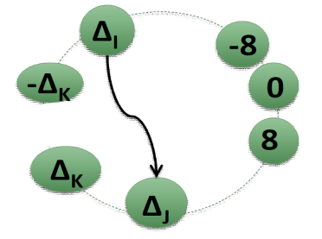
Let a signal of RR-increments be given
There is a limited set of values of RR-increments
Let us count all events where a given pair of events occurred
Transition network approach
Adjacency matrix A is referred to as the matrix obtained by normalization of edge weights by the total number of events .
Transition matrix T is referred to as the matrix obtained by normalization each row of these weights by the total number of events in a row.
Introduction: Transition network approach

Slide 3
20’s
50’s
80’s
Makowiec D, Wejer D, Kaczkowska A Zarczynska-Buchowiecka M, Struzik RZ
(2015), Frontiers in Physiology, 6:201
A
Makowiec D, Kaczkowska A , Wejer D. Zarczynska-Buchowiecka M, Struzik RZ
(2015), Entropy 17, 1253-1272
T is a collection of probability vectors arranged in a matrix
[TΔ_{i}|Δ_{-K}), …, TΔ_{i}|Δ₀),…, TΔ_{i}|Δ_{K})].
T
Entropy rate
Introduction: Properties of Transition Matrix

Slide 4
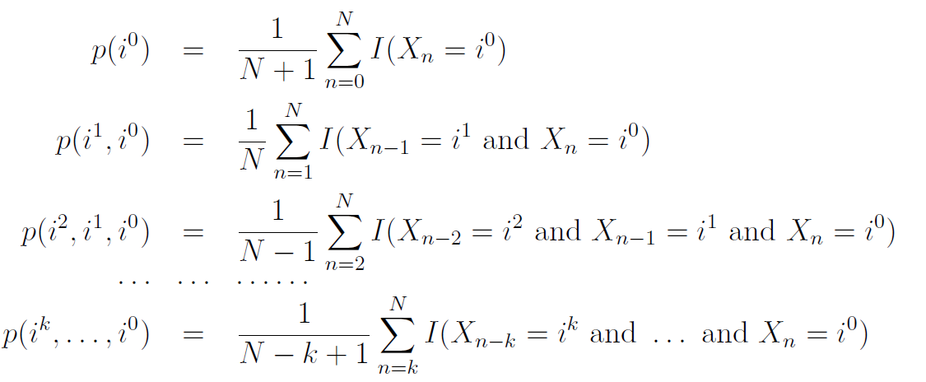

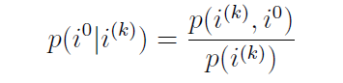
Χ (n) a stochastic process, each Χ (n) has same distribution
Let ( X₀, X₁, …., X_{N} ) be a realization of the process.
Based on a realization we construct a hierarchy of empirical distributions describing time interdependences between subsequent steps in the stochastic process
A vector of past values of X
A transition probability matrix is a probability to see i⁰ given i^{(k)} :
4/9
Methods: Hierarchy of pattern distributions and resulting transition matrices

Slide 5




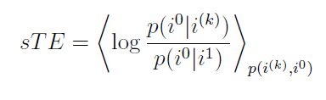
self
Transfer
Entropy
5/9
Methods: From entropy rate to self transfer entropy

Slide 6
From twenty-four hour Holter recordings of, in total 194, healthy participants, six-hour of nocturnal periods were extracted individually due to either evident transition wake-sleep or 23pm : 5 am
The participants included into the study, were classified in age –gender groups:
  20's 36 subjects (18 women),
  30's: 26 subjects (13 women),
  40's: 36 subjects (16 women),
  50's: 32 subjects (13 women),
  60's: 24 subjects (11 women),
  70's : 22 subjects (10 women),
  80's: 18 subjects (11 women).
Żarczyńska-Buchowiecka M.,
Doctoral Thesis (2015)
Results : self transfer entropy
6/9

Slide 7
Results: tensors of self transfer entropy pooled according to age and gender
7/9

Slide 8
Results: tensors for individual signals of the oldest people – arrhythmia detection
8/9

Slide 9
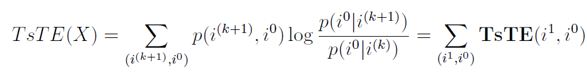

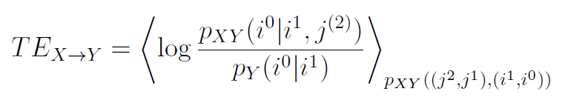
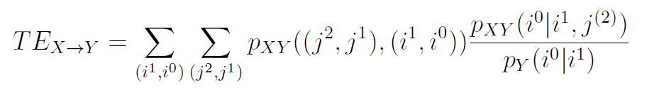
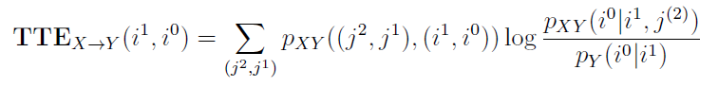
Generalizations
longer memory
Interaction between stochastic processes
Thank you
Conclusions: Generalizations and limitations
9/9

