Slide 1
Asymmetry in heart rate and blood pressure manifested in the head-up tilt test
Danuta Makowiec, Gdańsk University, Poland
Beata Graff, Medical University of Gdańsk, Poland
Dorota Wejer , Gdańsk University, Poland
Zbigniew R. Struzik, RIKEN Brain Science Institute, Japan, The University of Tokyo, Japan
S20: Dirk Cysarz:
Analysis of short and nonstationary cardiovascular time series
UMO-2012/06/M/ST2/00480

Slide 2
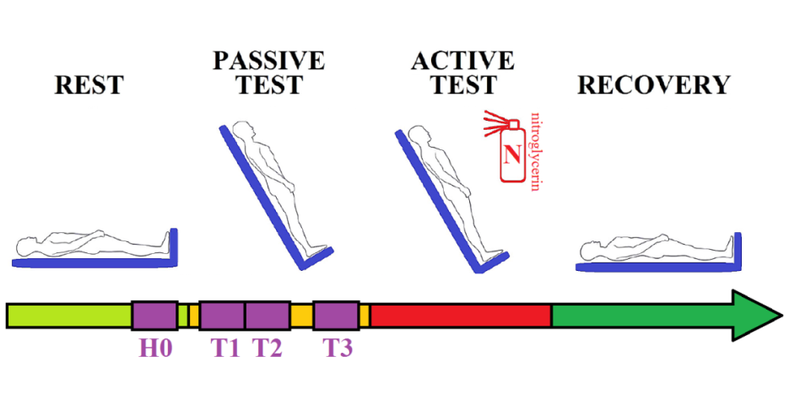
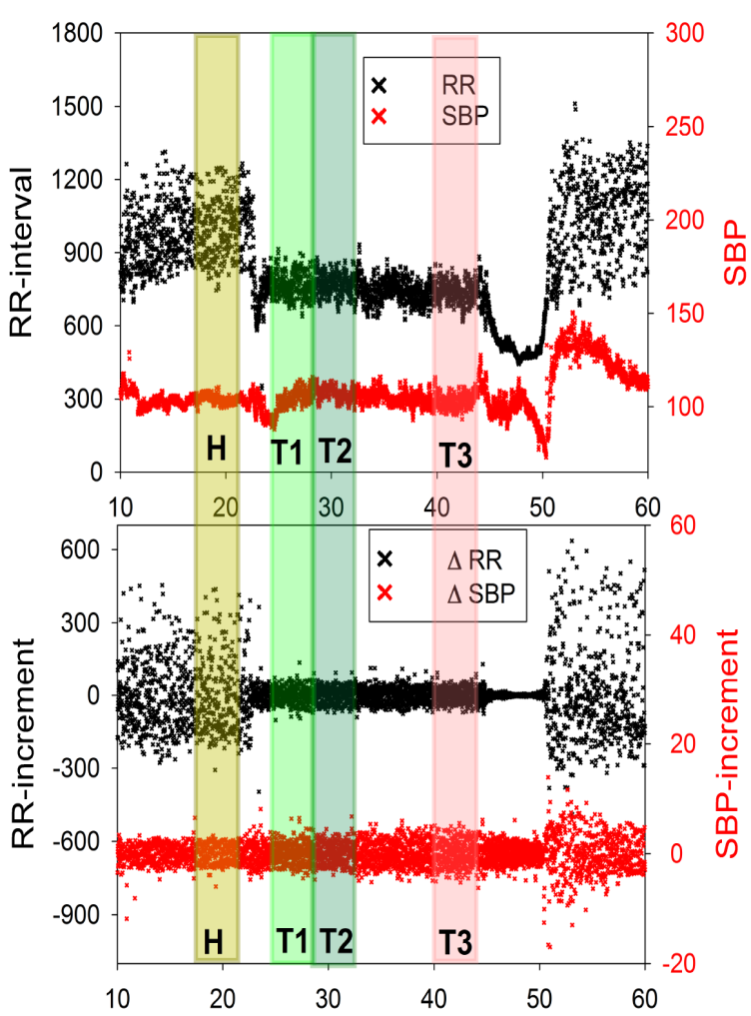
Head-up tilt test under paced breathing
with activity part stimulated by nitroglycerin
Group name | CG | NEG | VVS1 | VVS2
size | 29 (15 /14) | 34(12/22) | 57(17/40) | 21(5/16)
age | 24.9 ±1.3 | 29.0 ± 1.3 | 26.2 ± 1.0 | 27.8 ± 1.3
History of syncope/ syncope in the test | no / no | yes / no | yes /vvs1 | yes /vvs2
Time windows: H0,T1,T2,T3
each consists of 300 points
Methods: Studied signals

Slide 3
Let
denote a change between subsequent values i and i-1 of RR-intervals
denote a change between subsequent values i and i-1 of systolic blood pressure
Generalized Porta Index (GPI)
Multistructure Index (MI)
total of p(acceleration)^{q}
--------------------------------
total of p(any change) ^{q}
total of deceleration ^{q}
--------------------------------
total of (any change) ^{q}
total of p(falls in SBP)^{q}
---------------------------------------
total of p(any change in SBP) ^{q}
total of (rises in SBP) ^{q}
--------------------------------
total of (any change) ^{q}
decelerations and accelerations are compared according to their probability of occurrence
decelerations and accelerations are compared according to their sizes
Methods: Indices of asymmetry: GPI and MI

Slide 4
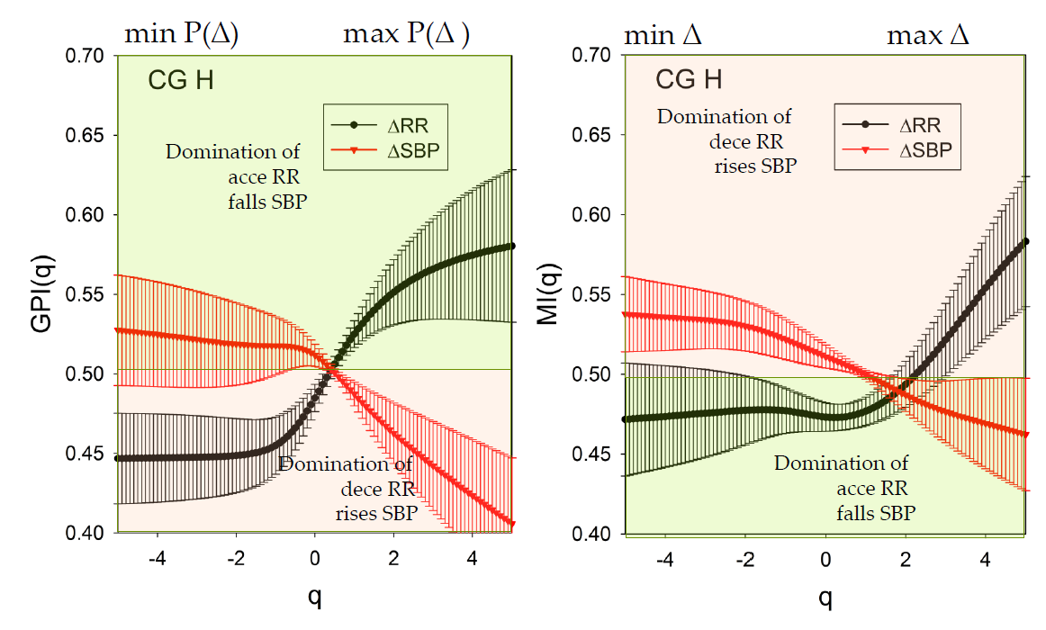
Typical distributions of ΔRR or ΔSBP are sharply peaked around the zero.
Therefore,
the smallest increments are usually the most probable events,
and
the largest changes coincide with the least probable events.
As a consequence, the functions GPI(q) and MI(q) are to some degree related to each other.
Cardiovascular homeostasis is maintained:
SBP: more frequent small rises balanced by larger falls but occurring rarely.
RR: by more frequent small decelerations balanced by larger accelerations but occurring rarely.
Results: the rest state (H0) for healthy people

Slide 5
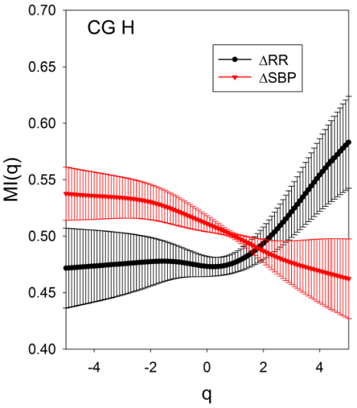
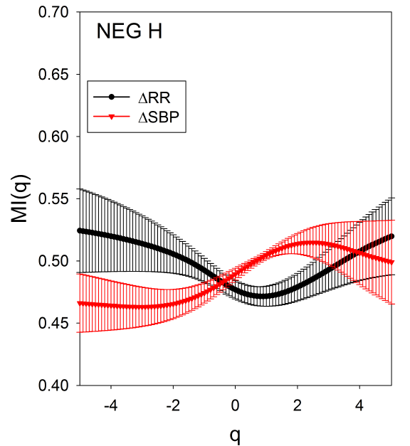
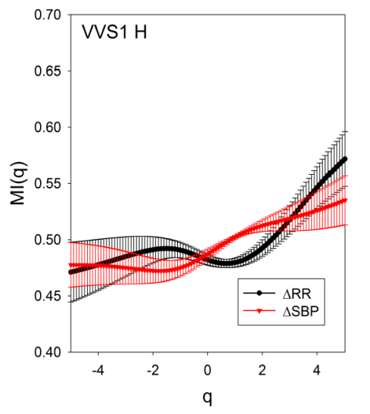
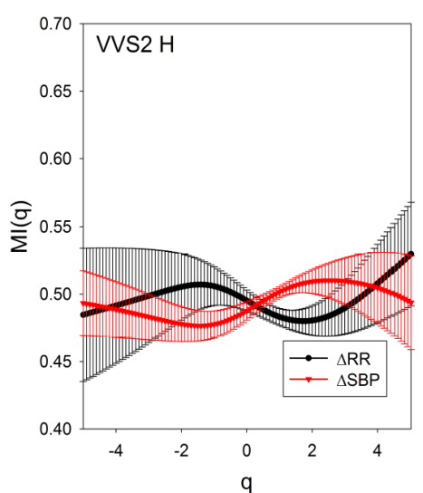
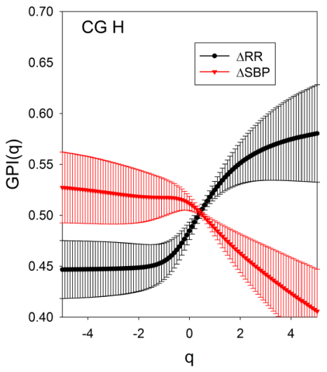
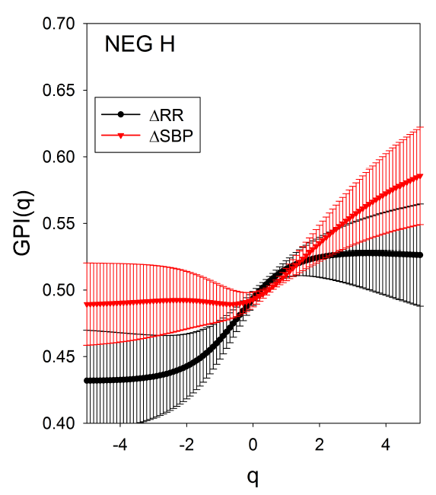
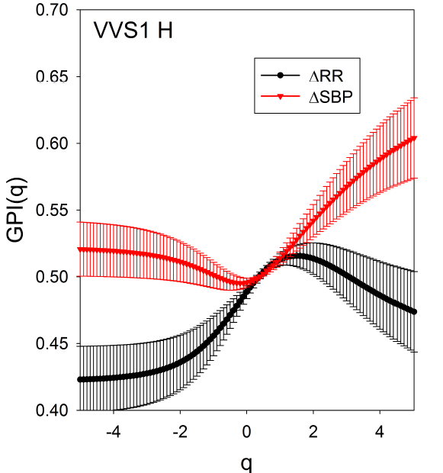
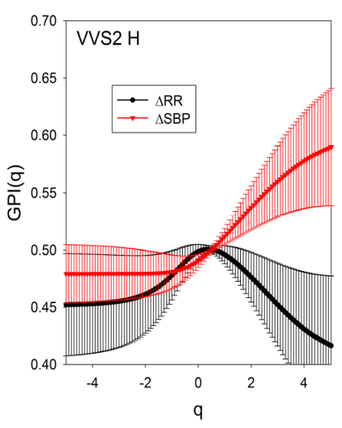
Healthy people
Vasovagal patients
Results: the rest state (H0) for vasovagal patients

Slide 6
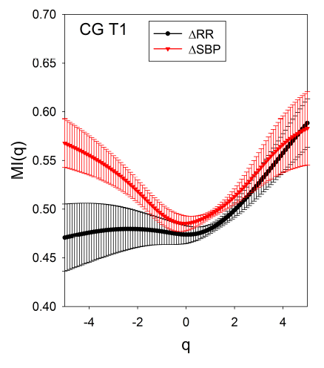
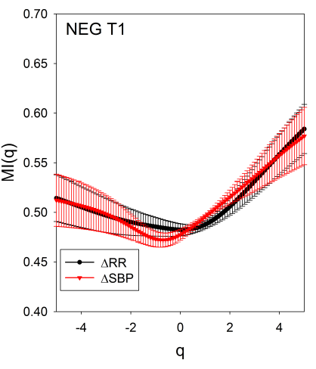
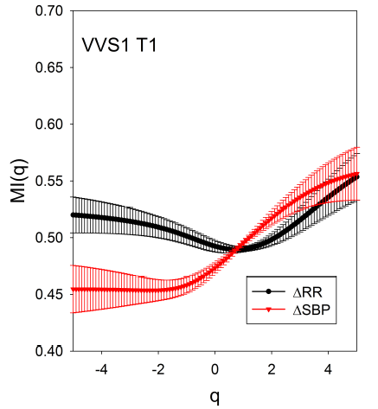
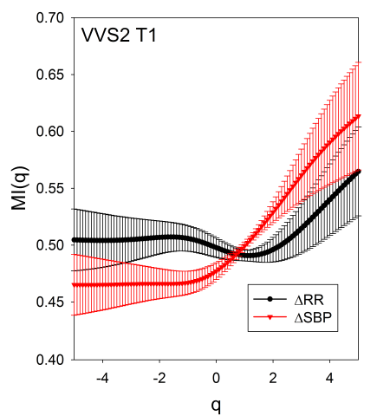
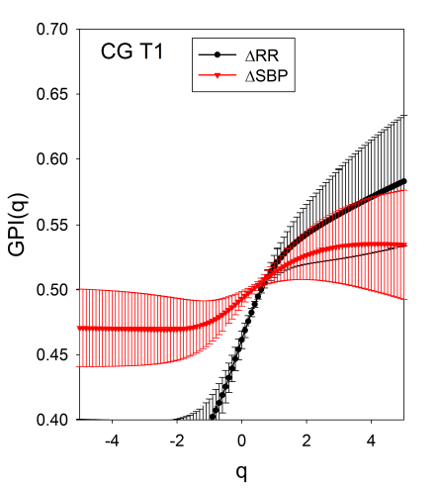
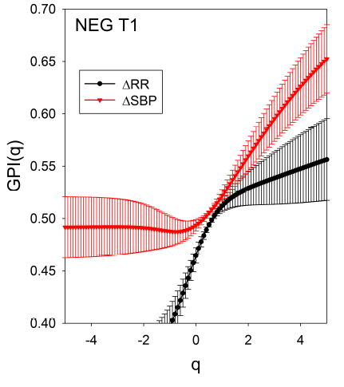
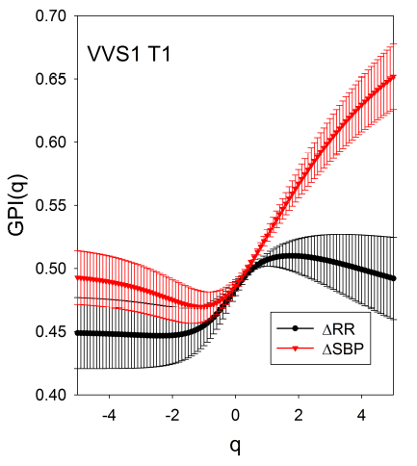
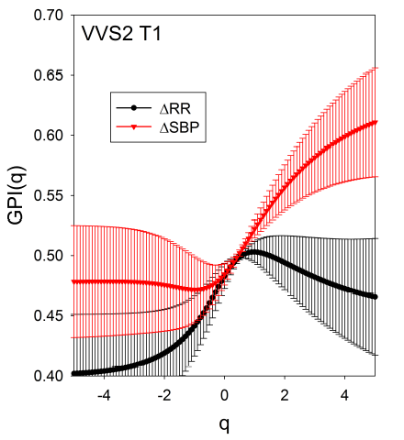
MI differentiates slow versus fast dynamics
GPI differentiates typical versus rare events
Results: the tilt state T1 – early tilt

Slide 7
Thank you
Although to some extent consistent, the relationship between GPI(q) and MI(q) is not straightforward and captures distinct non-linear dependency and possibly reveals compensatory mechanisms interacting through sizes and probabilities of events
In particular, it indicates at fundamental differences in cardiovascular regulatory systems between healthy people and vasovagal patients.
Method limitations:
3 ≤ RR(i) ≤ 200 ms in the case of H0 window
3 ≤ RR(i) ≤ 100 ms in T1, T2 and T3 windows
0.2 ≤ SBP(i) ≤ 10 mmHg in all time windows
Makowiec D, Graff B, Miklaszewski W, Wejer D, Kaczkowska A, Budrejko S, Struzik ZR ( 2015 ) Generalised heart rate statistics reveal neurally mediated homeostasis transients EPL 110(2) 28002.
Makowiec D, Graff B, Struzik ZR (2016) Multistructure index characterisation of heart rate and systolic blood pressure reveals precursory signs of syncope. Phys.Rev.E, under consideration.
Discussion : summary and method limitations

