Slide 1


Multifractality w Lancaster
Multifractality of R-R interval signals and healthy ageing
Danuta Makowiec, Gdańsk University, Poland
Marta Żarczyńska-Buchowiecka, Medical University of Gdańsk, Poland
Zbigniew R. Struzik, RIKEN Brain Science Institute, Japan
The University of Tokyo, Japan
S18: Paulo Castiglioni: Fractal methods in complexity analysis
UMO-2012/06/M/ST2/00480

Slide 2
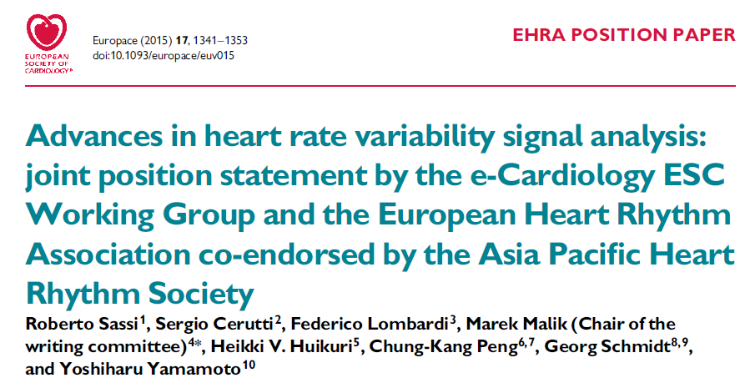
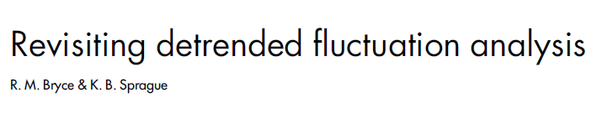


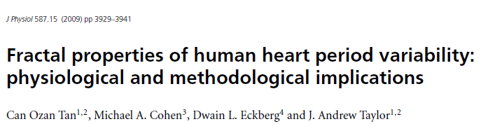
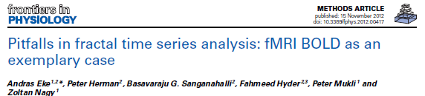
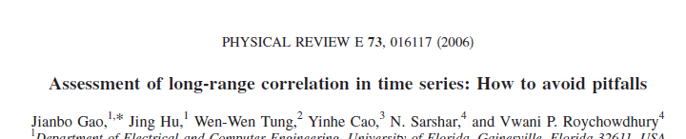
„….the main limitation of fractal analysis is the lack of direct correspondence to physiology.
Changes of scaling exponent observed in different clinical conditions are not specific for underlying physiologic and/or pathologic mechanisms.”
(2012)
(2011)
(2009)
(2012)
(2006)
Introduction: stating the problem

Slide 3
What is wrong?
concept of scaling in RR signals?
methods ?
usage of methods ?
preprocessing of signals?
Wavelet Transform Modulus Maxima
Multifractal Detrended Fluctuation Analysis
Introduction: stating the problem

Slide 4
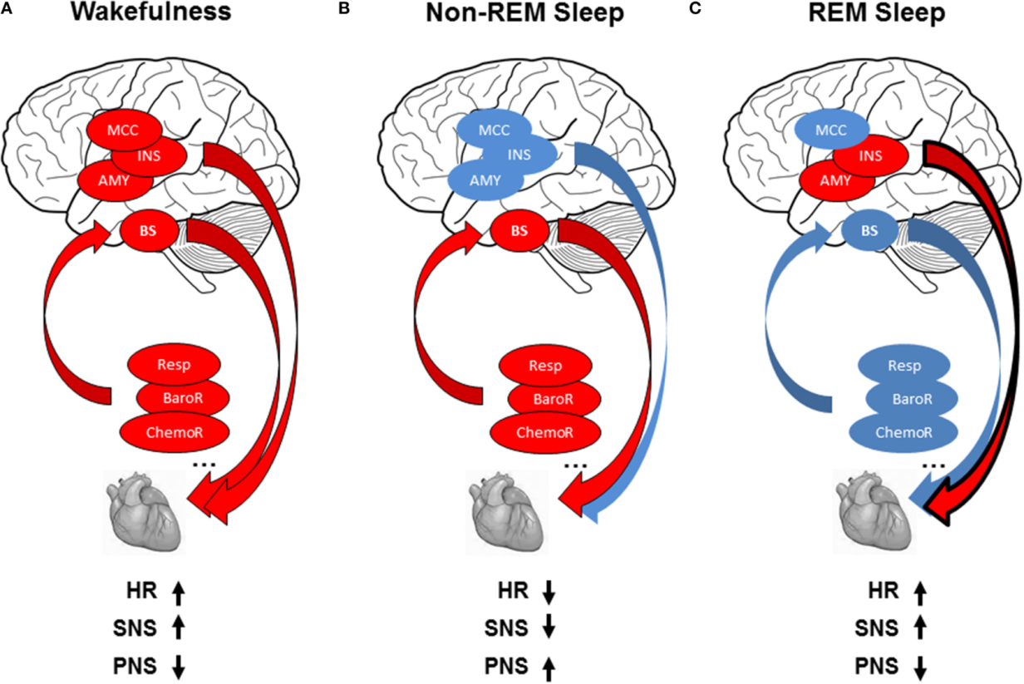
Chouchou F and Desseilles M (2014)
Heart rate variability:
a tool to explore the sleeping brain?
Front. in Neurosc. 8.
BS: brainstem
MCC: midcingulate cortex
INS: insula
AMY: amygdala
A nocturnal signal seems to offer a good insight into the autonomic regulation.
It represents a signal arising from on-off process , switches between
non-REM sleep – domination of autonomic reflex control
and
REM sleep – domination of central nervous system with strong withdrawal of autonomic control
Introduction: autonomic regulation versus central nervous system

Slide 5
From twenty-four hour Holter recordings of, in total 194, healthy participants, six-hour of nocturnal periods were extracted individually due to either evident transition wake-sleep or 23pm : 5 am
The participants included into the study, were classified in age groups:
  20's 36 subjects (18 women),
  30's: 26 subjects (13 women),
  40's: 36 subjects (16 women),
  50's: 32 subjects (13 women),
  60's: 24 subjects (11 women),
  70's : 22 subjects (10 women),
  80's: 18 subjects (11 women).
M.Żarczyńska-Buchowiecka,
Doctoral Thesis (2015)
average values
Over 20000 points in each series
edition:
if errors < 5 beats then local median,
and |ΔRR| > 300 ms
then local median,
otherwise deleted.
age average values of mRR
age
f m
age
f m
age
f m
age
f
m
Methods: the study group - preprocessing the data
5

Slide 6
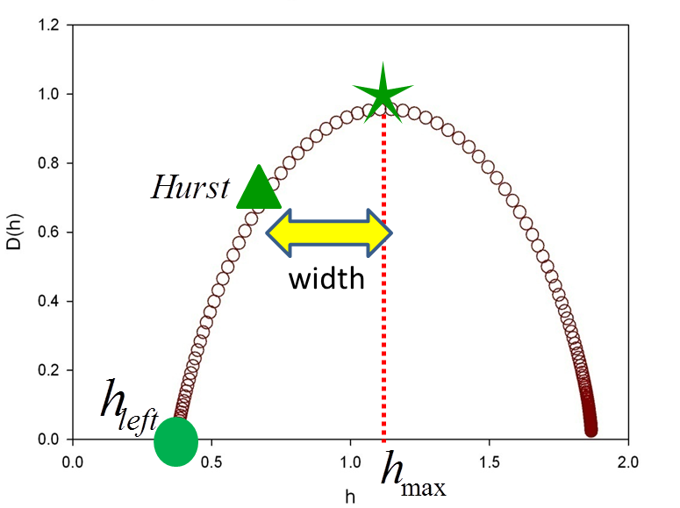
Protocol leading to the age group results:
each signal was considered twice
    as it was an integrated noise ( then multifractal methods apply directly)
    as it was a noise ( then multifractal methods apply to the integrated signal)
group average
for each signal and its integrated partner two partition functions were estimated
    by wtmm Z(n,q)
    by mdfa F(n,q)
Implementation of MDFA and WTMM based on PHYSIONET,
AL Goldberger, et al., (2000) Circulation 101(23): e215-e220
based on scaling properties of partition function found for n=30…300 heart beats (approximation of VLF frequency band) determinants of multifractality were extracted:
    h_{max} : capacity exponent h(q=0)
    H : Hurst exponent
    width : |h(q=0)- h(q=2)|
    h_left : h(q=5)
    Δ : distance between h_{max} for
    integrated signal and signal
group multifractals
group average of subjects
Methods: usage of methods
6

Slide 7
p_{age} = NS, p_{gender} = NS
p_{age} = 0.069, p_{gender} = 0.019
p_{age} = 0.011, p_{gender} = 0.052
An expected parabola-like shape is mixed up
p_{age} <0.001, p_{gender} = 0.001
7
Results: multifractal picture of aging in a healthy poplulation by MDFA traditionally applied.

Slide 8
p_{age} <0.001, p_{gender} = NS
p_{age} = NS, p_{gender} = NS
p_{age} = 0.001, p_{gender} = NS
p_{age} <0.051, p_{gender} = NS
Results: multifractal picture of aging in a healthy poplulation by MDFA applied to signals.

Slide 9
p_{age} = 0.005, p_{gender} = NS
p_{age} = NS, p_{gender} = NS
p_{age} = 0.002, p_{gender} = NS
p_{age} = NS, p_{gender} = NS
Results: multifractal picture of aging in a healthy poplulation by WTMM applied to signals.

Slide 10
p_{age} = NS, p_{gender} = 0.092
p_{age} < 0.001, p_{gender} = 0.018
p_{age} < 0.001, p_{gender} = NS
p_{age} < 0.001, p_{gender} = 0.079
Results: multifractal picture of aging by WTMM applied to integrated signals.

Slide 11
Monofractal or other?
p_{gender} = 0.010
p_{age} = 0.007
p_{gender} = 0.024
p_{age} = NS
Gender differences statistically significant:
30’s (p=0.022), 60’s (p=0.003)
Results: distance between capacity exponents.
11

Slide 12
Healthy heart rhythm is complex.
Its characterization demands methods developed in the complex system field.
Multifractality is a properly chosen tool.
The scaling properties of structure functions both Z(n,q) and F(n,q) were perfectly satisfied for all signals, i.e., on the scale of 0.5 to 5 minutes the studied signals have scaling properties.
Hence, autoregulation on the scale of few minutes exhibits the scale-free dynamics.
But different methods lead to distinct – often contradictory, results from the scaling.
Our understanding of multifractal methods is unsatisfactory.
Thank you !
message to take home
12

