Slide 1
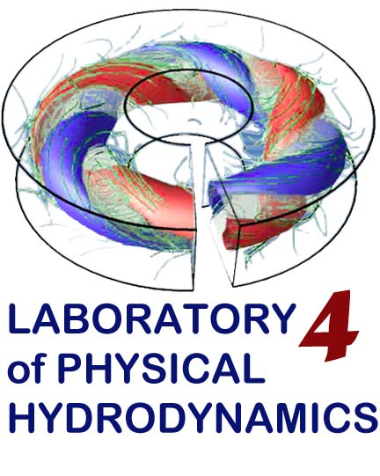
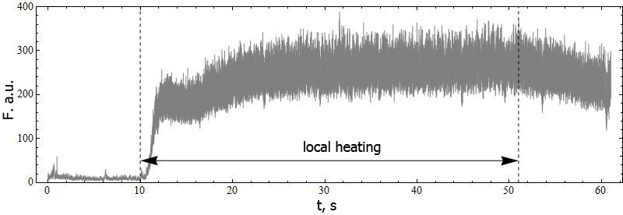
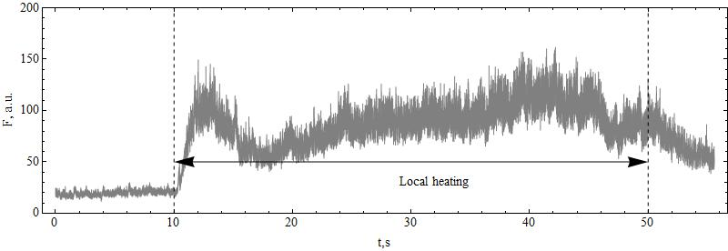
Reaction of blood flow in microvessels on the local heating in patients with DM1
Irina Mizeva, Darya Airikh
Institute of continuous media mechanics, Perm, Russia
Microcirculation plays a significant role in the diabetic complications development, especially in diabetic neuropathy and diabetic foot syndrome. We present the results of experiments examining the human skin microcirculatory response to local heating obtained by laser Doppler flowmetry (LDF) of health subjects and patients with diabetes mellitus (DM1). One of the approach of LDF study is based on the determination of the average skin perfusion and its changes in response to physiological tests [Roustit M., Cracowski J. 2012 ]. To the best of our knowledge, the issue of changing skin perfusion in response to local heating is nowadays elucidated in sufficient detail [Johson M., Kellog D. 2010] and it depends on the regime of heating (rate, maximum value). The perfusion -- time curve demonstrates several phases observed during the physiological test. Fast increasing of the blood flow for the first few minutes after heater turning on is associated with the axon-reflex, on prolonged heating at the same temperature, the LDF signal has a local minimum, accompanied by an increase of the perfusion, driven by another physiological mechanism -- local synthesis of vasodilator agent NO).
Health
t, min
Axon-reflex NO mediated vasodilation
Diabet
t, min
Measurements
Results
Control group (12 healthy volunteers)
Subjects with DM1 (8), the diagnosis was clinically identified, the duration of the disease was longer than 5 years. Subjects were caffeine free for 12 hours before start of the test and were for 15 minutes under comfort laboratory conditions. For the analysis of blood flow changes in the skin area exposed to heating, a two-channel laser Doppler flow meter. A skin heater unit was mounted on the volar site of the forearm of the left hand. Measurements of temperature and LDF were recorded continuously. During the first 10 minutes the heating element was turned off, and recordings of the basal blood flow were made. In the eleventh minute the heating element was turned on (heating to 40°C during 1 minute was performed gradually - 1°C per 15 seconds). Then at the temperature of 40°C the perfusion parameters were recorded during 40 minutes. 50 minutes after the start of the experiment the heating element was turned off, and the cooling phase was recorded during 15 minutes. For the statistical analysis we apply moving average procedure to data with the scale of averaging 5 s. After this procedure we obtain smooth curve for LDF, and find maximum value of LDF in the phase of axon-reflex and mean value during plateau phase. Mann-Whitney test was used to compare intergroup results.
Parameter | Control Group | DM1 | p
N | 12 | 8
Age
P_{baseline} , p.u. | 9.5±0.75 | 7.5±1.4 | p=0.3
P_{axon reflex}, p.u. | 190±90 | 110±50 | p=0.06
P_{NO}, p.u. | 250±100 | 140±70 | p=0.03
P_{NO}/P_{baseline} | 24±10 | 24±8 | p=0.4
P_{NO} /P_{baseline} | 22±9 | 21±13 | p=0.7
P_{NO} /P_{axon}
C (P_{NO} ,P_{baseline}) | -0.46 p=0.26 | -0.65 p=0.09
C (P_{axon} ,P_{baseline}) | -0.44 | -0.40
C (P_{NO} ,P_{axon}) | 0.96, p=0.003 | 0.96 p=0.002
Healthy and DM1 subjects demonstrated similar two phase reaction on the local heating. Significant difference between these two groups is founded only in the second phase of vasodilation which is caused by NO synthesis. This fact indirectly proves the dysfunction of endothelium of subjects with DM1 without vascular complications. The similar results was obtained in [Khan F. 2012], in [Sun P. 2012 ] it was suggested that early impairment of low-frequency flow motion (a measure of endothelium-dependent microvascular regulation) correlates closely with the presence of sudomotor dysfunction as a manifestation of autonomic neuropathy. The study is limited by poor statistic of the groups and it will be useful to study together results of physiological tests and endothelial function markers. We plan to study contribution of microvascular tone regulation mechanisms separately using the wavelet analysis of the LDF signals [Tankanag A. and Chemeris N. 2008, Mizeva I.A., Vetrova D.V. 2014, Stefanovska A. Bracic M. and Kvernmo H. 1999]
This work was supported by the Russian Science Foundation under project No 14-15-00809.)

