Slide 1
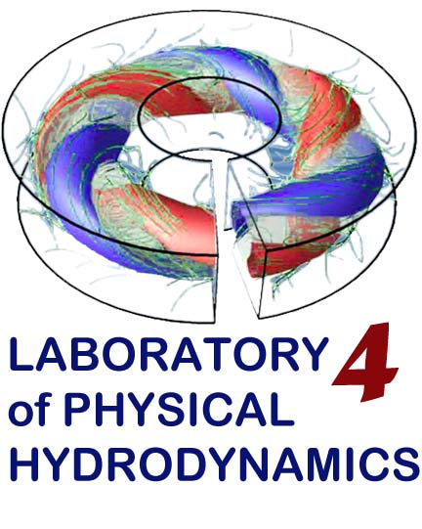

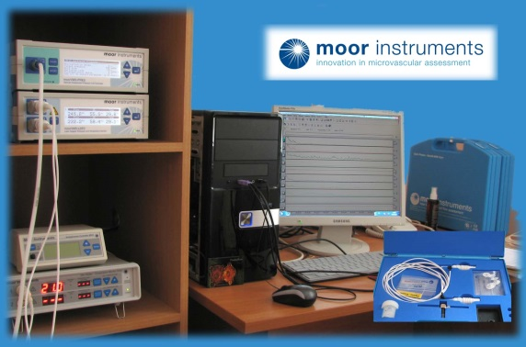

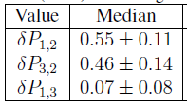
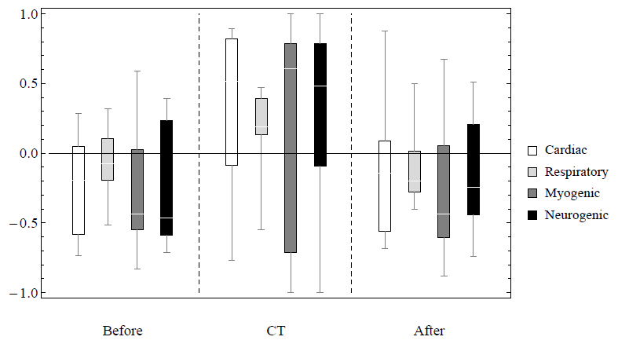
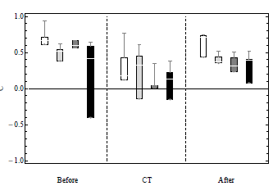

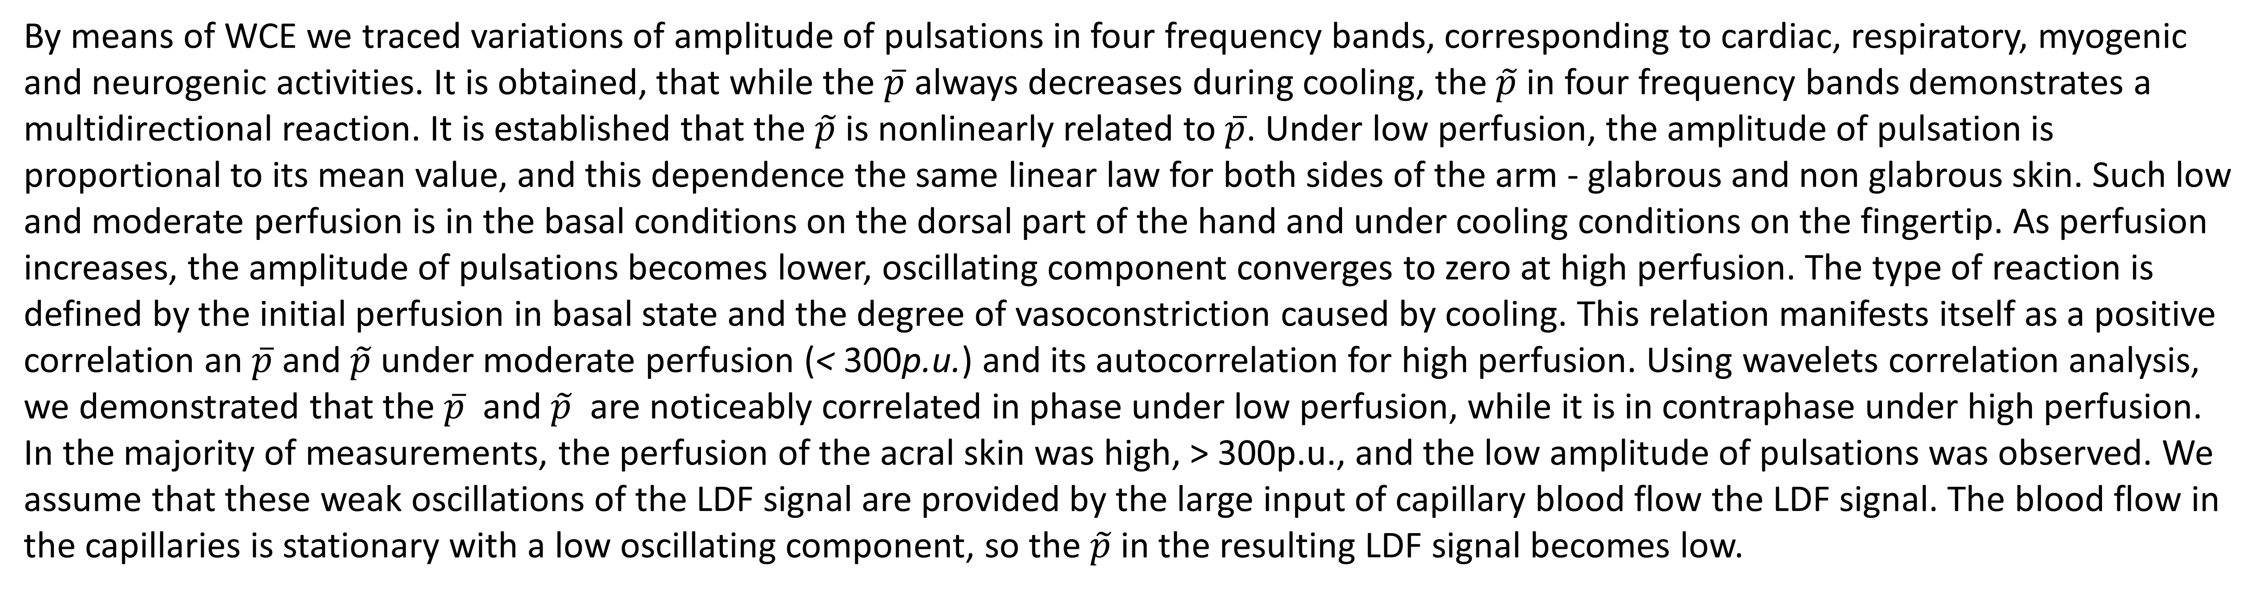
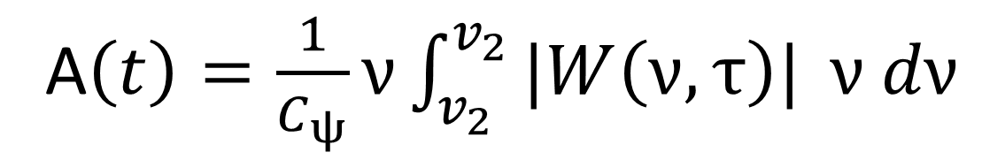
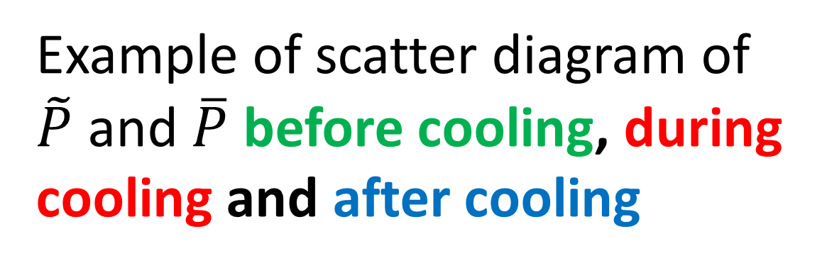
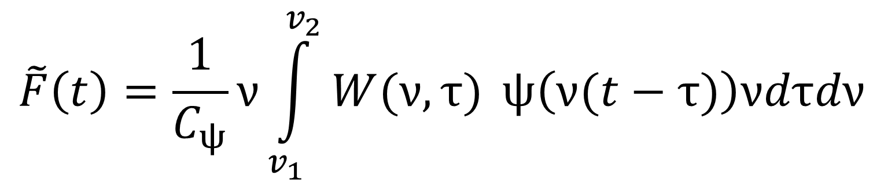
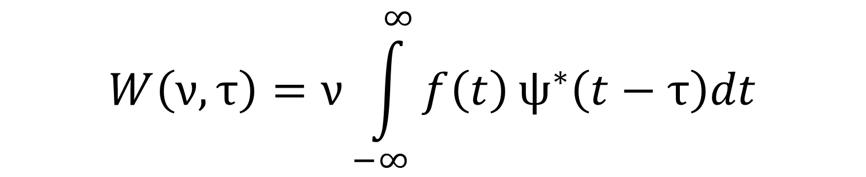

Skin blood flow oscillations during cold pressor test
Irina Mizeva, Peter Frick, Sergey Podtaev
Institute of continuous media mechanics, Perm, Russia
Laser Doppler flowmetry (LDF) has become an attractive technique for the intravital studies of cutaneous blood ow. It enables simple, real-time monitoring of the relative changes of red blood cell flux in cutaneous microvascular bed, which consists of nutritive capillaries and deeper elements of the skin vascular tree. LDF signals beside the average, slowly varying component, also includes an oscillating component [Aalkjer C. et al 2011], which reflects the cardiac, respiratory, neurogenic, myogenic and endothelial activities [Rossi M. et al 2008, Stefanovska A. et al 1999]. However, in the majority of clinical studies, the pulsations are typically smoothed by data preprocessing and only the mean blood flow is taken into consideration.
Measurements
Wavelet coefficient envelope analysis
14 subjects (6 males, 8 females), 35±5 years
Contralateral pressor test:
23 minutes (10 basal, 3 contralateral cooling, 10 after cooling)
$$f(t)$$
- signal
$$W\left(ν,τ\right)=ν\int_{−∞}^{∞}{f\left(t\right)}ψ^{∗}\left(t−τ\right)dt$$
$$\tilde{F}\left(t\right)=\frac{1}{C_{ψ}}ν\int_{v_{1}}^{v_{2}}{W(ν,τ) }ψ\left(ν(t−τ)\right)νdτdν$$
IWC
$$C_{ψ}=\frac{1}{2π}\int_{−∞}^{∞}{\frac{|\hat{ψ}(ν)|}{|ν|}}dν$$
A$\left(t\right)=\frac{1}{C_{ψ}}ν\int_{v_{2}}^{v_{2}}{|W\left(ν,τ\right)| }ν dν$
WCE
Podtaev S., Stepanov R., Smirnova E., and E. Loran, 2015
Results
Example of IWT and WCE
Wavelet cross correlation of $\tilde{P}$ and $\overline{P }$ before and during cooling
Example of scatter diagram of $\tilde{P}$ and $\overline{P}$ before cooling, during cooling and after cooling
Dimensionless scatter diagram for all measurements
Box whisker diagram for linear correlation analysis
fingertip dorsal part
By means of WCE we traced variations of amplitude of pulsations in four frequency bands, corresponding to cardiac, respiratory, myogenic and neurogenic activities. It is obtained, that while the $\overline{p}$ always decreases during cooling, the $\tilde{p}$in four frequency bands demonstrates a multidirectional reaction. It is established that the $\tilde{p}$is nonlinearly related to $\overline{p}$. Under low perfusion, the amplitude of pulsation is proportional to its mean value, and this dependence the same linear law for both sides of the arm - glabrous and non glabrous skin. Such low and moderate perfusion is in the basal conditions on the dorsal part of the hand and under cooling conditions on the fingertip. As perfusion increases, the amplitude of pulsations becomes lower, oscillating component converges to zero at high perfusion. The type of reaction is defined by the initial perfusion in basal state and the degree of vasoconstriction caused by cooling. This relation manifests itself as a positive correlation an $\overline{p}$and $\tilde{p}$ under moderate perfusion (< 300p.u.) and its autocorrelation for high perfusion. Using wavelets correlation analysis, we demonstrated that the $\overline{p}$ and $\tilde{p}$ are noticeably correlated in phase under low perfusion, while it is in contraphase under high perfusion. In the majority of measurements, the perfusion of the acral skin was high, > 300p.u., and the low amplitude of pulsations was observed. We assume that these weak oscillations of the LDF signal are provided by the large input of capillary blood flow the LDF signal. The blood flow in the capillaries is stationary with a low oscillating component, so the $\tilde{p}$ in the resulting LDF signal becomes low.

